Slide 1
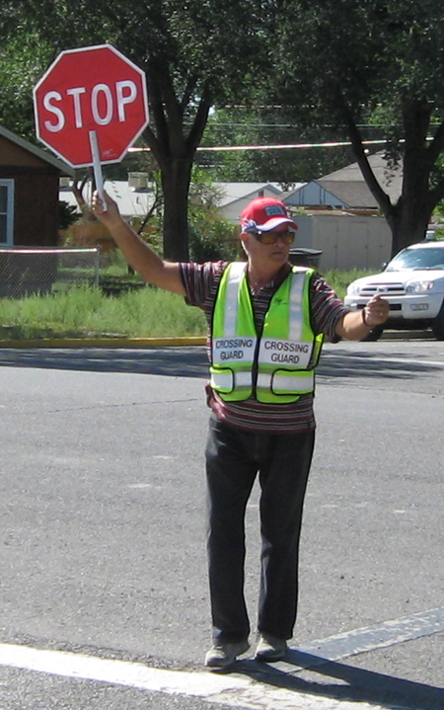
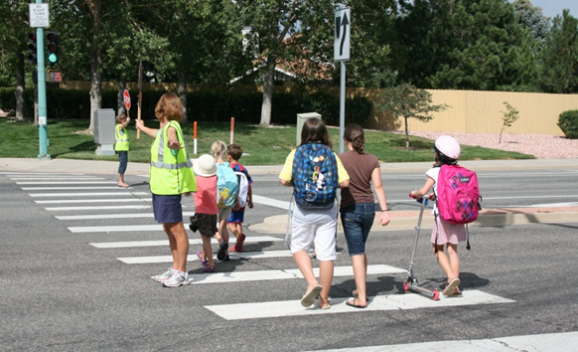

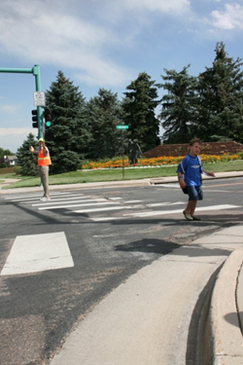
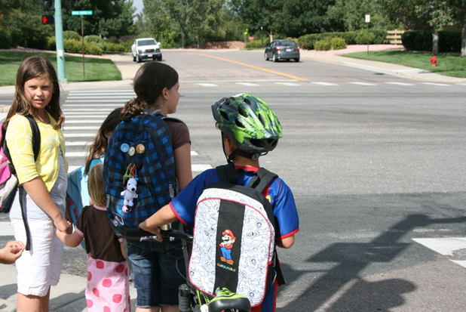

Montana School Crossing Guard Training
Distributed by
Montana Office of Public Instruction

Slide 2
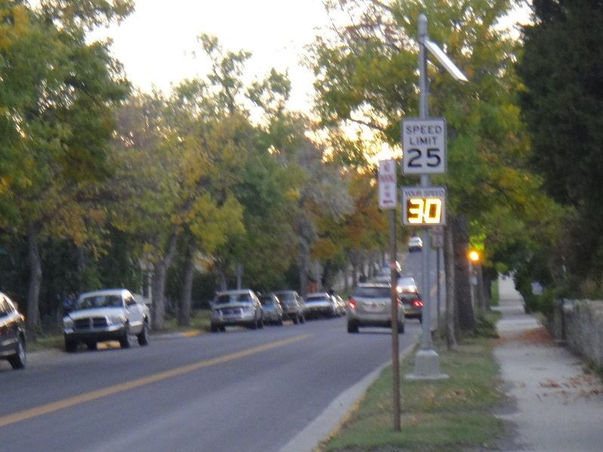
What’s in this presentation?
Rules governing the training of school crossing guards in Montana
Why we need crossing guards
Understanding children as pedestrians
Traffic operations, signs and signals
Special considerations of bicyclists
Being a school crossing guard
Step by step techniques
Two videos & review questions
Note: This presentation is not intended to fully train someone to become a school crossing guard. Refer to the training guidelines and materials at the Montana Office of Public Instruction Driver Education Resources web site

Slide 3
Training for Adult School Crossing Guards (ARM 23.3.1101-1103)
TRAINING FOR ADULT SCHOOL CROSSING GUARDS
An adult school crossing guard may be a school district employee or an adult volunteer member of the community. Training for adult school crossing guards may be provided by the school district or local law enforcement and should include:
  safety issues for crossing guards and limitations of children as pedestrians;
  review of basic traffic laws, school zone signs, and pavement markings;
  methods of identifying traffic gaps and signaling drivers;
  street-crossing procedures and ways to impart them to children; and
  other information on traffic safety, injury prevention, and personal responsibility that the school district considers important for pedestrian safety and safe crossing operation.
SAFETY EQUIPMENT FOR ADULT CROSSING GUARDS
Adults performing school crossing supervision shall wear high-visibility, retro reflective Class 2 safety apparel and use a STOP paddle
OPERATING PROCEDURES FOR ADULT CROSSING GUARDS
Adult crossing guards shall not direct traffic or act in a manner similar to that used by a law enforcement officer at the scene of a crash or within an area of high-volume traffic. School crossing guards shall control only pedestrian traffic.
Adult crossing guards shall direct and assist school-age children by identifying and utilizing gaps in traffic to help pedestrians safely cross a street. The school crossing guard shall identify and take advantage of a sufficient gap in the traffic flow. When safe, the school crossing guard shall stand in the roadway with a STOP paddle to alert motorists that pedestrians are in the process of using or waiting to use the crosswalk and that all vehicle traffic must stop and yield to pedestrians.
AUTH: 20-1-214, MCA

Slide 4
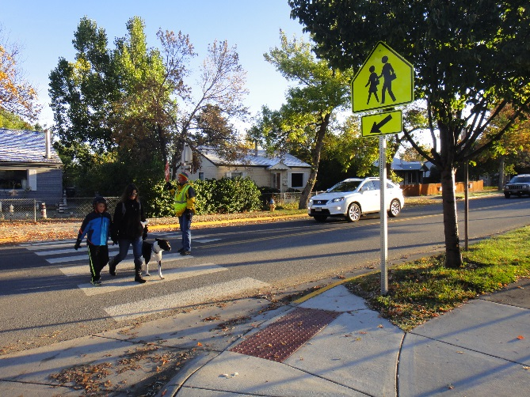
School Crossing Guards are Needed
Children lack traffic experience and don’t understand complex traffic situations.
Each supervised crossing is an opportunity to teach safe crossing skills which will help children at other road crossings.
Children have a hard time judging:
  safety of intersections,
  speed and distance of
  approaching vehicles.
School crossing guards control
only pedestrian traffic.

Slide 5
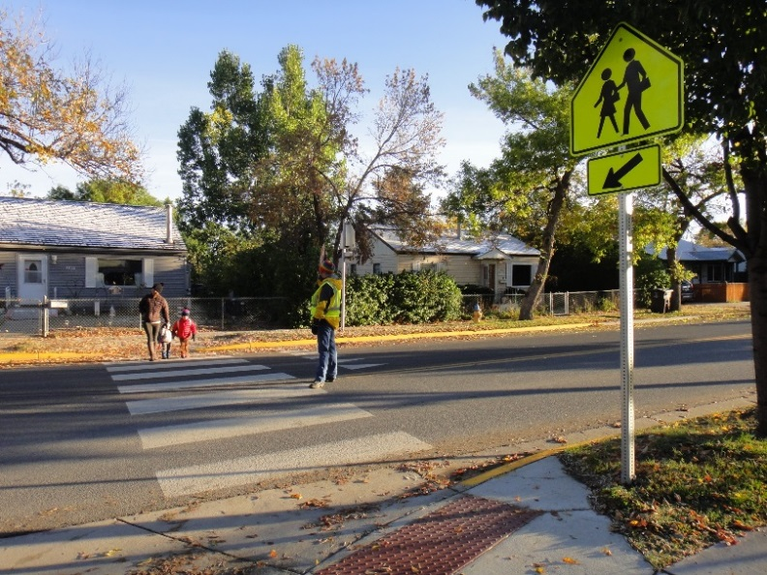
Relationship to Children
Children are not naturally safe.
  Perceptions of the world are different
  Physical capabilities are different
  Children think differently than adults.
Children can learn to be safe.
Children need assistance in locations where safety risks are higher.
Notes:
The reason children need you to assist them with their safety is that they do not naturally know how to be safe.
There are physical reasons children do not behave safely such as their different ability to see and hear.
There are cognitive reasons children do not behave safely such as their different ability to judge distance, speed, or think logically.

Slide 6
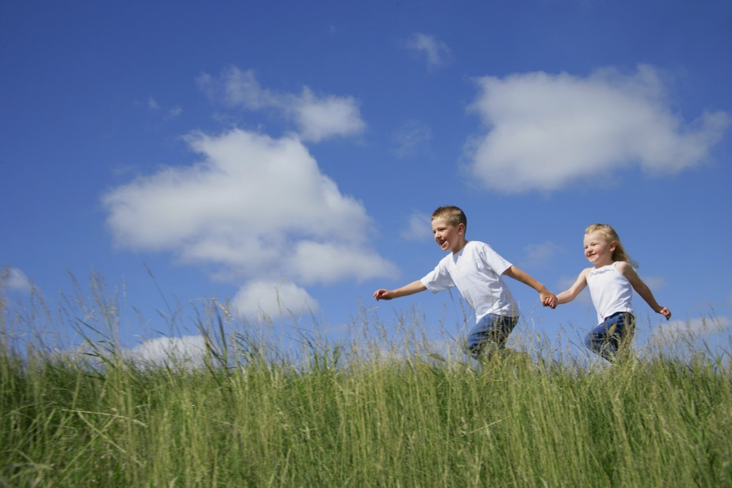
Characteristics of Children
Children will complete any motion they start.
Overestimate their abilities.
Model their actions after others.
Possess a different system of logic than adults.
Treasure near misses.

Slide 7
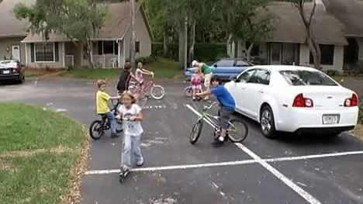
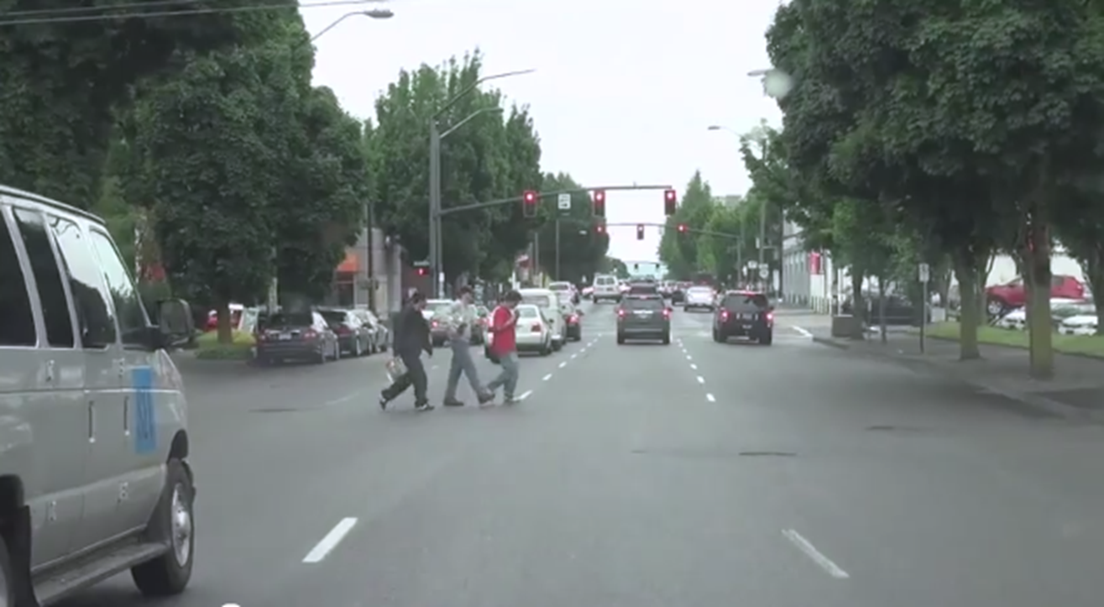
Understanding Children’s Needs
Children can be impulsive.
They do not judge speed and distance well.
Children often simply assume that if one car stops for them because they see them, others will too.
Notes:
http://imc.tv/files/2011/04/Childeren-Playing-In-Street.jpg
Colorado Dept. of Transportation Safe Routes to School

Slide 8
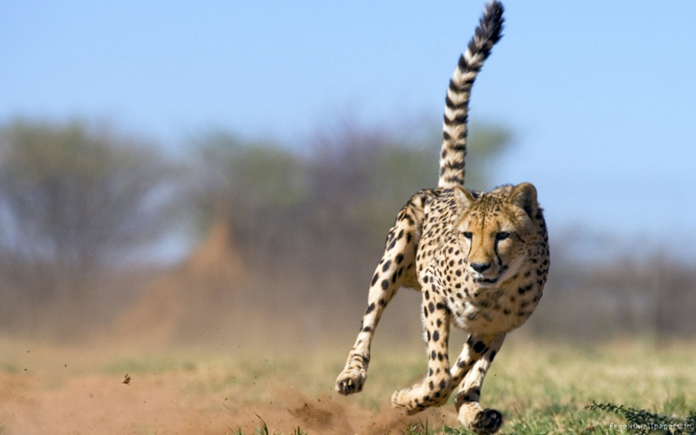
Children Overestimate their Abilities
Children may think they can run faster or change direction more quickly than they really can.
Children may consider simply running across the street is a viable crossing strategy.
Notes:
This idea is consistent with the characteristic of confusing fantasy with reality
Children tend to overestimate their own abilities, including physical abilities. They think they can run faster, change direction more quickly, stop, or jump higher than they can.
This characteristic can get children into trouble when around traffic, because they may think they can run across the street faster than the car that is approaching, or jump out of the way more quickly than they really can.

Slide 9
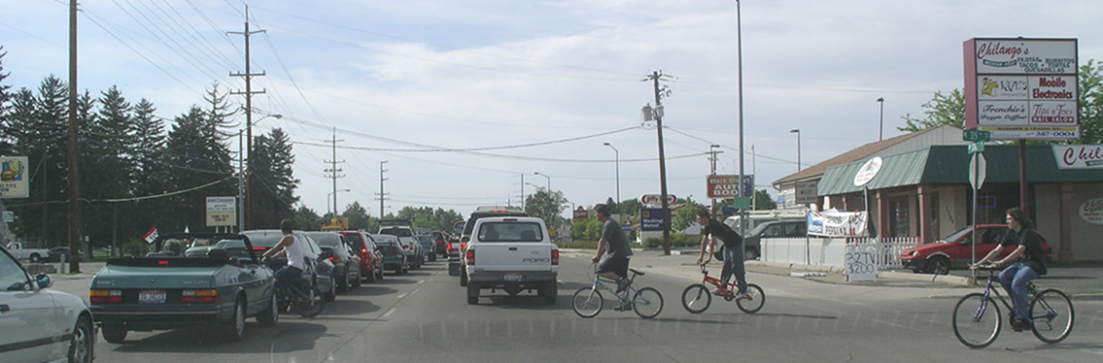
Children lack experience navigating roads and streets, so they can’t anticipate what might happen.
Adult logic
  If moving cars can hurt us and moving cars are in the street, then running into the street can hurt us.
Child logic
  If moving cars can hurt us and moving cars are in the street, we can just run between the cars so they don’t hit us.

Slide 10
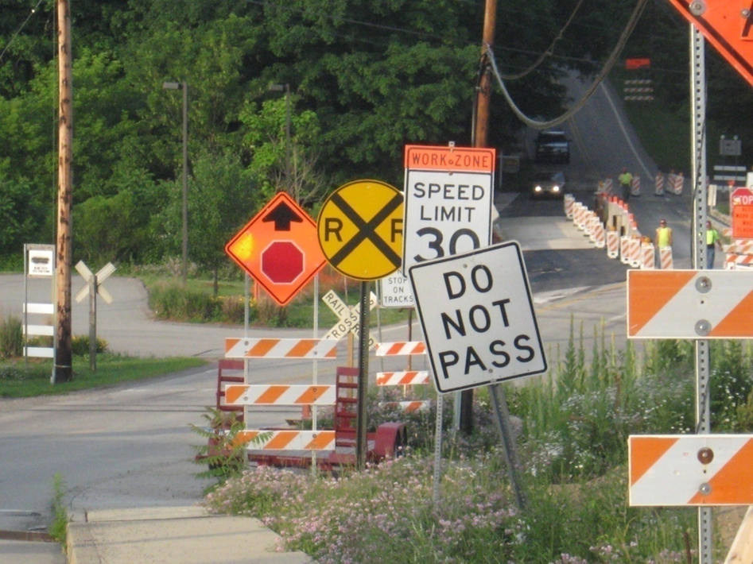

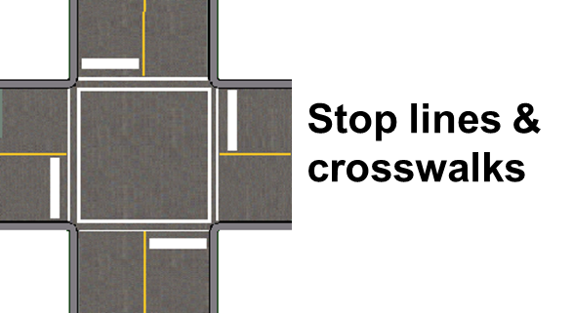
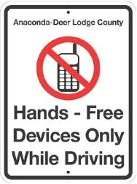
Traffic Control
• Traffic Laws and Regulations
• Signs
• Pavement Markings
• Traffic Signals

Slide 11

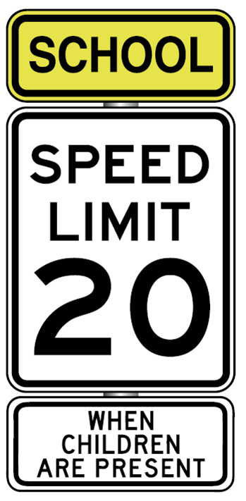
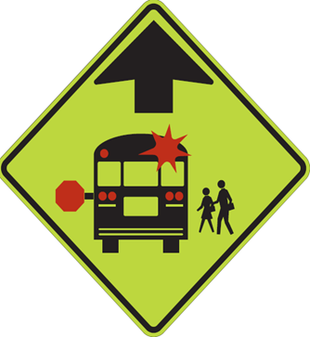
School Zone Signs

Slide 12
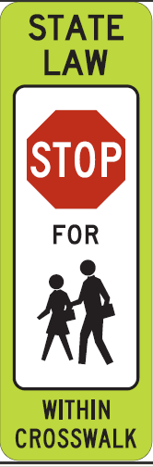
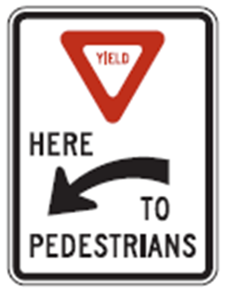
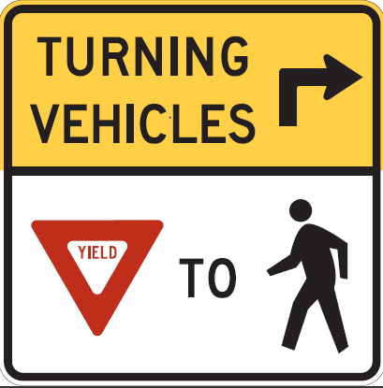
Yield to Pedestrians
Notes:
MCA 61-8-504. Operators to exercise due care. Notwithstanding 61-8-501 through 61-8-503, an operator of a vehicle shall exercise due care to avoid colliding with a pedestrian or with a person propelling a human-powered vehicle or using an assistive mobility device upon a roadway, shall give warning by sounding the horn when necessary, and shall exercise proper precaution upon observing a child or an obviously confused, incapacitated, or intoxicated person upon a roadway.

Slide 13
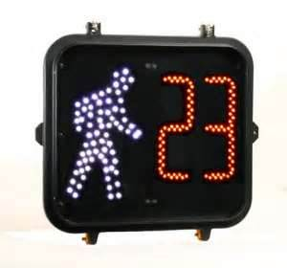
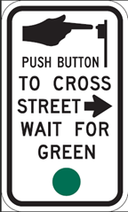
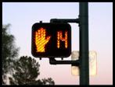
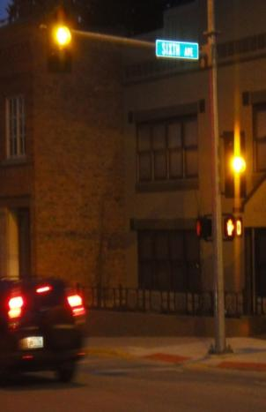
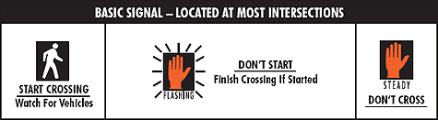
Pedestrian Countdown Signals
Help children notice and learn to follow the instructions on these types of signals.

Slide 14
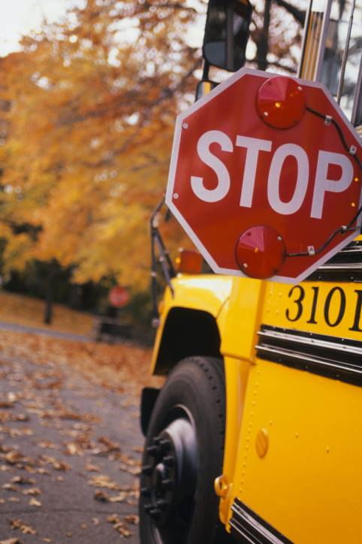
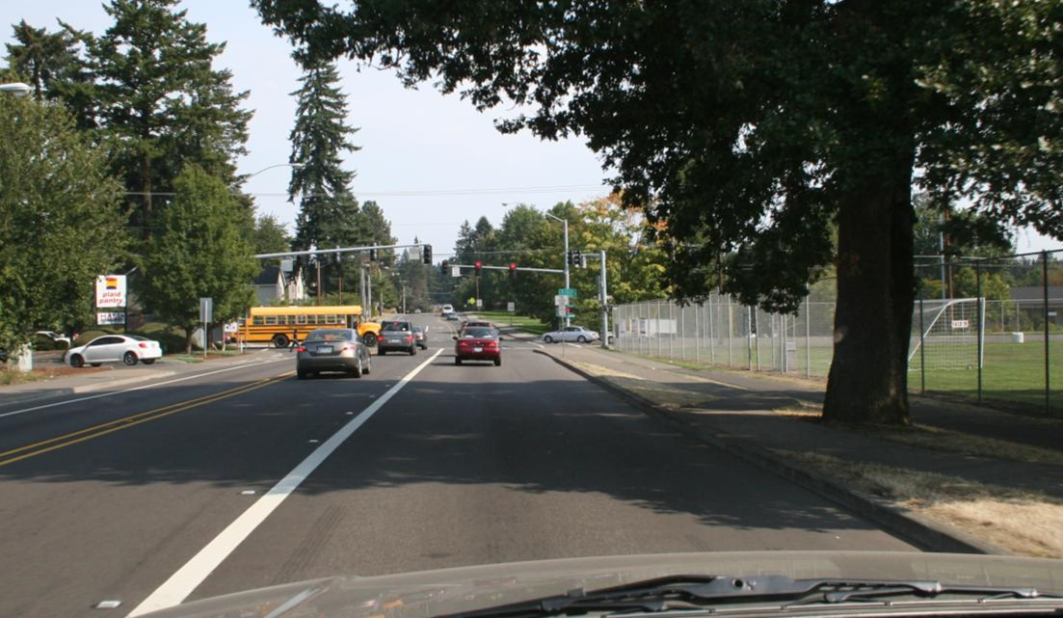
Traffic Operations
Speed Limits
Required Stops
Turning Movements
Parent Pickup/Drop-off
Notes:
NOTE: Vehicles on divided highway need not stop for school bus on a different roadway
MCA 61-8-351. Meeting or passing school bus
Upon overtaking from either direction a school bus that has stopped on the highway or street to receive or discharge school children, a driver of a motor vehicle:
(a) shall stop the motor vehicle not less than approximately 15 feet before reaching the school bus when there is in operation on the bus a visual flashing red signal as specified in 61-9-402; and
(b) may not proceed until the children have entered the school bus or have alighted and reached the side of the highway or street and until the school bus ceases operation of its visual flashing red signal.
(6) The driver of a motor vehicle upon a highway with separate roadways need not stop upon meeting or passing a school bus that is on a different roadway or when upon a controlled-access highway and the school bus is stopped in a loading zone that is a part of or adjacent to the highway and where pedestrians are not permitted to cross the roadway.

Slide 15
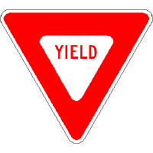
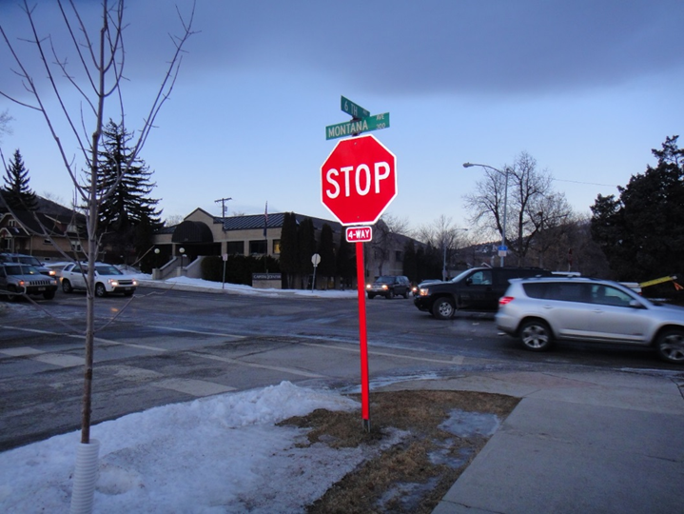
RIGHT OF WAY
Must be given, not taken
All vehicle traffic must stop and yield to pedestrians.
School crossing guards control only pedestrian traffic.
Notes:
Most students believe that when the law says they have the right of way that they can take it with impunity. Thinking in terms of giving right of way versus assuming and taking right of way. This will protect them from crashes when they are mixing with traffic. There used to be a commercial that stated you may be right but you don’t want to be dead right. Even though I have the right of way I can’t always be certain that the other users know who has right of way and who must yield.

Slide 16
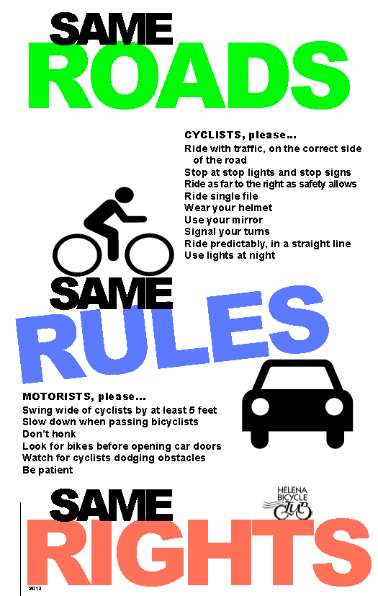
Kids and Bicycles
Bicycles on the road must follow traffic rules and stop for signals, stop signs, crosswalks, and pedestrians.
Children bicycling on the sidewalk should stop at the corners and get off their bikes.
Then look left, right and left again, wait, and walk their bike across the intersection.
Children should be encouraged to wear helmets.

Slide 17
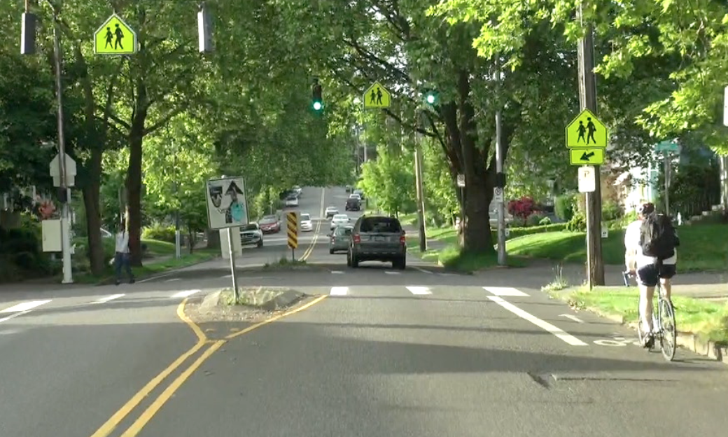
Bicycles and cars must yield to pedestrians
Intersections with traffic signals, school zone signs, painted crosswalks and low speed limits may not have crossing guards.

Slide 18
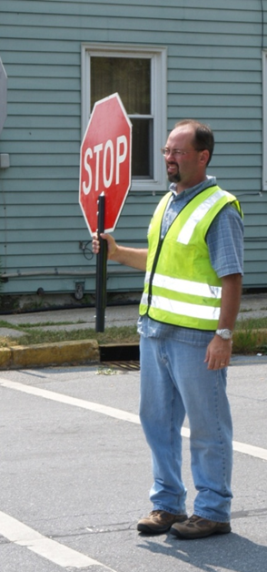
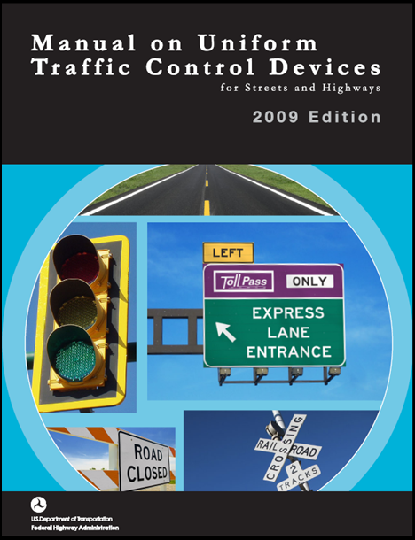
What characteristics make a good School Crossing Guard?
The MUTCD states that adult crossing guards should possess the following:
  (at least) average intelligence
  good physical condition, including sight, hearing, and mobility
  mental alertness
  neat appearance
  good character
  must pass criminal background check
  dependability
  sense of responsibility for safety of students
Notes:
Who here is responsible for ‘finding’ or hiring crossing guards?
This list makes sense, right?

Slide 19
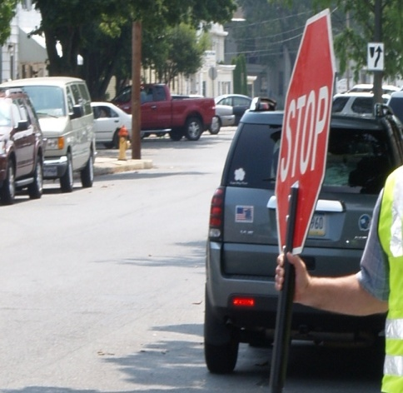
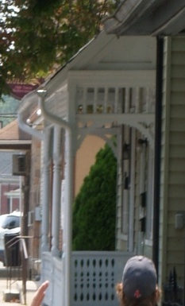
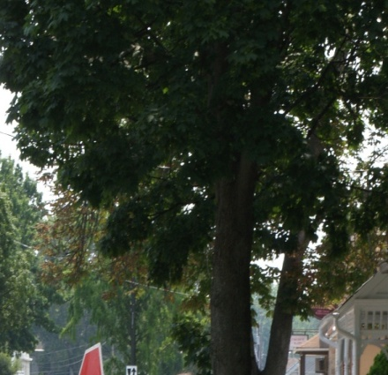
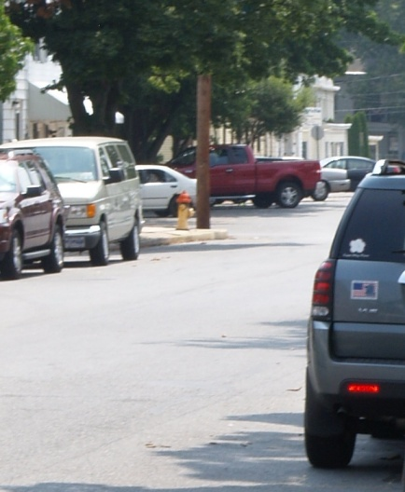
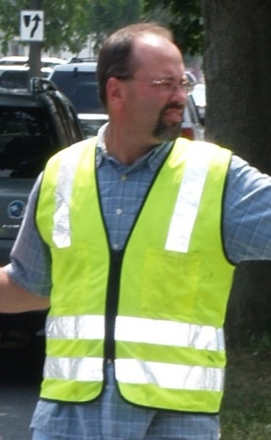
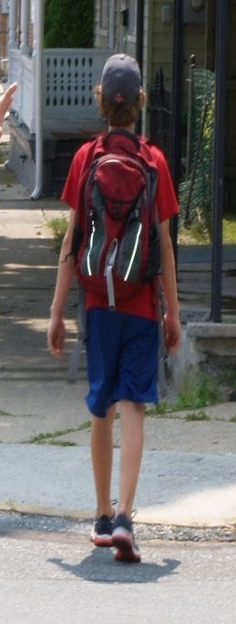
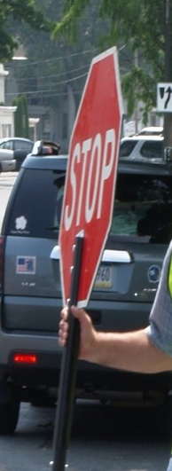
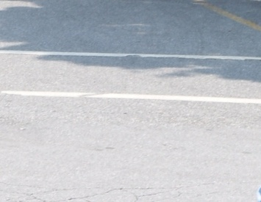
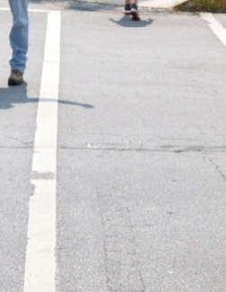
What a driver sees
Notes:
Street – Is there other traffic?
Parked cars – pedestrians could emerge
STOP paddle – is that expected?
Crossing Guard vest – is that expected? What is he doing?
That’s a big tree!
Child – is that expected? What is he doing? What might he do next?
Pavement marking – Is anyone in the crosswalk?
Pavement marking – Is anyone in the crosswalk? The Crossing Guard! The child is at the other side of the street.
Nice porch – they must have just repainted.

Slide 20

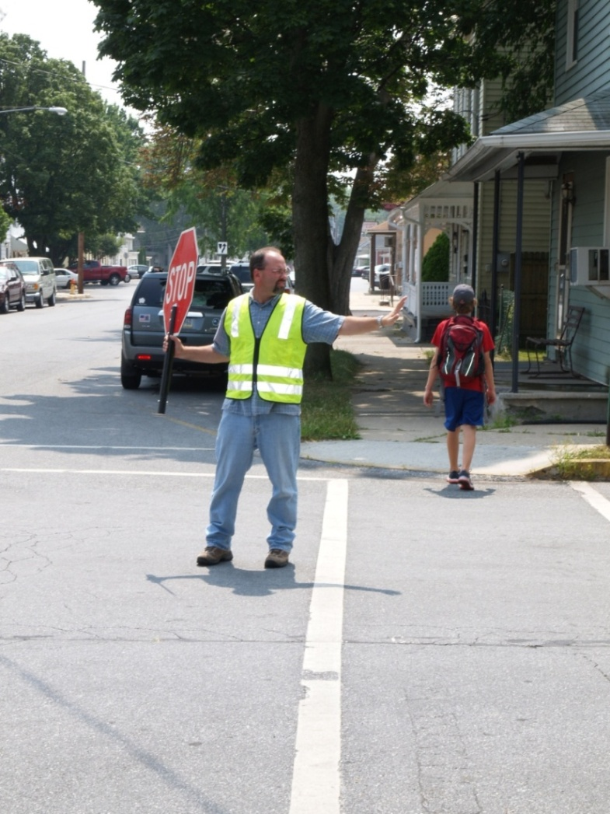
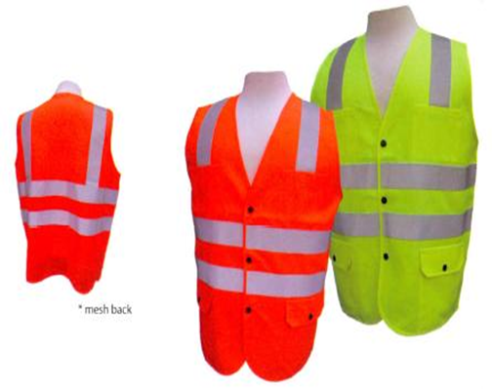
Make sure drivers see You
STOP paddle must be 18”, with letters at least 6” high.
The sign must be retro reflective if used in darkness
Fluorescent and Retro-reflective Vest:
- Class 2 is necessary for greater visibility
- Wear the vest over your winter coat
Notes:
Now, here is the same scene again. Knowing all that might be competing for the driver’s attention, ask these questions:
Is the Crossing Guard visible?
Is the Crossing Guard conspicuous?
Does the Crossing Guard blend into the background and all else a driver might see?

Slide 21
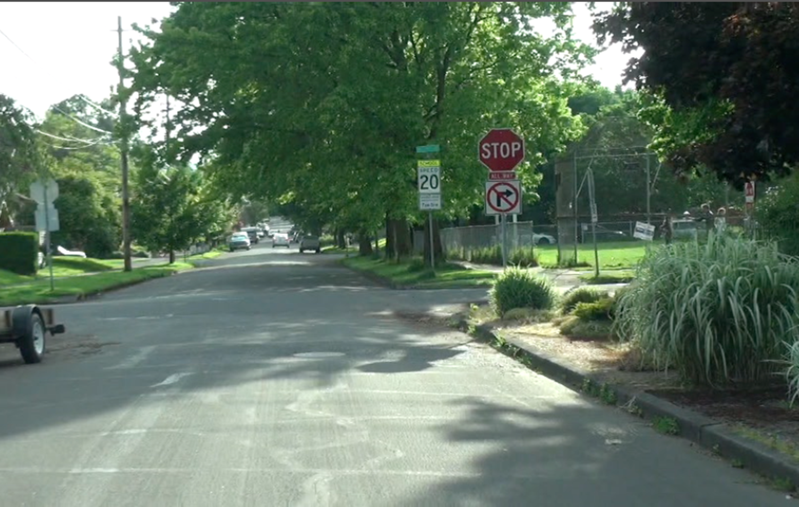
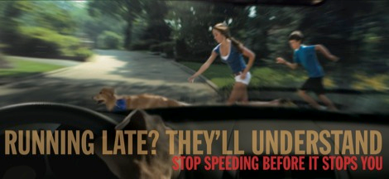
Road Hazards
Poor visibility
Turning movements
Drivers and other road users

Slide 22
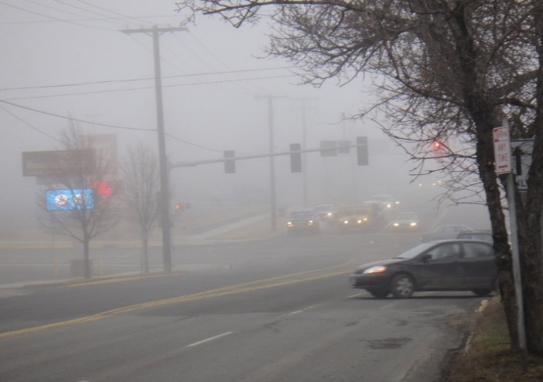
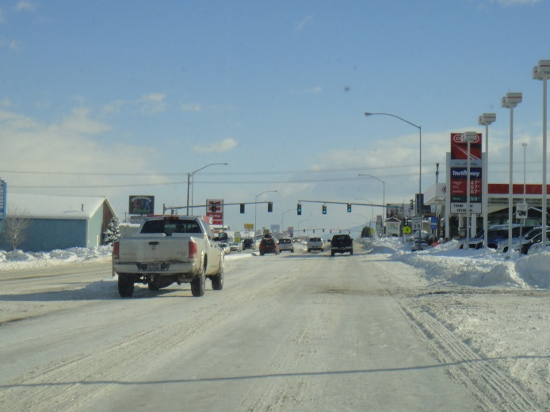
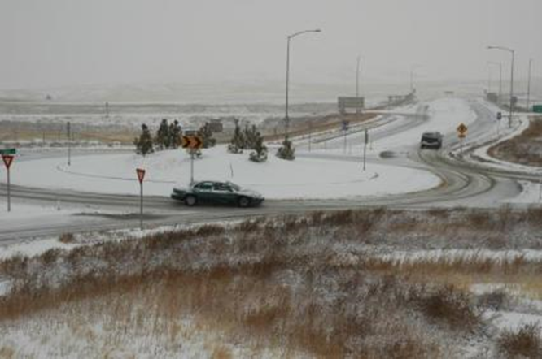
Weather:
Sun-Rain-Wind-Snow-Ice
Bad weather tends to make drivers and pedestrians hurry and pay less attention.
Visibility may be reduced. Be sure to get motorists’ attention before crossing into the street.
Stopping distances increase as roads become slippery.
Always wear the retro reflective vest over any rain or cold weather jackets to stay visible.

Slide 23
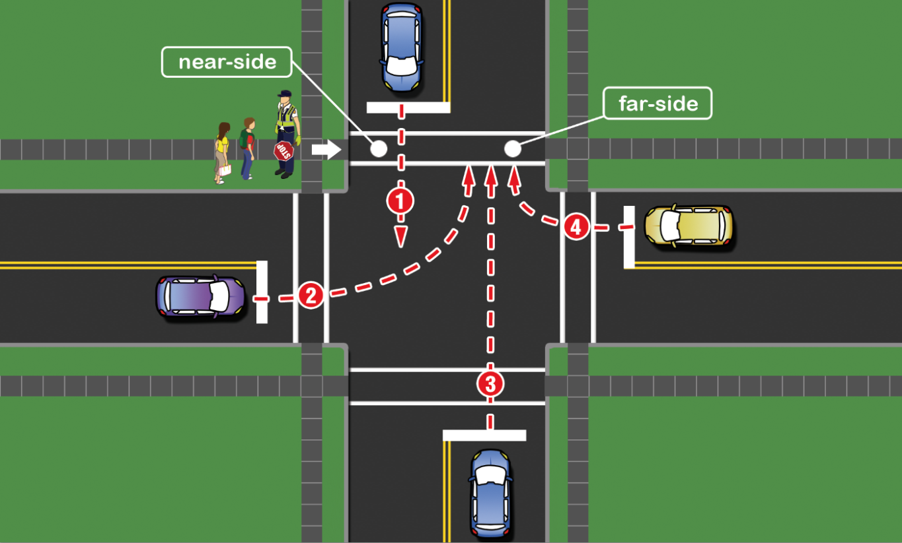
Traffic hazards at unsignalized intersections
1. Through vehicle approaching near side
2. Vehicle approaching to turn left onto far side
3. Through vehicle approaching far aide
4. Vehicle approaching to turn right onto far side

Slide 24


Multiple threat crashes
The first driver stops to allow a pedestrian to cross, but a second driver fails to stop.
Multiple threat conflict point

Slide 25



Crossing Guard Responsibilities
School crossing guards control only pedestrian traffic.
Adult crossing guards direct and assist students by identifying and utilizing gaps in traffic to help them choose the safest time to cross a street.
Then, using the stop paddle, they make sure traffic remains stopped until all pedestrians are finished crossing.
Notes:
Ask question: Does your agency require practical training?

Slide 26

Video: Crossing Technique
Click image to play video

Slide 27

Crossing Techniques in Five Steps
Step 1. Gather the children at the corner
Stop children a safe distance from the curb or edge of the street
Instruct children only to cross on your verbal signal
Ask bicyclists to get off their bike and prepare to walk
Notes:
Gather the children
Stop children a safe distance from the curb or edge of the street, or behind a stand-back line if one is present. Instruct children only to cross on your verbal signal. This is good opportunity to teach children about the importance of stopping “at the edge.” Children who are on bicycles or kick scooters should be encouraged to dismount and walk their bicycles across the street and children who are on skateboards should carry them across the street.
How do you cross kids now? Why might you only do it verbally?

Slide 28


Crossing Techniques – Step 2 of 5
Step 2. Scan for traffic
Face the roadway and search to the left, right and left again
At an intersection, search forward and behind
Be aware of vehicles turning from side streets, not just crossing the intersection

Slide 29
Crossing Techniques – Step 3 of 5
Step 3. Identify the gap
Identify the traffic gap
If the gap seems adequate, before proceeding into the crosswalk, make a final search to the left
At uncontrolled intersections, make sure vehicles have time to stop before you begin crossing

Slide 30

Crossing Techniques - Step 4 of 5
Step 4. Begin to cross
When crossing the street, continue to scan for moving vehicles
As you enter the street hold the STOP paddle high, facing the motorists
Notes:
Using the Stop Paddle
MUTCD recommends using the STOP paddle as the primary signaling device for motorists. As you are enter the street hold the STOP paddle high, facing the motorists. Hand signals and whistles can be used to supplement the crossing procedure. Refer to your local agency guidelines for additional details.
Enter the crosswalk
With STOP paddle held high, facing motorists, enter the crosswalk, continuing to scan the street for oncoming traffic
Signal to children to cross
Verbally instruct the children to cross, reminding them to look left-right-left before leaving the curb and to continue to scan for cars while crossing the street
Do you use whistles? Hand gestures?

Slide 31

Crossing Techniques - Step 5 of 5
Step 5. Cross the street
Enter the crosswalk alone holding the STOP paddle high
Verbally tell children when to cross. Tell them to look left, right, left and all around for moving cars while crossing
After the children cross the street, return to starting position holding the STOP paddle high
Notes:
Using the Stop Paddle
MUTCD recommends using the STOP paddle as the primary signaling device for motorists. As you are enter the street hold the STOP paddle high, facing the motorists. Hand signals and whistles can be used to supplement the crossing procedure. Refer to your local agency guidelines for additional details.
Enter the crosswalk
With STOP paddle held high, facing motorists, enter the crosswalk, continuing to scan the street for oncoming traffic
Signal to children to cross
Verbally instruct the children to cross, reminding them to look left-right-left before leaving the curb and to continue to scan for cars while crossing the street
Do you use whistles? Hand gestures?

Slide 32
Review Questions
What is a multiple threat crash?
What is the third step in the crossing technique?
Do you cross children with a hand signal?

Slide 33
Answers
1. What is a multiple threat crash?
It’s a crash that occurs when the first driver stops to allow a pedestrian to cross, but a second driver fails to stop, usually at a four-lane intersection.
2. What is the third step in the crossing technique?
Scan and identify a gap in traffic.
3. Do you cross children with a hand signal?
No, you verbally tell children when to cross.

Slide 34



Video: Crossing procedures for a signalized crosswalk
Click image to play video

Slide 35
Video Review Questions
Do you start to cross children on a flashing Don’t Walk signal?
Are children allowed to cross the street riding their bicycle or scooter?
Where do you, the crossing guard, stand in the crosswalk?
How do you direct students to cross the street?
What directions do you give to the children before they begin crossing the street?

Slide 36
Answers
1. Do you start to cross children on a flashing Don’t Walk signal?
No, start crossing children on a “fresh” Walk signal.
2. Are children allowed to cross the street riding their bicycle or scooter?
No, they should be asked to dismount and walk.
3. Where do you stand in the crosswalk?
Just outside the crosswalk facing the greatest threat.
4. How do you direct students to cross the street?
Verbally – tell students when it is safe to begin crossing
5. What directions do you give the children before they begin crossing the street?
To look left, right, left and behind them and to keep scanning for traffic while they cross.

Slide 37

Emergency Situations
During your crossing guard shift, in the case of an emergency, your job is to stay at your position and keep control of the children.
Immediately stop crossing the children and gather them in a safe place away from the street.
Ask several people to call 911. It may be appropriate for you to do so using your cell phone, but check with the local agency for proper procedure.

Slide 38

Reporting Problems or Emergencies
Dial 911 first for:
  Crashes
Call your supervisor first for:
  Your illness
  Student illness
  Child safety issues
  Hazardous conditions
  Operation malfunctions
Notes:
Hazardous conditions include sight obstructions or other conditions that force pedestrians to unsafe locations, like a broken section of sidewalk that forces pedestrians to walk in the street.
Operations malfunctions include traffic signal malfunctions or damaged or downed signs.
If you have to call 911, be sure to:
Have notepad and pencil for noting details
Be able to describe car(s) involved
Get license plate numbers if possible
Contact your supervisor if:
Incident blocks your primary crossing
Crash scene requires you to employ a contingency plan to safely cross children.

Slide 39

What to report to law enforcement
You may occasionally encounter trouble with motorists. The following behaviors should be reported to your local law enforcement agency:
  Unsafe or illegal behavior by motorists.
  Car going through crosswalk while occupied by guard or students.
  Repeat offenders.
  Other moving violations such as speeding must be verified by radar or traffic officer.

Slide 40

How to give a report to
law enforcement
If you want to report an incident, make note of the following information:
  License plate
  Description of vehicle
  Date, time and location
  Ability to identify driver
After providing all necessary information you may be asked to fill out a witness statement or file a complaint
Officers may choose to issue a warning or a citation or take no action at all

Slide 41
Best practices and conduct
Remain standing
  Standing puts you in the best position to be seen by drivers as well as children. Stay alert.
Avoid distractions
  Focus on traffic and children.
  Do not listen to the radio, headphones, read books, magazines, newspapers or other materials while on duty.
  Guards may use 2-way radios for official communication if allowed by the local agency. Cell phones should only be used in emergencies.
Notes:
Remain standing
Standing puts you in the best position to be seen by drivers as well as children. A guard needs to be alert to his or her surroundings and ready to react to unexpected events. The visible presence of an alert guard can also help to discourage unsafe behavior.
Avoid distractions
Your primary function is to safely cross children to or from school. Any distractions while on duty (eating, drinking, smoking) must be avoided. You should not listen to the radio, use headphones, read books, magazines, newspapers or other materials while on duty. Guards may use 2-way radios for official communication if allowed by the local agency. Cell phones or other mobile devices shall only be used in emergencies.

Slide 42
Interacting with children
No physical touching of children is ever allowed
Never give gifts to students
Never put a child in your car
Be firm, courteous, pleasant
Maintain self-control
Notes:
There is to be no physical touching of children and no gifts given to students. Children should never be put in your car. As a visible representation of the local agency and the community, it is very important to maintain professionalism on the job.

Slide 43
Review
In an emergency situation, do you continue to cross children?
Name one violation that should be reported to law enforcement.
Is it all right to cross adults?
Is it all right to listen to the radio while you are on duty?

Slide 44
Review
1. In an emergency situation, do you continue to cross children?
No. Immediately stop crossing children and keep them a safe distance from the street.
2. Name one violation that should be reported to law enforcement.
Possible answers: cars going through the crosswalk while occupied by guard or students, speeding in the school zone.
3. Is it all right to cross adults?
Yes, courtesy crossing of adults is allowed as long as it doesn’t interfere with crossing students.
4. Is it all right to listen to the radio while you are on duty?
No, you are not allowed to listen to the radio, headphones or read while on duty.

Slide 45

Thanks for keeping our children safe
Resources used with permission from:
Colorado Department of Transportation's Safe Routes to School Program
Pennsylvania Dept. of Transportation (http://www.saferoutespa.org/Training/Crossing-Guard-Training)

