Slide 1
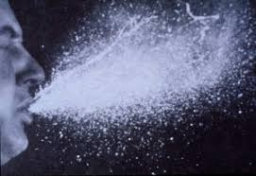
Virus Transmission
And Smallpox
Created by Montana Office of Public Instruction Indian Education for All Unit

Slide 2
Virius kills millions
How did a virus kill millions of people globally and decimate Native American populations before the 1900s?

Slide 3
MS-LS1-1
MS-LS1 From Molecules to Organisms: Structures and Processes
Students who demonstrate understanding can: MS-LS1-1. Conduct an investigation to provide evidence that living things are made of cells; either one cell or many different numbers and types of cells. [Clarification Statement: Emphasis is on developing evidence that living things (**including Bacteria, Archaea, and Eukarya) are made of cells, distinguishing between living and non-living things, and understanding that living things may be made of one cell or many and varied cells. **Viruses, while not cells, have features that are both common with, and distinct from, cellular life.
MS-LSI from Molecules to organisms: Structures and processes

Slide 4
Questions
What are three viruses that you know of (think about the vaccinations you have received if you need help triggering your memory)
1 –
2 –
3 –
What diseases and symptoms do each cause?

Slide 5
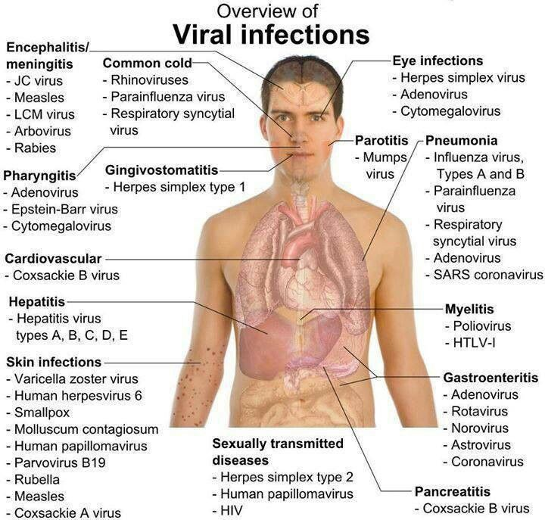
Viral Infections Overview

Slide 6
Discussion Questions
Discussion:
From what you already know, what are the best things you can do to limit disease transmission?
The cold virus (rhinovirus)?
The flu virus?
Chickenpox?
Rotavirus?

Slide 7
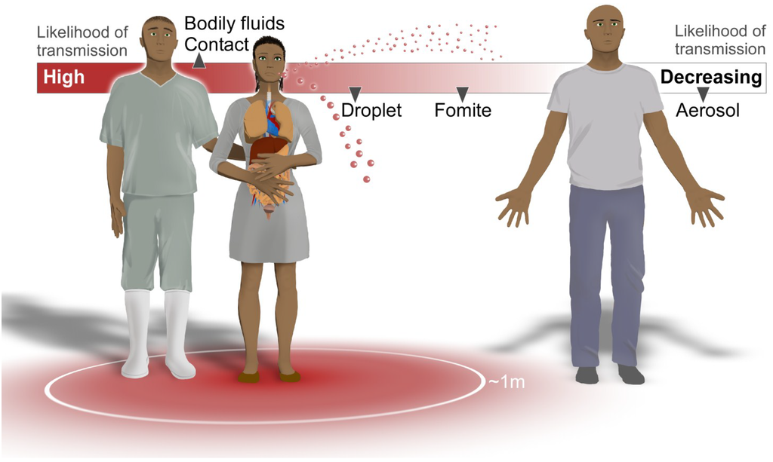
Transmission Likelihood

Slide 8
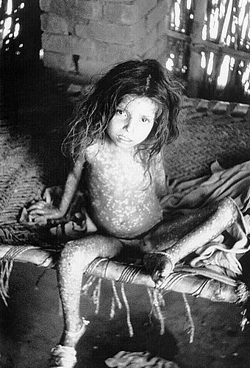
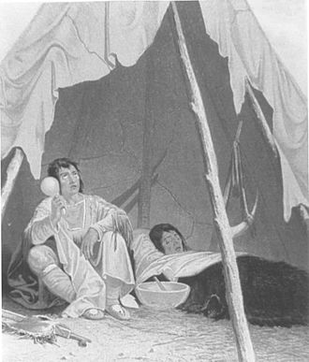
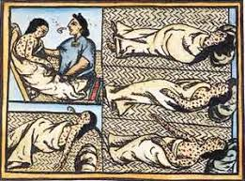
Fomites definition
Fomites: /foam eh teas/
Objects or materials that are likely to carry infection
Blankets
Clothing
Utensils

Slide 9
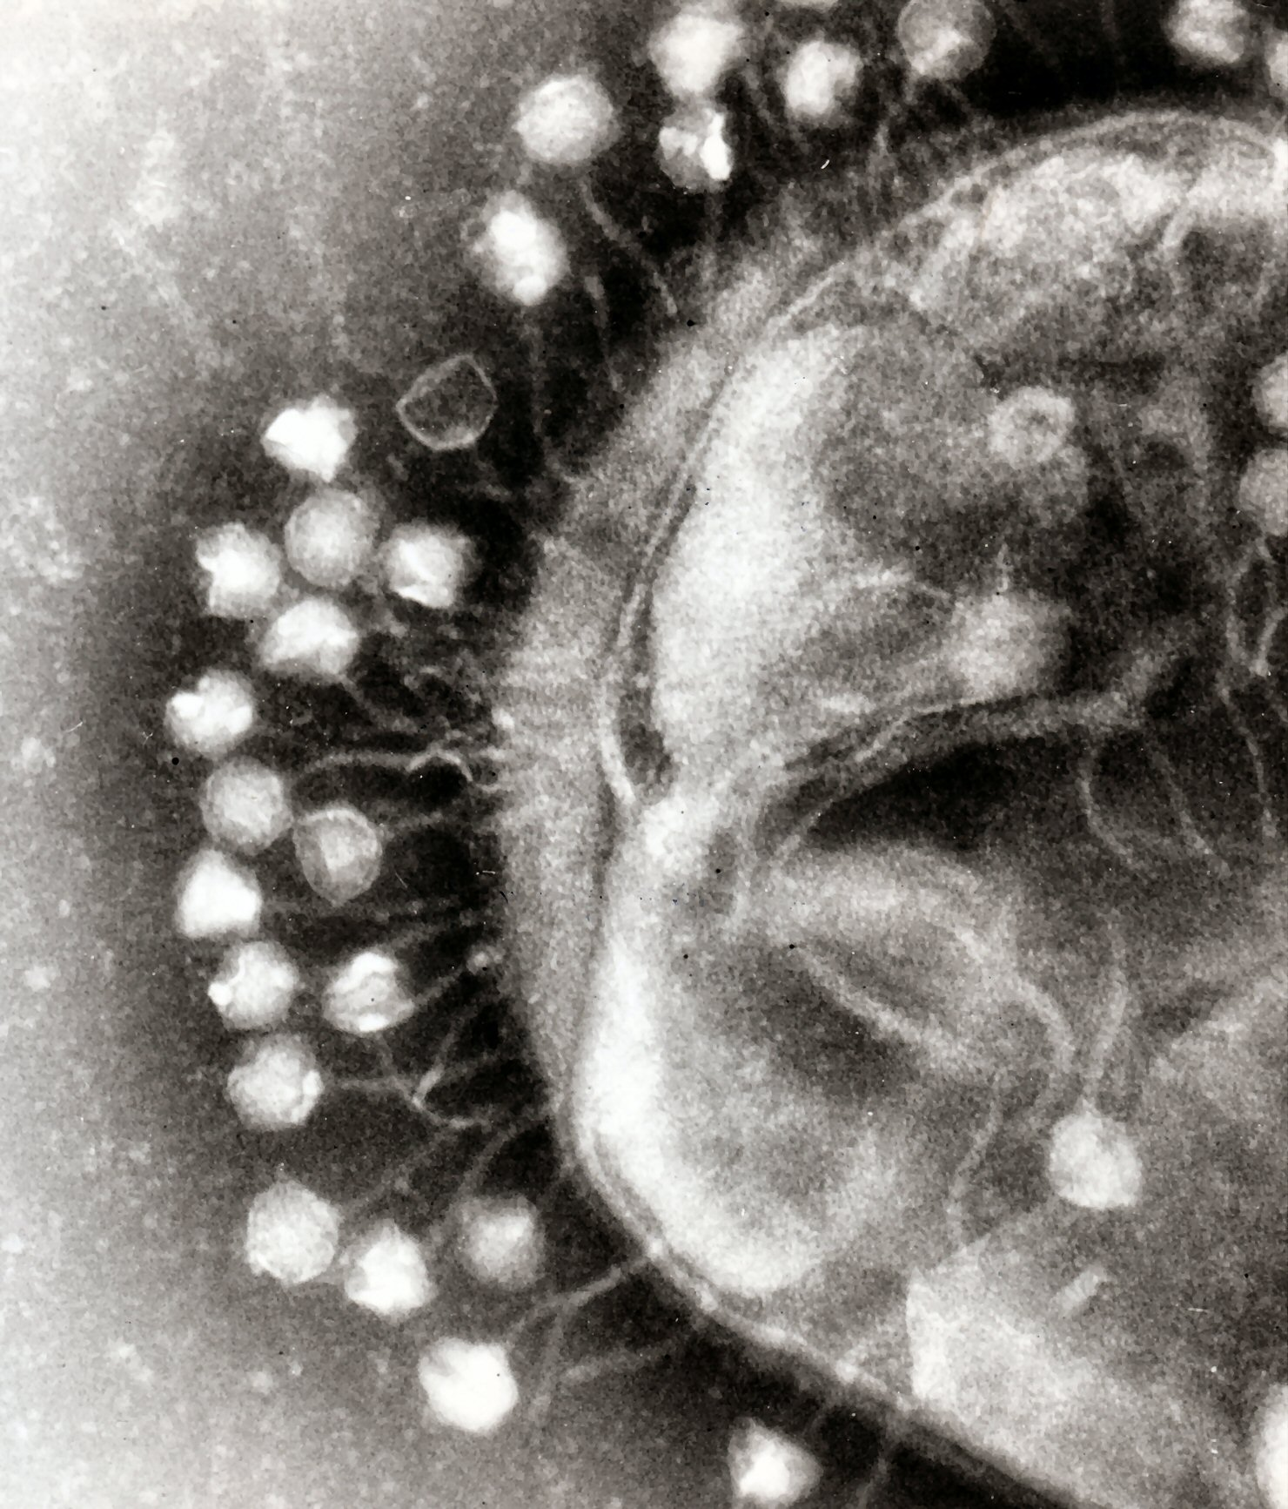
Virus picture

Slide 10
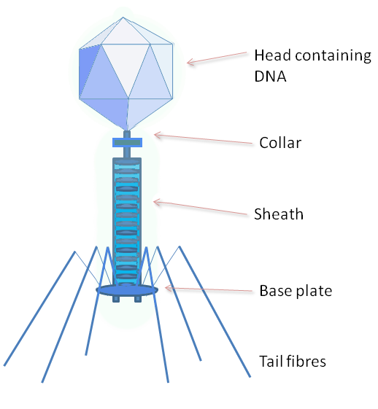
Virus structure visual

Slide 11
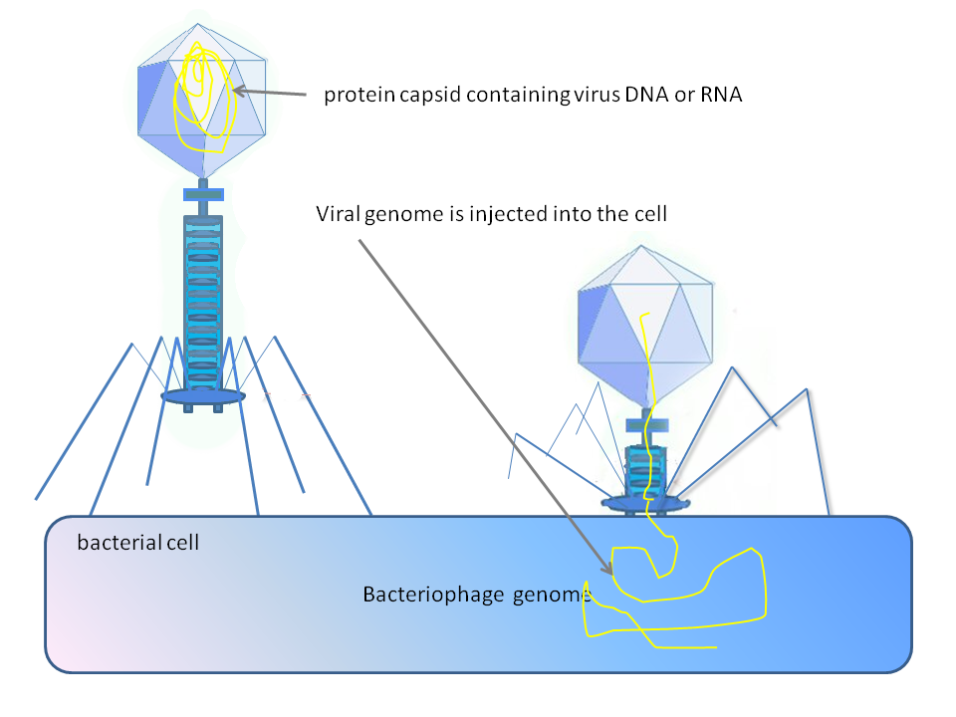










Virus structure visual continued
Created by Graham Colm

Slide 12
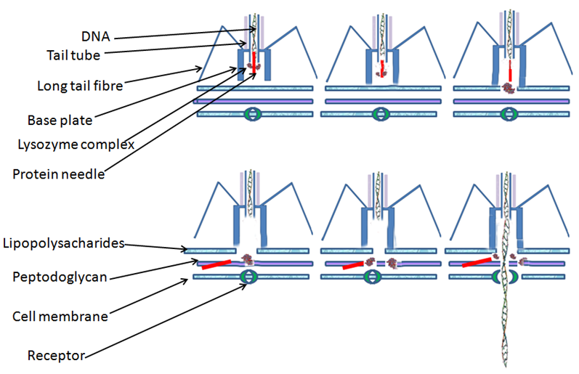
Virus structure visual continued 2

Slide 13
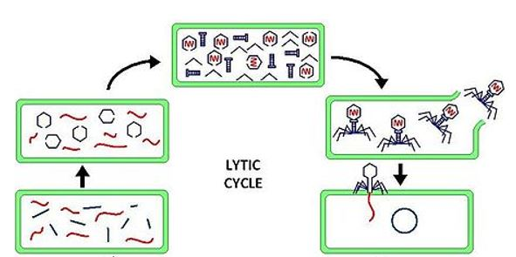
Lytic cycle

Slide 14
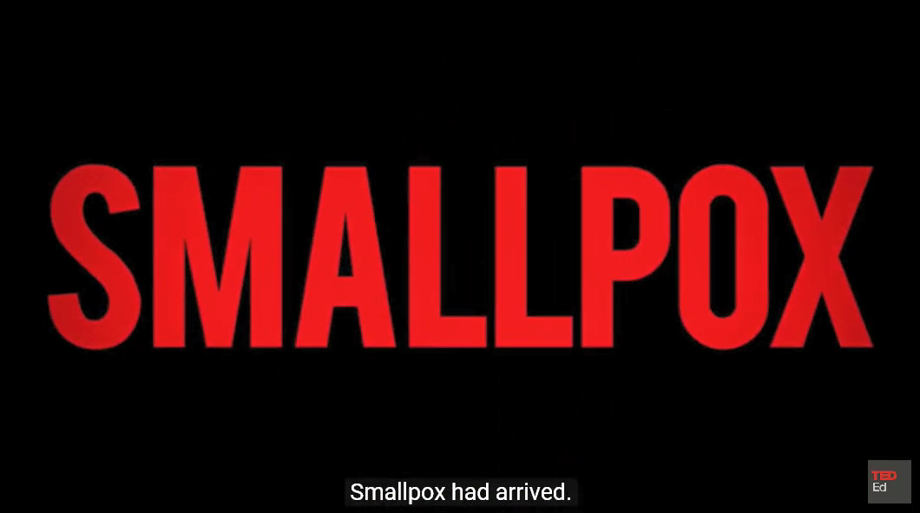
Smallpox had arrived

