Slide 1
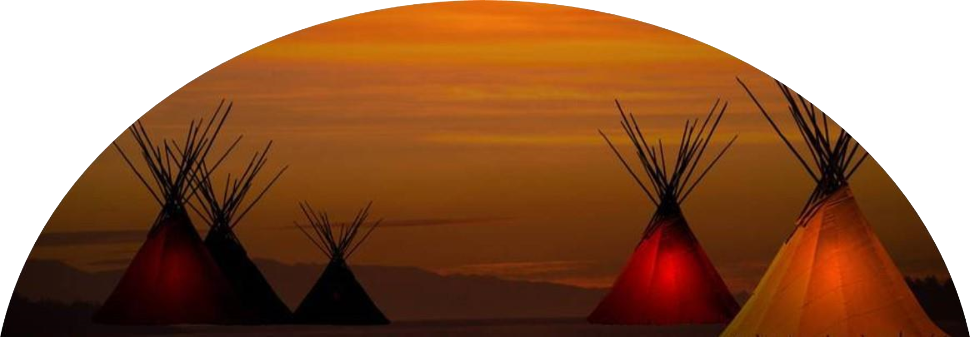

Indian Education for All and
ELA Standards
Mandy Smoker Broaddus, Education Northwest
Mike Jetty and Jennifer Stadum, MT OPI Indian Education

Slide 2
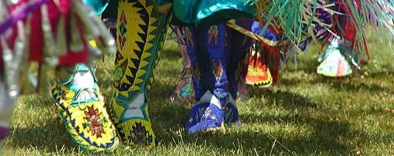

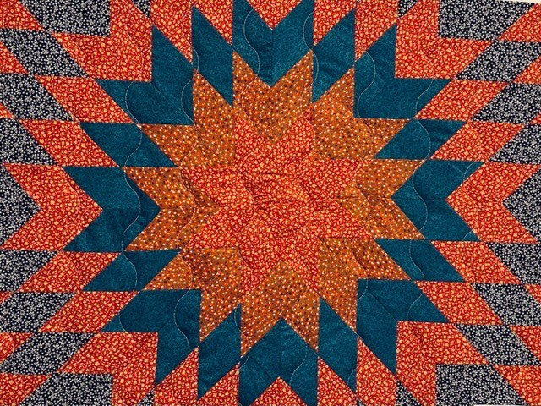
Agenda
Introductions and Land Acknowledgement
Setting the Stage: IEFA Context in Standards
Banks’ Dimensions of Multicultural Education
Application: Thunderous
The work: Approaching the standards through existing work by grade band

Slide 3

Land Acknowledgment
In the spirit of healing, we honor and recognize that the state of Montana has been peopled and stewarded by unique, distinct, and prosperous groups of indigenous peoples for thousands of years.
Today, eight federally recognized Tribal Nations that comprise 12 different tribes exist in Montana: The Blackfeet Tribe, the Chippewa-Cree Tribes, the Confederated Salish & Kootenai Tribes, the Crow Tribe, the Fort Belknap Tribes, the Fort Peck Tribes, the Little Shell Chippewa Tribe, and the Northern Cheyenne Tribe.
These are not the only indigenous peoples to have inhabited the Montana region and we also acknowledge tribes such as the Bannock, Nez Perce, Northern Arapaho, and Shoshone.

Slide 4
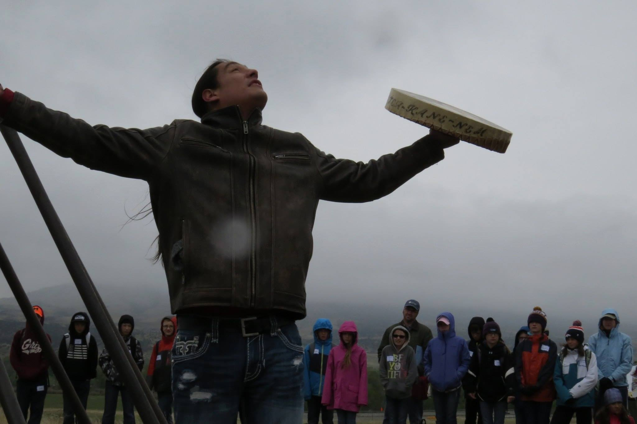
Setting the Stage: IEFA in the ELA Standards
Opportunity to make sweeping changes that celebrate and encourage deeper appreciation for multiple worldviews
Inspiration to include standards that support the implementation of IEFA
Robust inclusion of Indigenous authors and poets
Respectful and relevant strategies promoting tribally-specific stories, narratives, histories, and current voices
Possibilities for considering how various communities learn and express speaking and listening skills

Slide 5
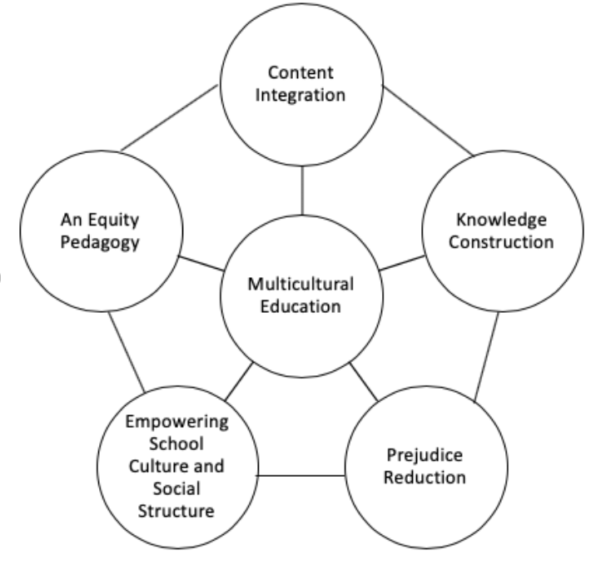
Dimensions of Multicultural Education
James Banks’ Dimensions of Multicultural Education
Content Integration: Examples and content from a variety of different cultures
Knowledge Construction: Students understand, investigate, and determine how biases, frames of reference, and perspectives influence ways knowledge is constructed
Prejudice Reduction: Students develop positive and inquisitive attitudes towards different racial, ethnic, and cultural groups
Equity Pedagogy: Teachers intentionally modify instructional practices to facilitate academic achievement of students from diverse, racial, cultural, or social class groups
Empowering School Culture: Culture and organization of culture transformed in ways that empower students regardless of racial, ethnic, socio-economic, gender diversity in a way that all students experience equity, safety, and acceptance in the school environment

Slide 6

Thunderous

Slide 7
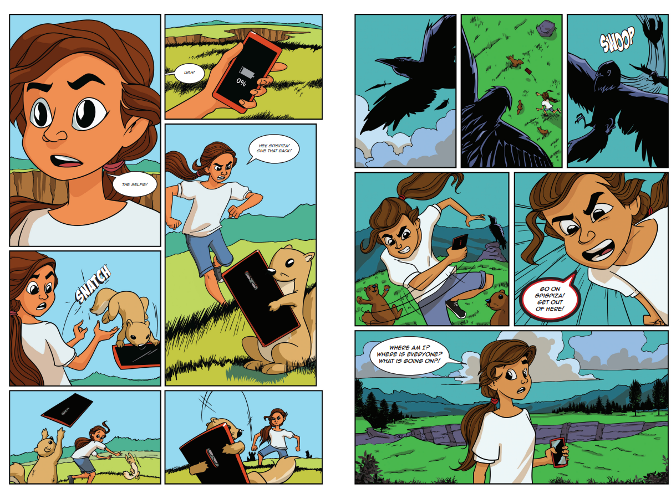

Slide 8
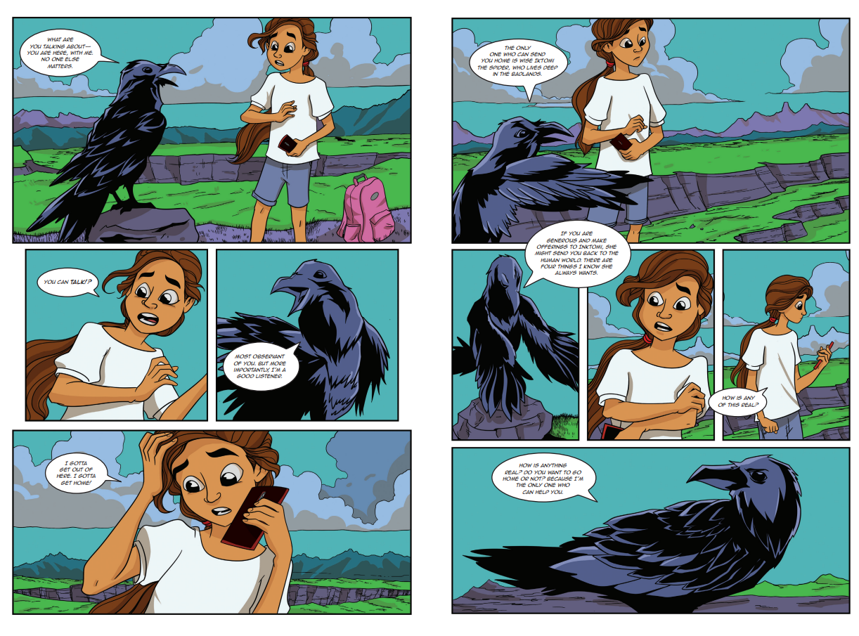

Slide 9
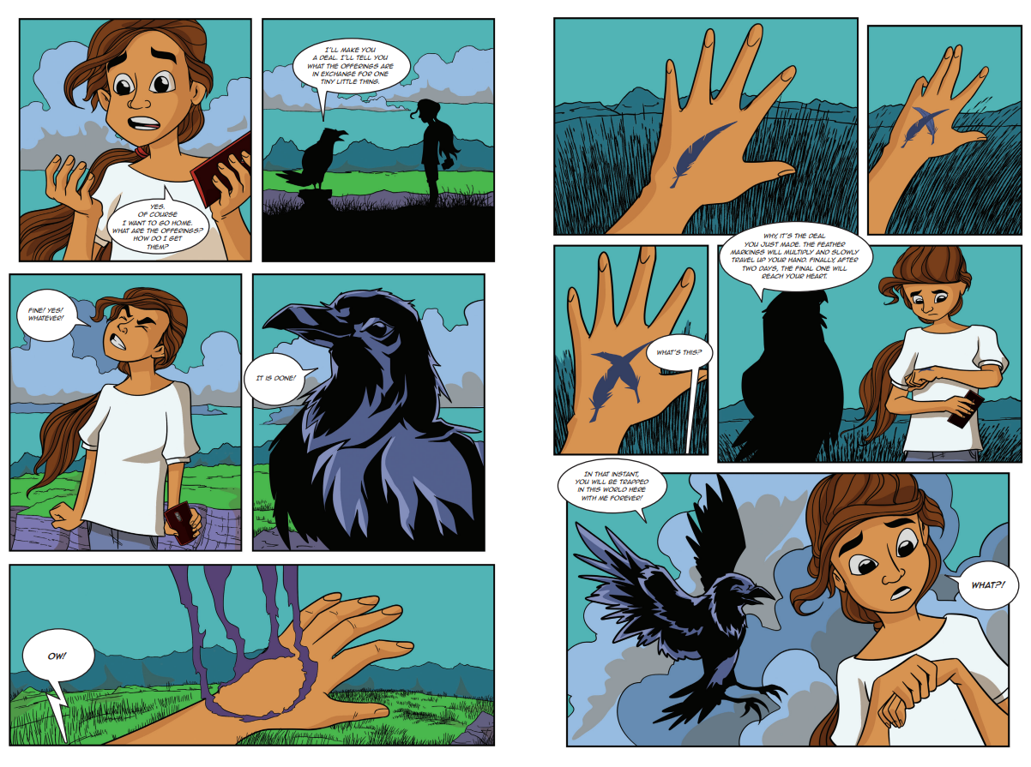

Slide 10
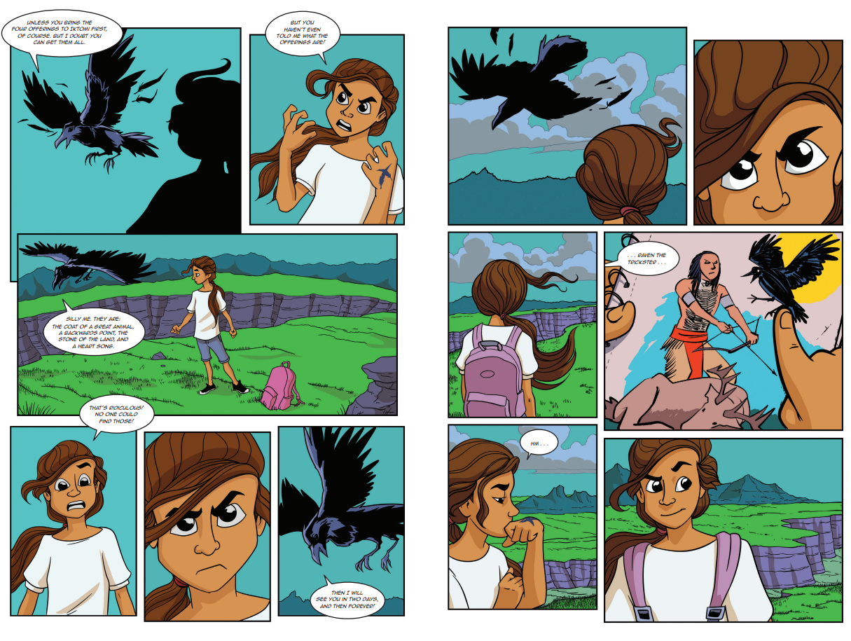

Slide 11
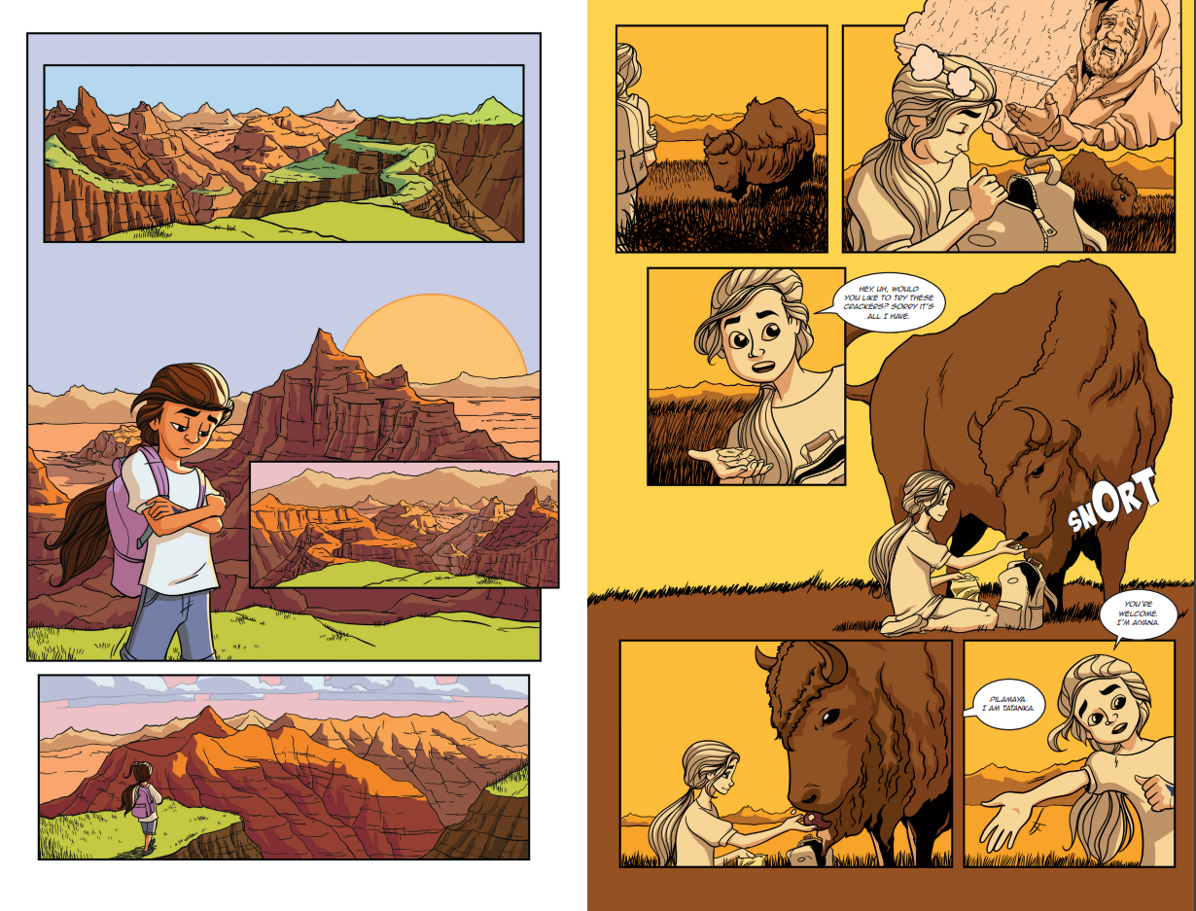

Slide 12
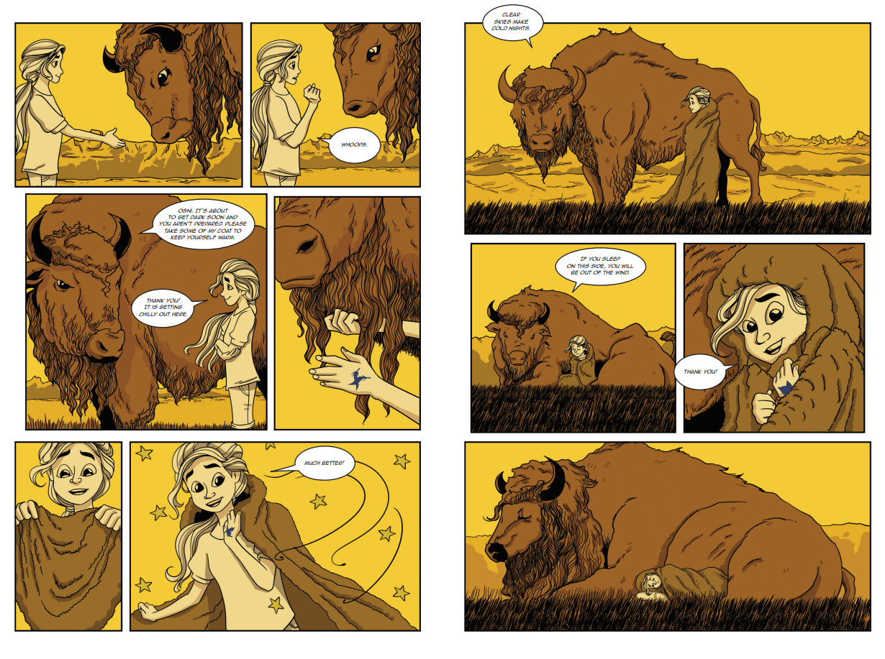

Slide 13
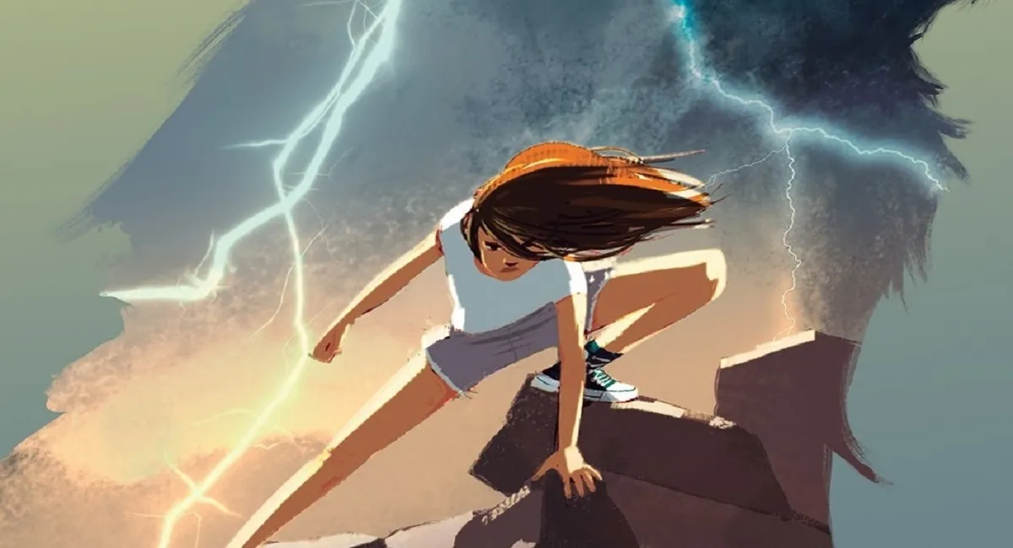
The Application: Thunderous
Learning Objectives
While reading and discussing the aspects of the book, students will: • work effectively and respectfully in a small group, listening to everyone’s responses. • understand and analyze literary elements such as character and plot. • ask questions, check inferences, and summarize information from reading and viewing background sources related to Lakota cultural traditions. • determine mood and tone of artwork of the story. • retell the important details of the story. • connect the details of the story to the traditional land base of the Lakota. • develop an increased awareness regarding Essential Understanding 3 and understand how powerful cultural and spiritual connections impacted the outcome of the story
Notes:
Mandy provide synopsis of book

Slide 14
The Application: Thunderous
Themes from the story:
Storytelling • Heritage/Traditions • Imagery • Fitting in • Listening • Two worlds metaphor • “We are always Lakota no matter where we are.” • Black Elk Peak (history) • Humor • Bullying • Peer pressure • Kinship/Family • Being a good relative
Notes:
How does contemporary Native experience impact the character's developent

Slide 15
The Application: Thunderous
Key Ideas and Details
Analyze how particular lines of dialogue or incidents in a story or drama propel the action, reveal aspects of a character, or provoke a decision. (RL.8.3)
Craft and Structure
Analyze how an author develops and contrasts the points of view of different characters or narrators in a text. (RL.7.6)
Integration of Knowledge and Ideas
Analyze how a modern work of fiction draws on themes, patterns of events, or character types from myths, traditional stories, or religious works such as the Bible, including describing how the material is rendered new and include texts by and about American Indians. (RL.8.9)
Notes:
How does contemporary Native experience and identity impact the character's development, voice/dialogue, point of view

Slide 16
Preparing for the work
Preparing for the work: A backwards analysis – How can we add, revise, clarify, Indigenize the standard?
Reading Standards for Literature K-2
(RL.1.2) Key Ideas and Details: Retell stories, including stories by and about American Indians, that include key details and demonstrate understanding of their central message or lesson.
Reading Standards for Literature 3-5
(RL.5.2) Key Ideas and Details: Determine a theme of a story, drama, or poem from details in the text, including how characters in a story or drama respond to challenges or how the speaker in a poem reflects upon a topic; summarize the text; and include texts by and about American Indians.
(RL.5.6) Craft and Structure: Describe how a narrator's or speaker's point of view influences how events are described; include perspectives of American Indians.
Reading Standards for Literature 6-8
(RL.8.3) Key Ideas and Details: Analyze how particular lines of dialogue or incidents in a story or drama propel the action, reveal aspects of a character, or provoke a decision.
(RL.6.6) Craft and Structure: Explain how an author develops the point of view of the narrator or speaker in a text.
Reading Standards for Literature 9-10
(RL.9-10.3) Key Ideas and Details: Analyze how complex characters (e.g., those with multiple or conflicting motivations) develop over the course of a text, including those of American Indians, interact with other characters, and advance the plot or develop the theme.
(RL.9-10.4) Craft and Structure: Determine the meaning of words and phrases as they are used in the text, including figurative and connotative meanings; analyze the cumulative impact of specific word choices on meaning and tone (e.g., how the language evokes a sense of time and place; how it sets a formal or informal tone).

Slide 17
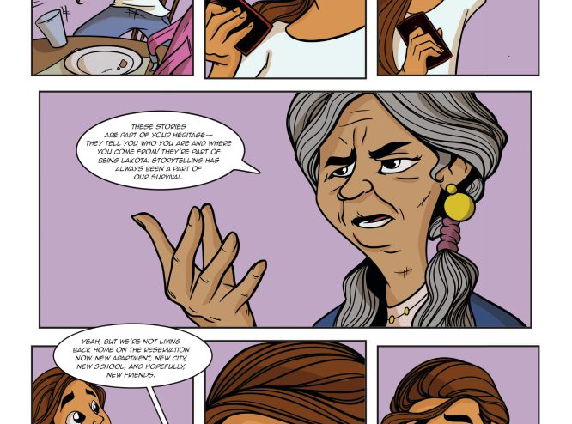
Breakout Room Task
You will enter a breakout room for your assigned grade band as reflected in your role on the task force. You will have approximately 20 minutes for this conversation in your breakout room.
Your task in each group is look at the standards appropriate for your grade band’s breakout room and discuss:
How can we add, revise, clarify, Indigenize the standards provided to thoughtfully, respectfully, and relevantly integrate Indian Education for All ?

Slide 18

Post Breakout Summary and Next Steps
ELA Standards
Considerations for your upcoming work:

Slide 19

OPI Indian Education for All PD opportunities
Starting in September: 1st and 3rd Tuesdays - FREE! Always same Zoom link!
1st Tuesdays ENERGIZE! IEFA Monthly Gathering
3rd Tuesdays Indian Education for All Across the Content
Webinar Recordings
Earn PD renewal units
Unpacking the Essential Understandings
Essential Understandings Deeper Dives
Indian Education for All Across the Content (ELA)
Birthright Videos (ELA resource)
And, MORE!!!
4-5 p.m.
1 PD renewal unit
Announcements
New curriculum
Lessons modeled
Games
Prizes
4-5 p.m.
1 PD renewal unit
Math, ELA, Art, Health Enhancement, Industrial Arts, Social Studies, Science, Music, Family and Consumer Sciences
Presented by Montana K-12 exemplary teachers

Slide 20
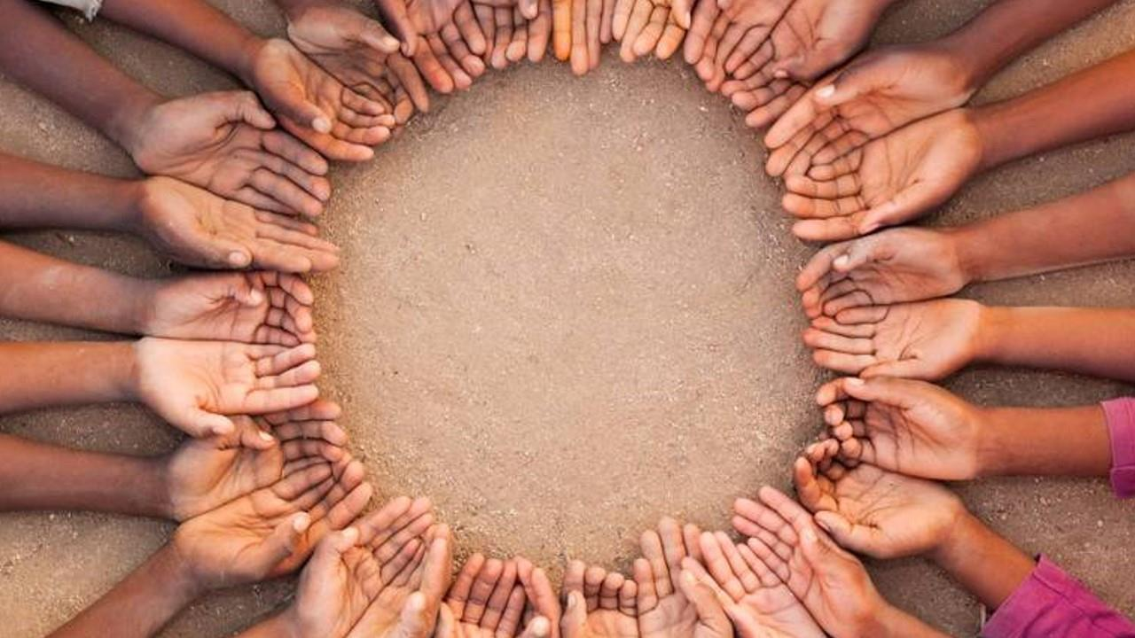

“Languages are complex. They are also necessary for humans to adapt, grow, and live together.”
Mandy Smoker Broaddus in Thunderous

Slide 21
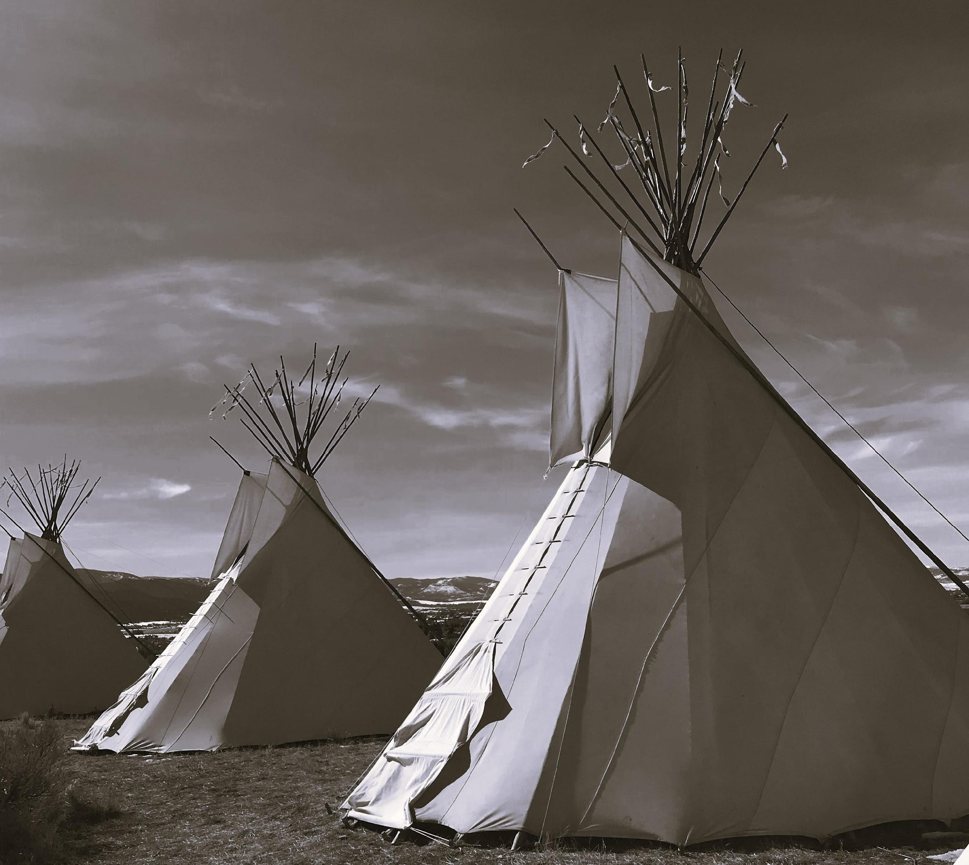
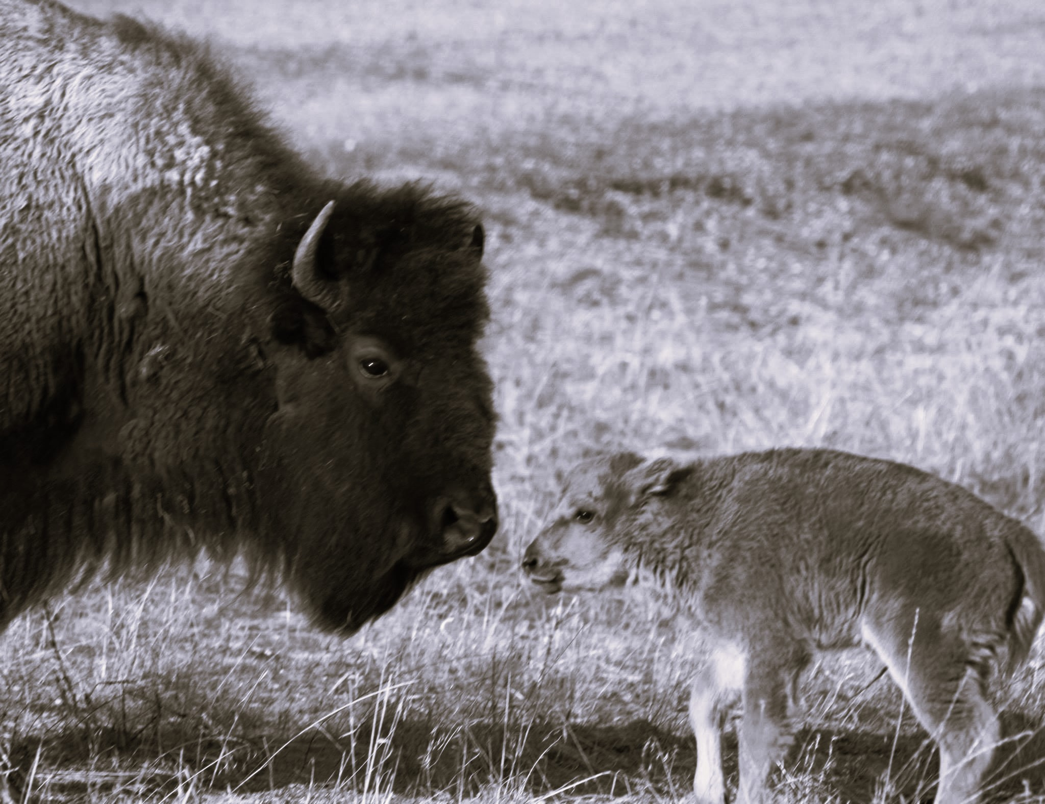
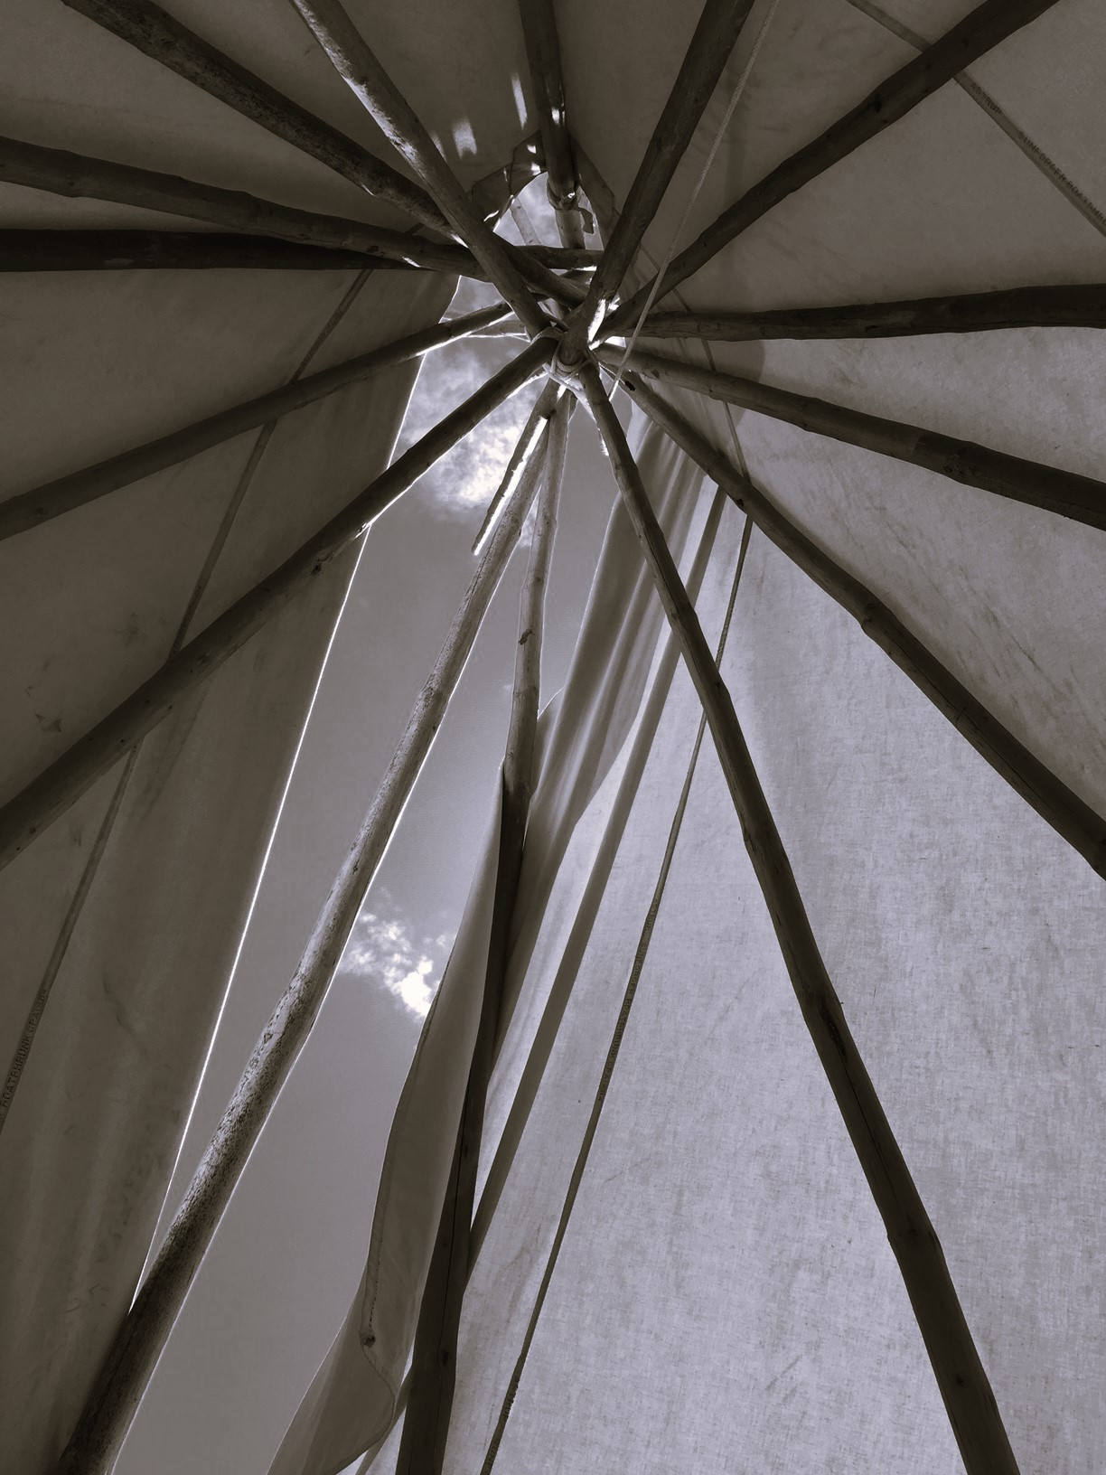
Thank you
Pidamaya
Toda Raba
Mandy Smoker Broaddus
smokerbroaddus@ednw.org
Mike Jetty
mjetty@mt.gov
Jennifer Stadum
jstadum@mt.gov
https://opi.mt.gov/Educators/Teaching-Learning/Indian-Education-for-All

