Slide 1

Emergencies
Montana Teen Driver Education and Training
Module 5.2
What should you do?

Slide 2
Emergencies - Objectives
Understand that emergency situations occasionally arise while driving.
Understand that each emergency situation can be dealt with effectively.
Know what procedures to use in specific emergency situations.
How to avoid potential emergency situations.

Slide 3
Vehicle Malfunction:
It happens
Well maintained vehicles sometimes malfunction.
Reduce danger, repair costs, and inconvenience by:
  Maintaining your vehicle;
  Understanding the warning signs of a vehicle malfunction;
  Knowing how to take corrective action.
Make sure you are always buckled up.
Keep your hands on the wheel and eyes on the road.
Notes:
A quick review of Module 2.1 Preparing to Drive would reinforce this topic area. The 2.1 Fact Sheet Alert and Warning Controls and the Pre-Drive Checklist are relevant to avoiding and handling emergencies.

Slide 4
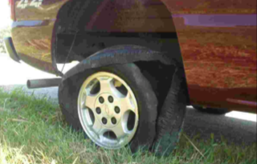
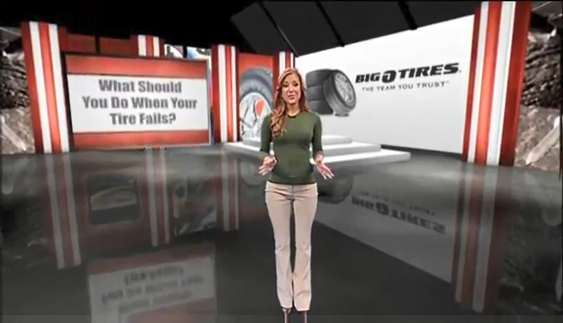
Tire Blowout
Don’t brake.
Look to your target area.
Steer toward your target.
Slow down gradually.
Pull to the side of the road.
Turn on hazard lights.
PLAY VIDEO (1:21)
Maintain good tire pressure and make sure there is adequate tread on your tires.
Notes:
PLAY VIDEO. A closed captioned video is available on YouTube here: https://youtu.be/FoiK7L3_74M.
Don’t overload your vehicle – that is frequently the cause of a tire blowout.
The difference in friction created by the blown out tire will cause the car to pull in that direction. So, a right rear tire blowout will cause the car to pull in the direction of the blowout. Likewise a left front blow out will cause the car to pull to the left toward oncoming traffic.
The driver has a tendency to hit the brakes when there is a blow out, but in this case any rapid reduction in speed will accentuate the drag caused by the tire failure. A gradual slow-down is the best remedy for this situation.

Slide 5
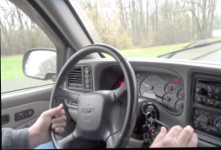
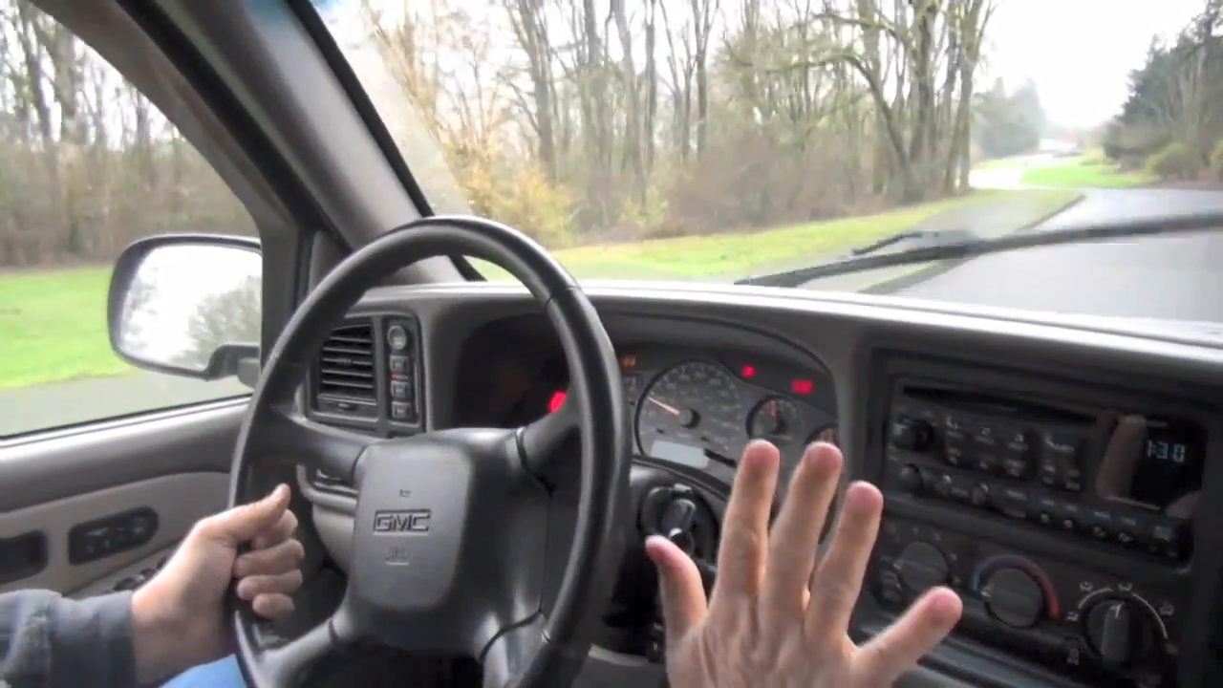
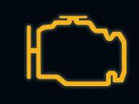
Engine Stalls
Keep eyes on target area.
Maintain firm grip on wheel.
Open palm shift to neutral.
Twist key to restart motor.
When motor restarts, shift back to drive and proceed.
Pull to side of road if car doesn’t restart.
Turn on hazard lights.
PLAY VIDEO (:09)
Notes:
PLAY VIDEO.
When the “Check Engine” light goes on, it means that a system in the vehicle (examples: ignition, fuel injection, emission control) is not operating at peak performance, even if the vehicle appears to be running normally.
A glowing check engine light doesn't mean the driver must immediately pull over to the side of the road, but ignoring the warning light could severely damage engine components and incur additional repair expenses. A light that flashes indicates a more severe condition that should be checked out right away to prevent damage to the catalytic converter.
Reasons for engine stall
Lack of fuel
Poor maintenance
Water in fuel
Remember that when an engine stalls that you will lose power steering and power brakes. This will require you to maintain a firm grip on the wheel and more strength from you when trying to steer and brake.
BTW Lesson for Handling Emergency Situations: instructor turns ignition key off on a practice drive. Student needs to restart and note the change in power steering. Try first on straight road and later when there is a bend in the road.

Slide 6
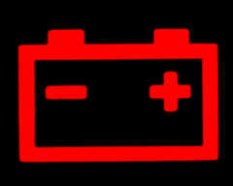
Electrical Problems
Battery - Alternator – Starter - Fuses – Spark plugs
Electricity is needed for the ignition, vehicle lights, power steering, power windows, and all the accessories
If the alternator does not generate enough electricity to run the vehicle, the battery will eventually be drained and stop.
Notes:
Alternators generate electricity to power a vehicle’s electrical system. The warning light displays a red battery symbol or ALT or GEN. When the light goes on, the electrical system is not getting power from the alternator. If the alternator does not generate enough electricity to run the vehicle, the battery will eventually be drained and stop.

Slide 7
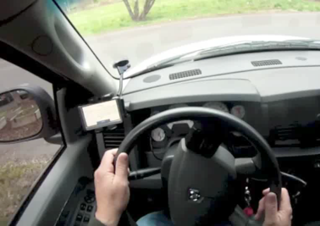
Loss of Steering
Suddenly and without warning something in the steering mechanism has broken or jammed.
Loss of power steering can make it difficult to turn or it feels “loose” and “sloppy.”
Stop as quickly as possible.
Use your flashers, flashing headlights, or blow your horn to warn others.
Notes:
When there is a power steering failure, the vehicle can still be steered with much more effort.
Grip the steering wheel with both hands and steer to the side of the road to stop.

Slide 8
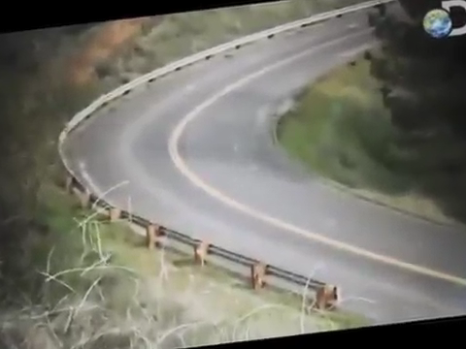
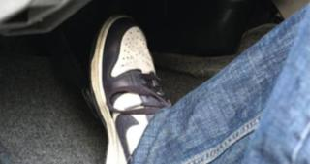
A brake failure can be a complete loss of brakes or only power brake failure.
Brakes Fail
Aim to the target area.
Control steering.
Rapidly pump the brakes.
Downshift.
Use parking brake, keep the release lever open.
Use soft crash area if necessary.
PLAY VIDEO (:46)
Notes:
PLAY VIDEO. A closed captioned video is available on YouTube here: https://youtu.be/UMLWa6g9iJU.
Notice that responding to every emergency situation requires that you look and steer toward your target area.
Pumping brakes may help re-establish brake fluid pressure and brake operation.
If that doesn’t work, then the driver needs to downshift. With a manual, depress the clutch and shift to the next lower gear. With an automatic, downshift from drive to 2 to L. Shifting to L too early may cause the transmission to malfunction and not slow the car.
Using the parking brake as a backup can be effective, but will require that the driver holds the brake release open so they don’t lock up the back wheels and cause a skidding crash
If all else fails aim for something soft to crash into: something like a soft embankment, bush, or open field.

Slide 9
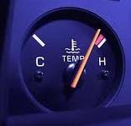
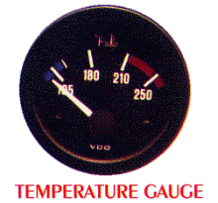
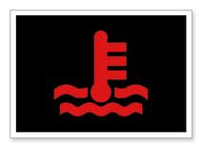
Engine Overheats
Excess heat can destroy an engine
Monitor your vehicle’s temperature, radiator hoses and coolant level.
STOP THE VEHICLE when the warning light comes on or the gauge shows a hot temperature.
Cool the engine:
Let the engine idle.
Turn on the heater and blower to high to help pull heat from the engine.
Turn the ignition off and open the hood.
Add coolant
Notes:
Excess heat can destroy an engine by cracking the engine block.
Monitor your vehicle’s temperature, radiator, hoses and coolant level.
A broken radiator hose can cause steam under the hood.
To check the coolant level, locate the hood latch at the front of the vehicle and squeeze to open the hood.
Check the coolant reservoir tank
Don’t open the radiator cap if the engine is hot.
Add coolant if you have some or water to the reservoir’s full level
If replacing coolant does not fix the problem, take the vehicle to a mechanic.

Slide 10
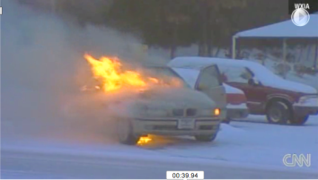
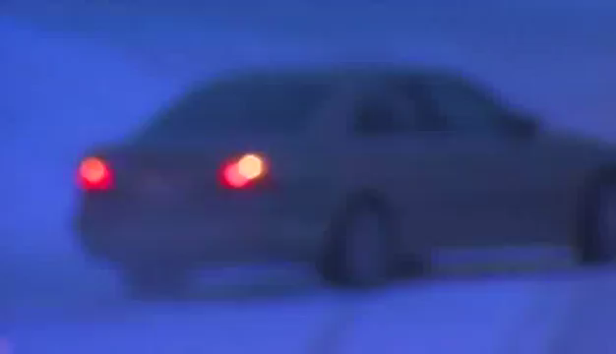
Engine Fire
Steer out of traffic, away from buildings, people, and other cars.
Have all occupants leave the car immediately and move away.
Do not open the hood.
PLAY VIDEO (:54)
Turn off the ignition if your engine catches fire. This will stop the fuel pump. Then get out quickly.
Notes:
PLAY VIDEO. A closed captioned video is available on YouTube here: https://youtu.be/G-gIsD3egr8.
If your car is on fire keep it away from flammable materials. You can start a forest fire if your car is on fire and you pull off the road into dry brush or grass.
Fires happen for many reasons. Make sure that when you are out of traffic and safely stopped, turn off the engine. The electric fuel pumps often continue to pump fuel onto the fire and make the situation worse. Turning off the ignition will shut the fuel pump off.
Get yourself and everyone else out of the car as quickly and safely as possible. Check to make sure everyone is out of the vehicle and assist those who need help, such as kids in car seats and elderly passengers.
Walk away from the car and let it go. Lifting the hood only provides oxygen for the fire and compounds the situation quickly. You need to contain the fire, not spread it.
Call 911 and stay away from the car. While most cars don’t explode like you see in the movies, a gasoline fire burns hot and your tires may blow up sending burning rubber and debris toward you.

Slide 11
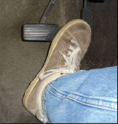
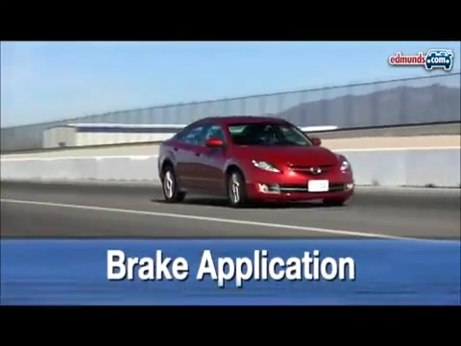
Stuck Accelerator
Aim to the target area.
Shift to neutral – open palm method.
Search for an escape path.
Steer smoothly.
Brake gently.
Pull off the roadway.
Turn off the ignition.
PLAY VIDEO (2:59)
Gas pedals can stick when a spring breaks, it catches on carpet or is held in the down position.
Notes:
PLAY VIDEO. A closed captioned video is available on YouTube here: https://youtu.be/3fL5VK4fCkA.
Carpets and floor mats can cause accelerators to stick in a down position, keeping the car accelerating and revving the engine or increasing speed. Keep your accelerator free of interference from loose carpets, mats or other objects.
Follow the actions on the slide. You can also try to unstick the pedal by pulling up under the accelerator pedal with your foot.
Shifting to neutral will cause the engine to race but will still give you power steering and power brakes. It may ruin the engine but it will allow you to pull off the road, stop the engine and then shut the engine off.

Slide 12
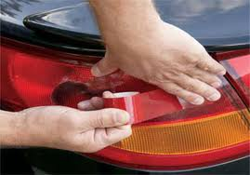
Malfunctioning head and tail lights
Montana law requires motor vehicles to have two functioning head lights.
At least one functioning tail light must be visible from a distance of 500 feet.
When head lights go out, try using high beam lights until you are able to replace the headlight bulb.
If your tail lights go out, you should replace the bulb and cover broken fixtures with red tape until repaired
Drivers risk being cited for driving without required lights.
Notes:
Identify problem lights by checking all vehicle lighting on a monthly basis, including the headlights, turn signals, brake lights, side lights, parking lights, taillights, backup lights and license plate lights.

Slide 13
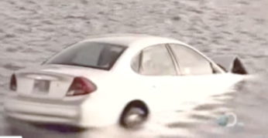
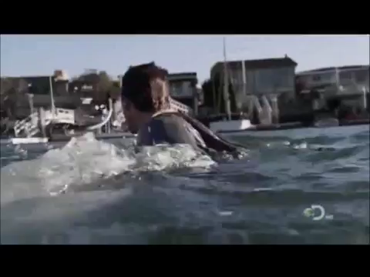
Submerged in Water
Act quickly, if possible, open door and exit.
Smash the window.
Keep your safety belt on.
Let car fill with water and pressure equalize.
Exit the vehicle.
PLAY VIDEO (:35)
Refer to the Emergency Kit for items that can help you escape a submerged vehicle.
Notes:
PLAY VIDEO. A closed captioned video is available on YouTube here: https://youtu.be/EQ6wjT9BBew.
Quick action and an emergency kit will come in handy if you find your vehicle starting to sink in a body of water. You might need to smash the window with a hammer or cut the seat belt to exit the vehicle. See Slide 24 for a list of items to keep in your emergency kit.
As little as six inches of fast-moving water can knock you off your feet. Fast-moving water two feet deep can wash away a vehicle

Slide 14
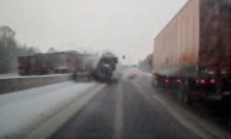
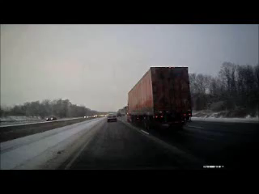
Head-on Evasion
Keep calm.
Aim through open escape path to the target area.
Keep off the pedals.
Three steering actions.
Use controlled braking.
PLAY VIDEO (:20)
Anything that startles you by blocking your path (wildlife, road debris, oncoming vehicle) may be averted if you see it.
Notes:
PLAY VIDEO. Video is also available on YouTube here: https://youtu.be/St-grBgWEBc.
The three steering actions are hard right, back left and then back right center to straighten vehicle.

Slide 15
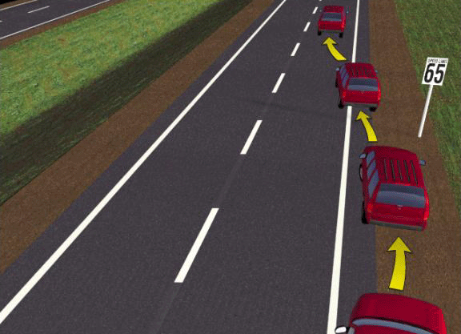
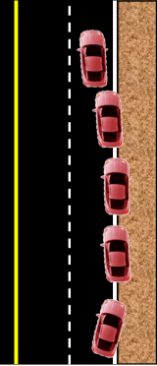
Off-Road Recovery
Don’t Panic - STOP and STEER onto road
Control steering, Don’t panic and steer too much. Hands at 9 and 3.
Slow down – feet off throttle.
Avoid braking.
Position for balance.
Safely stop – apply brakes slowly.
Check the slope of the shoulder!
Align edge of road to middle of car.
Steer onto road – 1/8 – 1/4 turn.
Counter steer back into lane – counter steering is double the first turn to counter balance the weight shift.
Notes:
Drifting off the road is often caused by fatigue or inattention. When a vehicle leaves the road, it can be tripped by soft surfaces, or roadway objects. Panic causes drivers startled by rumble strips and road departures to over-steer across the road. Drive along the road edge and slow. Hit the mile post markers and reflectors if you need to as you slow down and prepare to stop or steer back into your lane. Consider options and strategies as you scan the side of the roads you drive.
Rollovers are more likely to occur on rural roads and highways, particularly undivided, two-way roads or divided roads with no barriers and 70 mph speeds. Overcorrecting can be deadly.
RECOVERING SAFELY:
Remove foot from throttle and avoid braking – “When in doubt-both feet out “
Check slope of the shoulder and stop safely when possible.
Reduce speed to about 10 mph without using the brakes.
Balance and move the vehicle so that it straddles the roadway edge.
If necessary, brake lightly, check traffic.
Signal to return to the roadway.
Select a level location for returning to the road.
With hands at 9 and 3 o’clock, turn the wheel no more than 1/8 -1/4 turn back onto the road.
Counter steer back into lane ½ turn - counter steering is double the first turn to counter balance the vehicle weight shift
Look to the target and return to lane position one, check rear zone, cancel signal
Watch the Off Road Recovery video lesson in the Module 5.2 video folder. Advanced training is recommended before implementing off road recovery lessons. Learn more at the Montana DRIVE Summer Workshops in Lewistown

Slide 16


Skids and Traction Loss
Look – Where you want to go.
Steer – Where you want to go.
Off pedals – Release the brake or accelerator to maintain rolling traction.
Never give up - Maintain constant attention to steering until the vehicle is back under control.
Use trail braking if needed.
Notes:
Avoid traction loss by:
Controlling acceleration
Reducing speed
Reducing engine power
Actions when traction loss occurs:
Going downhill, shift to a lower gear
Avoid over-acceleration on slippery surfaces
Reduce speed
Reduce steering input
Trail braking if needed

Slide 17
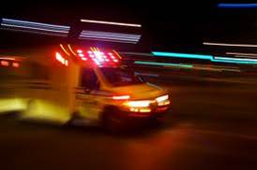
If you hear a siren …
Slow down and change lanes whenever possible. Remember the Move Over Law …
Notes:
Move Over Law (MCA 61-8-346) is also covered in Mixing With Traffic .
Class discussion: Why is it a good idea to move over to the next lane when you see a stopped emergency vehicle ahead? Remember that the Vehicle Control Sequence--seeing the need to move, checking the other lanes to make sure there is enough time and space to move over, and then executing the lane change in a safe and timely manner.
Remember S-I-R-E-N to know how to yield the right of way to emergency vehicles.
S Stay alert ─ keep the noise level down in the vehicle and look for more than one emergency vehicle approaching when a siren is heard.
I Investigate ─ check the rearview mirror, scan around the car, try to estimate the closing speed of the emergency vehicle to plan the next move.
R React ─ quickly and calmly scan in all directions, use the turn signal and exit the roadway without slamming on the brakes or pulling over suddenly.
E Enter ─ before reentering, scan in all directions; signal and gradually merge.
N Never ─ stop where there isn’t enough room to pull over safely and never follow or try to outrun an emergency vehicle

Slide 18
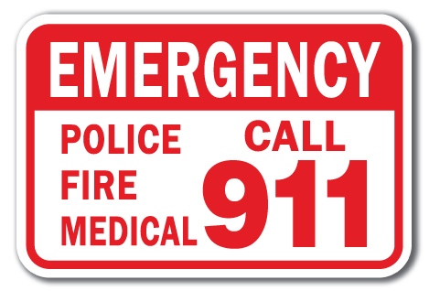
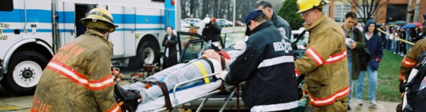
At the scene of a crash …
What do you do?
If you are involved, stop immediately,
regardless of how little damage appears.
Call 9-1-1 for medical assistance if anyone
is injured.
Do not move an injured person unless there is danger of fire or another collision.
Ensure all vehicles in the collision have engines turned off.
Set out reflectors to warn oncoming traffic.
Notes:
NHTSA photo courtesy of Office of Emergency Medical Services

Slide 19
Montana’s Good Samaritan Law…
This law helps protect rescuers who voluntarily help a victim in distress from being successfully sued in court. (i.e., for wrongdoing).
The law is designed to encourage people to help a stranger who needs assistance by reducing or eliminating the fear that, if they do so, they will suffer possible legal repercussions in the event that they inadvertently make a mistake when helping the victim.
Notes:
(MCA 27-1-714) Limits on liability for emergency care rendered at scene of accident or emergency.
Don’t hesitate to stop and assist others involved in a crash if you are concerned about liability. This law protects your good intentions

Slide 20
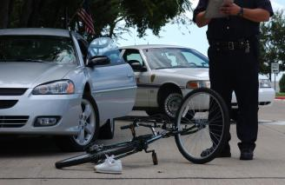
If you’re involved in a crash …
Exchange names, addresses, telephone numbers, and insurance company contact information.
Document the characteristics of the crash. Take photos.
If a vehicle is hit while parked and the owner is not present, the driver of the vehicle is legally obliged to leave a note with contact details on the windshield.
Notes:
Gather as much information about the collision as possible. This can help prevent disagreement concerning how the crash actually happened.
Time of day
Weather conditions
Road conditions
Street lighting or lack of lighting
Presence or length of skid marks
Get the names and addresses of any witnesses
Record the speed the vehicle was traveling
Draw a diagram of the location, include street names and locations of the vehicles, crosswalks, traffic lights and stop signs

Slide 21
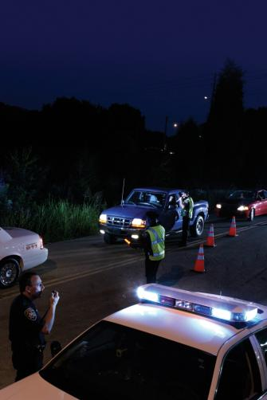
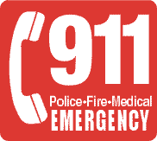
Call the police when …
Someone is injured or killed in the crash.
Property damage appears to be valued at more than $1,000.
Notes:
When a collision occurs, gathering as much information as possible may prevent problems resulting in a lawsuit.
A Montana crash report must be filed:
If a driver is involved in a crash where damage totals over $1,000, or someone is hurt or killed
Every driver must fill out a written report to the Highway Patrol within 10 days of the crash
The form can be obtained from any police, sheriff or patrol officer
Failure to report the crash could cause a driver’s license to be suspended
Montana law (MCA 61-7-108) requires the driver of a vehicle to immediately contact the local police department within the municipality the collision occurred, the county sheriff or nearest highway patrol office if there was an injury of death or property damage of at least $1,000.

Slide 22
Insurance Reporting Laws
Montana is a tort state, which means that drivers are financially responsible for the damage and injury they may cause during an auto accident.
Liability coverage is required in Montana. Insurance companies require the insured to contact the company immediately after a collision – regardless of the amount of damage or if you intend to file a claim.
The insurance company’s contact information and proof of coverage card should always be in the glove compartment or other secure place inside the car.
Notes:
Montana liability coverage is required of all drivers. The coverage must be 25/50/10:
$25,000 per person for injuries you cause to the other party,
up to $50,000 for all,
and $20,000 for any damage that you cause to the other driver’s car and/or property.

Slide 23
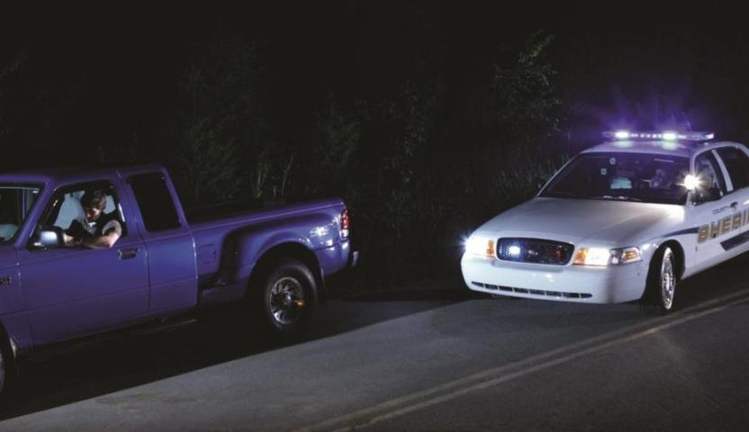
If you are pulled over…
Notes:
Note: The TE Resources video folder includes two short Traffic Stop clips. The clips can generate discussion about traffic stops and what a driver should do if they get pulled over and want to avoid a conflict with the officer.
If you see flashing lights and/or hear a siren behind you, immediately drive to a position parallel to, and as close as possible to, the nearest edge or curb of the roadway, clear of any intersection.
Stay in the vehicle, keep both hands on the steering wheel where they can be seen by the officer.
Do not start looking for any documents until after the officer asks for them.
The officer will probably ask the driver to roll down the window or may direct the driver to a different location.
All current vehicle registration, insurance, and driver’s license information should be within easy reach.
Drivers can be cited for not having a valid driver’s license, insurance or registration when requested

Slide 24
Always be prepared …
Essential items for your vehicle emergency kit:
Flashlight with reliable batteries
Ice scraper for winter driving
Pocketknife
First aid kit
Small hammer and seat belt cutter
Spare fuses
Emergency contacts
Keep in the trunk:
Battery jumper cables
Spare tire and sealant
Blanket
Fire extinguisher
Jack and lug wrench
Flares or reflective day/night devices
Dried nonperishable food
An empty gas can (never filled with fuel)
A plastic jug of water
WINTER DRIVING TIPS FROM THE MT DEPT OF TRANSPORTATION: http://www.mdt.mt.gov/visionzero/people/winterdriving.shtml
Notes:
An emergency requires quick action. Be prepared with a complete emergency kit. See the Emergency Kit Work Sheet for a student activity.
Place in the glove compartment:
The names, addresses, and telephone number of someone to call in an emergency
Spare fuses for the electrical system
A good flashlight with reliable batteries
An ice scraper for winter driving
A pocketknife
Keep in the trunk:
Battery jumper cables
Spare tire (properly inflated)
Can of tire sealant
Fire extinguisher
First aid kit
Jack and lug wrench for changing tires
Flares or reflective day/night devices
Blanket
Dried nonperishable food
An empty can to carry gasoline (if the vehicle runs out of gas) and
a plastic jug of water (if the engine’s radiator boils over and coolant is lost)
Never carry gas in the trunk - it is dangerous, and illegal in some places

Slide 25
Montana Driver Education and Training
Standards and Benchmarks
1. Laws and Highway System
1.1. know the laws outlined in the Montana Driver's manual;
1.2. understand the laws outlined in the Montana Driver’s Manual; and
1.3. consistently demonstrate knowledge and understanding by responsible adherence to highway transportation system traffic laws and control devices.
2. Responsibility
2.1. recognize the importance of making safe and responsible decisions for owning and operating a motor vehicle;
2.2 demonstrate the ability to make appropriate decisions while operating a motor vehicle;
2.3. consistently display respect for other users of the highway transportation system; and
2.4. develop positive habits and attitudes for responsible driving.
3. Visual Skills
3.1. know proper visual skills for operating a motor vehicle;
3.2. communicate and explain proper visual skills for operating a motor vehicle;
3.3. demonstrate the use of proper visual skills for operating a motor vehicle; and
3.4. develop habits and attitudes with regard to proper visual skills.
4. Vehicle Control
4.1. demonstrate smooth, safe and efficient operation of a motor vehicle; and
4.2. develop positive habits and attitudes relative to safe, efficient and smooth vehicle operation.
5. Communication
  5.1. consistently communicate driving intentions (i.e., use of lights, vehicle position, and personal signals);
  5.2. adjust driver behavior based on observation of the highway transportation system and other roadway users;
  5.3. adjust communication (i.e., use of lights, vehicle position, and personal signals) based on observation of the highway transportation system and other users; and
  5.4. develop positive habits and attitudes for effective communication.
6. Risk Management
  6.1. understand driver risk-management principles;
  6.2. demonstrate driver risk-management strategies; and
  6.3. develop positive habits and attitudes for effective driver risk-management.
7. Lifelong Learning
  7.1. identify and use a range of learning strategies required to acquire or retain knowledge, positive driving habits, and driving skills for lifelong learning;
  7.2. establish learning goals that are based on an understanding of one’s own current and future learning needs; and
  7.3. demonstrate knowledge and ability to make informed decisions required for positive driving habits, effective performance, and adaptation to change.
8. Driving Experience
  8.1. acquire at least the minimum number of BTW hours over at least the minimum number of days, as required by law, with a Montana-approved driver education teacher; and
  8.2. acquire additional behind-the-wheel driving experience with a parent or guardian’s assistance in a variety of driving situations (i.e., night, adverse weather, gravel road, etc.).
Notes:
Standards and Benchmarks: This is for your reference and not to be read to the class verbatim. Please review prior to the lesson so you are aware of what the student will be required to know at the end of the module.

