Slide 1

Module 5.4
Managing Risk with
Vehicle and Highway Design
Montana Teen Driver Education and Training
Notes:
Updated 2018

Slide 2
Managing Risk - Objectives
Students are expected to describe:
the crash survival features incorporated into highway and vehicular design;
collision types and actions to control the consequences of a crash;
how improved highway and vehicle technology helps minimize the consequences of a crash.

Slide 3
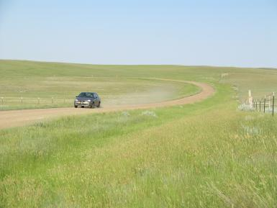
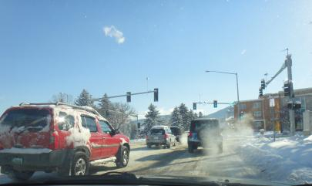
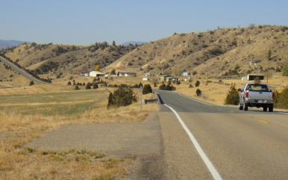
Vehicle and Highway Risks
Notes:
How Crashes Happen – “The road traffic system consists of three parts: the road and wider environment, the vehicle, and the individual (road user). The characteristics of these components and the interaction between them affect road traffic crashes and the resulting injuries. For example, a person who is driving on a road that is unlit, in a car that has bad brakes, or without wearing a seatbelt is more likely to be seriously injured than someone who is driving on a well-lit road, in a car that is in good condition, and is buckled up.”
Source: Youth and Road Safety Action Kit, YOURS – Youth for Road Safety (www.youthforroadsafety.org)
Montana Photos from MDT and OPI

Slide 4
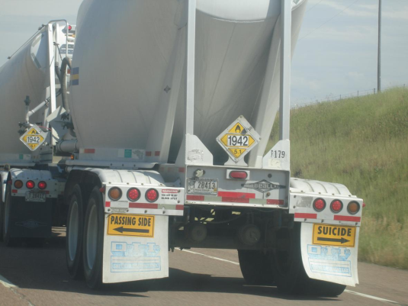
Is driving safe or dangerous?
Notes:
Discuss risk perception:
Am I focused on the right risks?
How do I know?
What will happen if I'm wrong?

Slide 5
Do you know someone who crashed?
One in five drivers is involved in a serious crash
One in eight drivers is seriously injured
One in three have a friend or relative seriously injured or killed in a crash
Notes:
Personal exposure with crashes.
AAA 2012 Traffic Safety Culture Index (AAAFTS.org)

Slide 6
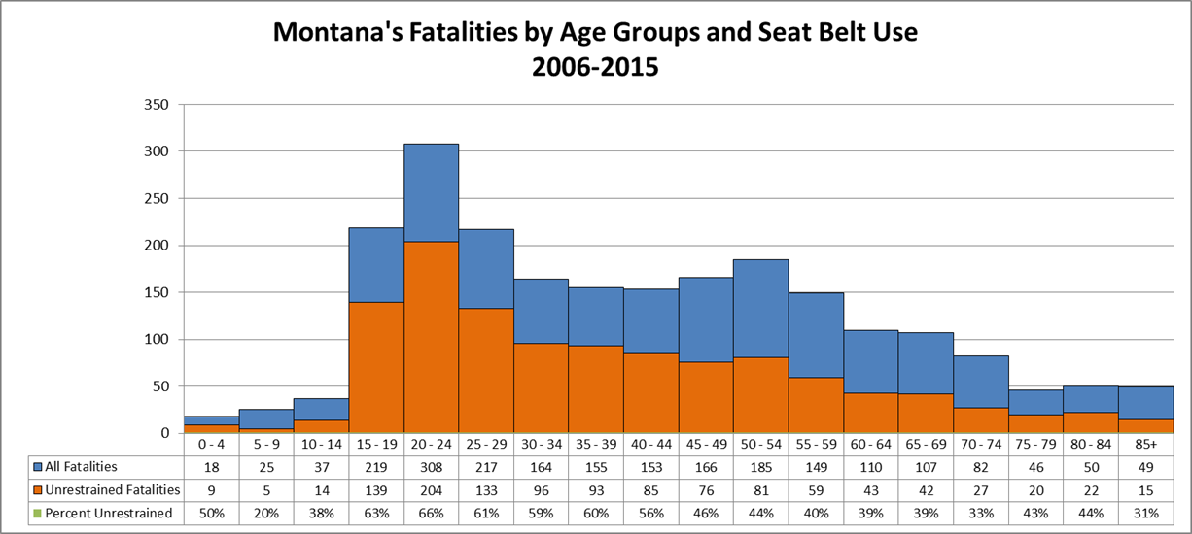
Teens & Young Adults at Risk
The deadly consequences of not buckling up
The orange section of the graphs shows how many people were not wearing seat belts and died in a crash.
Notes:
MDT Fatal Crash Data ten years 2006-2015

Slide 7
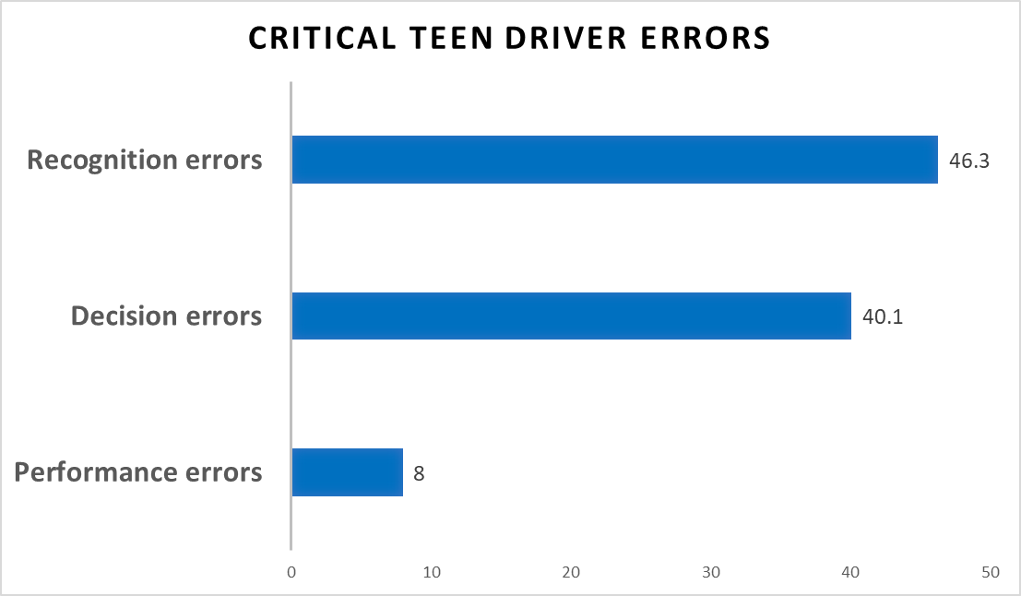
Driver error: 95.6% of crashes
Crashes involving 15 – 18 year old drivers
Notes:
Recognition errors: inadequate surveillance, distractions
Decision errors: following too closely, too fast for conditions
Performance errors: loss of control
Curry AE, Hafetz J, Kallan MJ, et al. Prevalence of teen driver errors leading to serious motor vehicle crashes. Accid Anal Prev. 2011 Jul;43(4):1285-90. Epub 2010 Nov 19
Analysis from National Motor Vehicle Crash Causation Survey RESULTS: 822 teen drivers were involved in 795 serious crashes, representing 335,667 teens in 325,291 crashes.
Driver error was by far the most common reason for crashes (95.6%), as opposed to vehicle or environmental factors.

Slide 8
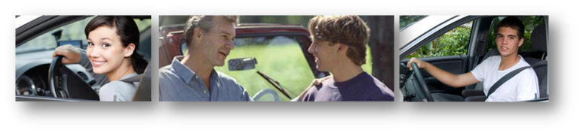
Driving Decisions
What are the risks facing young teen drivers?
  Inexperience
  Speed
  Distractions
  Fatigue
  Alcohol is involved in about 16% of fatal crashes involving 16- and 17-year-old drivers.
These factors cause crashes, but what kills?
Not wearing a seat belt …

Slide 9
Student Activity: Risk Factors
Risk on the road is complicated by….
Student groups of 2 or 3. Using the Risk Factors Worksheet:
List at least 10 driving risk factors
Identify strategies to manage driving risks
Risk = chance of injury, damage or loss
Notes:
Student Activity – Use the Risk Factors Worksheet and balls of different sizes/shapes.
Have students select several numbers from the list of typical risks and errors.
Toss balls to one student to represent an assortment of risks which can be handled one at a time, but are fumbled when there are many simultaneous risks.
Discuss strategies to manage risks while driving.

Slide 10
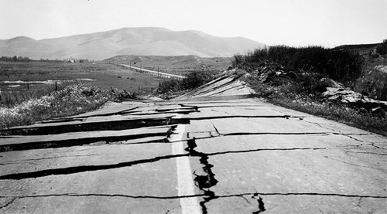
Engineering Road Safety Solutions
Notes:
“Systems engineering is the art and science of developing an operable system that meets requirements within imposed constraints. Systems engineering is holistic and integrative. Systems engineering is first and foremost about getting the right design - and then about maintaining and enhancing its technical integrity, as well as managing complexity with good processes to get the design right." - Excerpt from "The Art and Science of Systems Engineering" http://spacese.spacegrant.org/

Slide 11
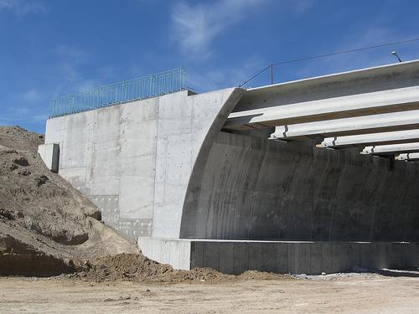
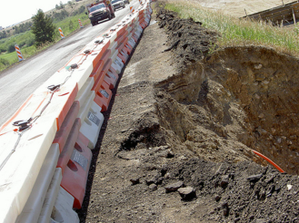
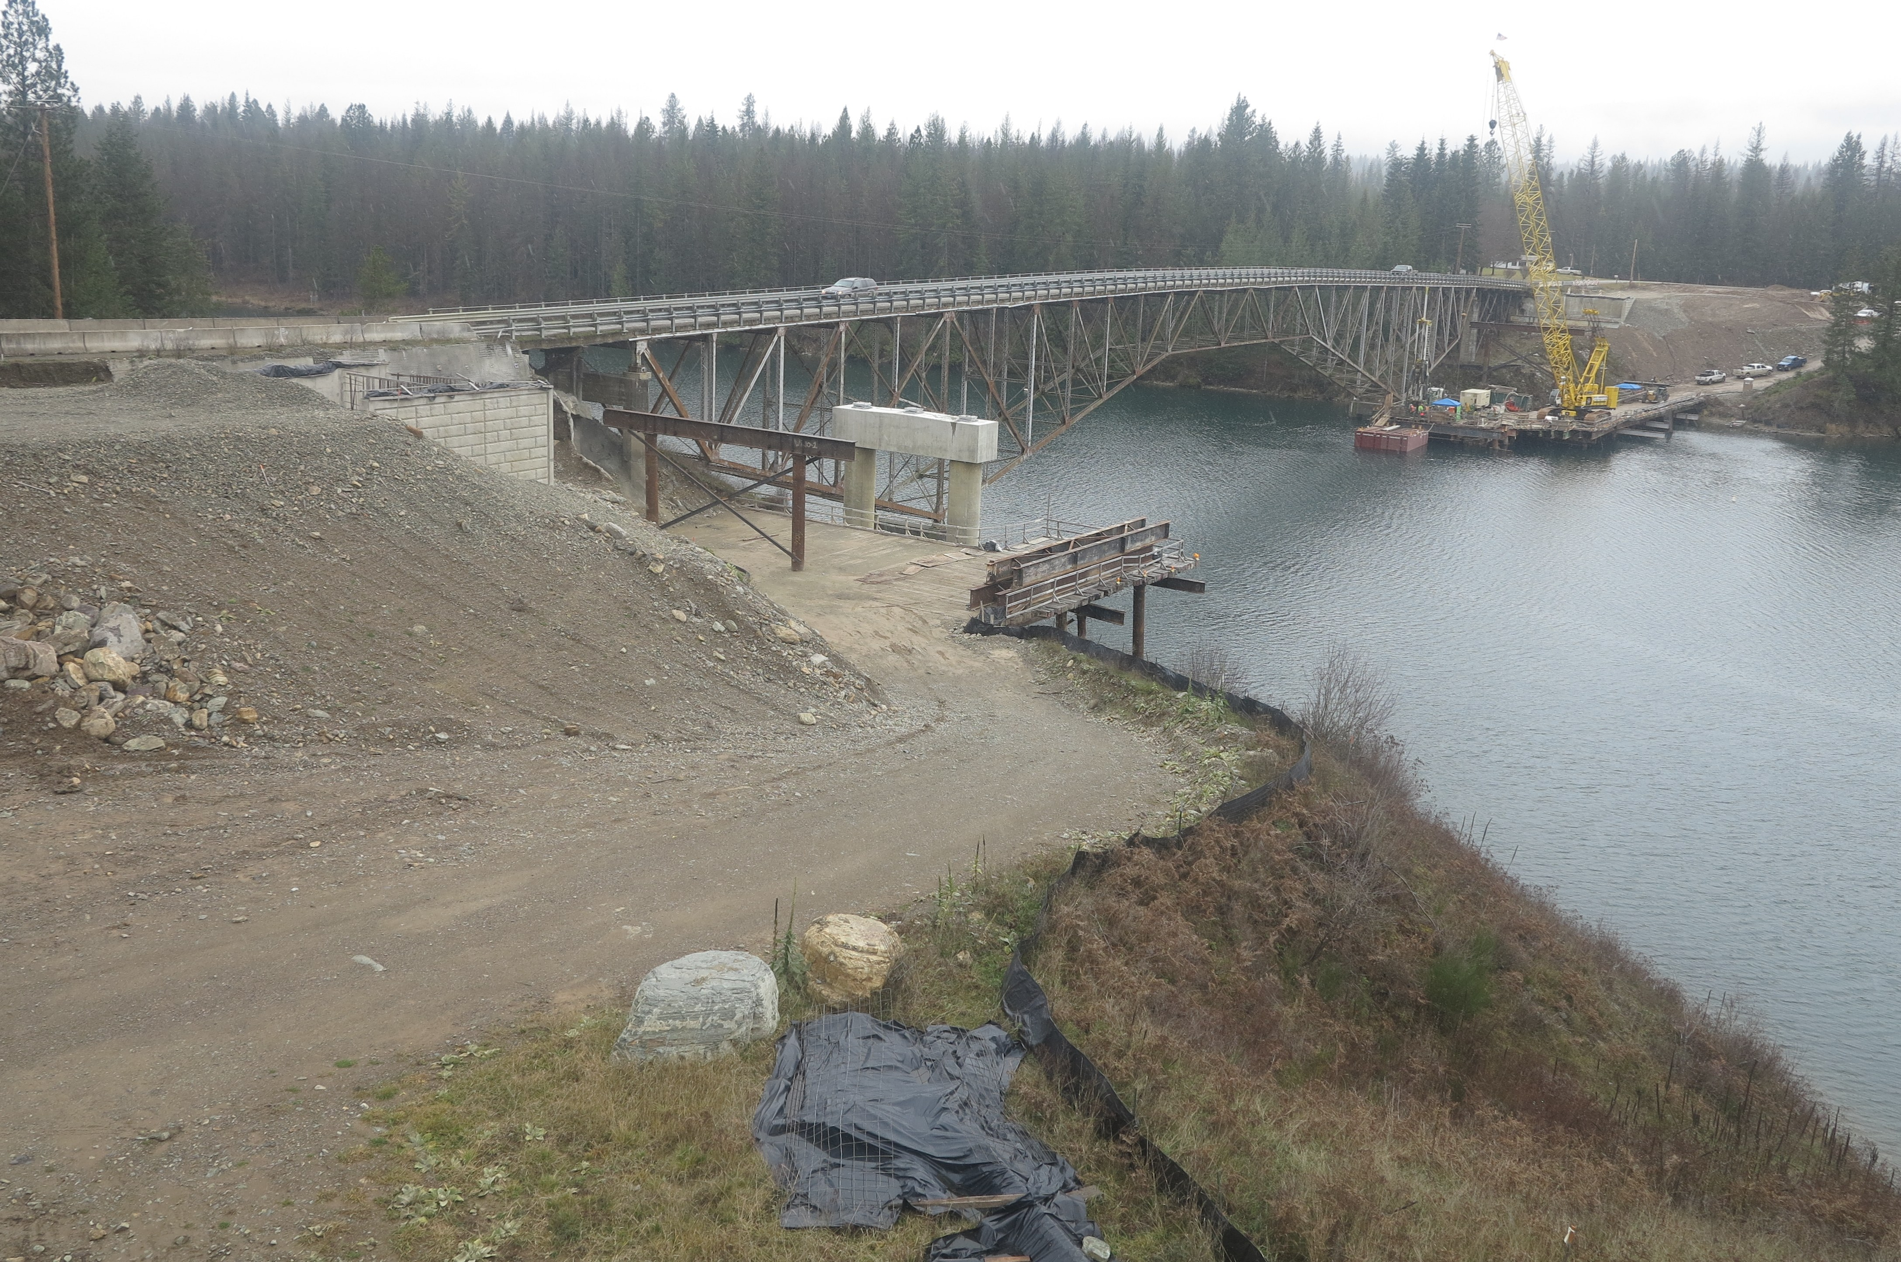
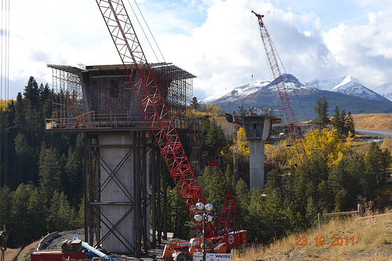
Improving Montana Roads and Bridges
Notes:
Two Medicine MT Bridge construction October, 2011 MDT photo
West Bozeman Interchange bridge beam placement, 2013

Slide 12
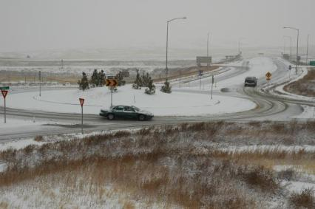
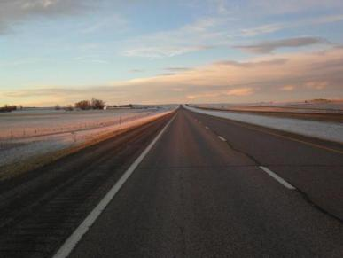
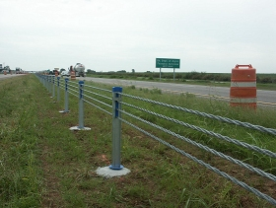
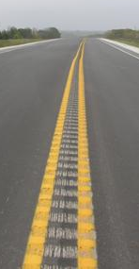
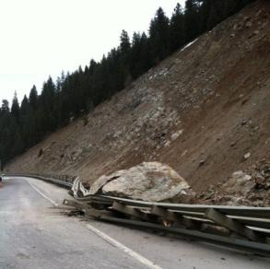
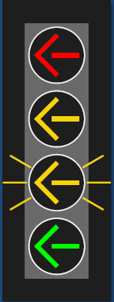
Cable barriers, roundabouts and more
Notes:
Cable median barrier installed to reduce crossover crashes
Rock fall barrier near Harrison, MT
Fog lines and rumble strips on side and center of two lane roads
Roundabouts reduce intersection crashes
Flashing yellow left-turn arrows

Slide 13

Crash Forces and Consequences
Three collisions in every crash:
Vehicle
Body
Internal Organs
Notes:
Crashing and Smashing
Extending the time of impact is the basis for many of the ideas about keeping people safe in crashes.
List three applications in vehicle or highway safety.
crumple zones 2. airbags 3. break-away light poles
Conserving Momentum and Energy - It’s the Law!
In a collision of two cars of unequal mass, the occupants of the lighter car would experience much higher accelerations , hence much higher forces than the occupants of the heavier car.
Motion-related energy is called kinetic energy . Energy due to an object’s position or conditions is called potential energy.
At what point in the pendulum's swing is its potential energy equal to its kinetic energy? (mid-point)
When is its kinetic energy at its maximum? (bottom)
Circle the correct formula for kinetic energy (KE).
KE = 1/2 m2v KE = 1/2 2mv2 KE = 1/2 mv2 KE = 1/2 mv2
Source – Understanding Car Crashes It’s Basic Physics by Griff Jones, Ph.D.

Slide 14
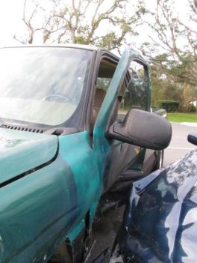
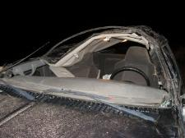
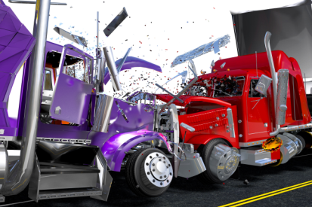
Collision Types
Rollover safety - cage intact.
Seat belt use saved teen drivers.
Notes:
Head on crash - simulated semi trucks
Side crash – 1998 GMC Sierra green truck hit at 45+ mph by blue Jaguar – seat belt use saved both drivers and one passenger. One broken wrist, bruises and two totaled vehicles
Roll Over crash – teen driving too fast on a curve at night. F250 crew cab truck rolled over 4 times. Seat belt use and rollover safety cage saved teen who suffered broken ankle and TBI – Traumatic Brain Injury.
Montana young drivers survived in these crashed pick up trucks due to seat belt use and rollover safety cage.
Physics – a collision is an event where momentum or kinetic energy is transferred from one object to another.
There are two general types – elastic and inelastic
Elastic – two objects bounce apart – example two rubber balls
Inelastic – two objects collide and do not bounce away from each other
A car bumper at low speeds conserves both momentum and kinetic energy to reduce damage. In a low speed collision, the kinetic energy is small enough that the bumper can deform and then bounce back, transferring all the energy directly back into motion. Almost no energy is converted into heat, noise, or damage to the body of the car, as it would in an inelastic collision at higher speeds.
http://www.volpe.dot.gov/sites/volpe.dot.gov/files/Truck_two_semitrucks_in_head-on_collision.jpg

Slide 15
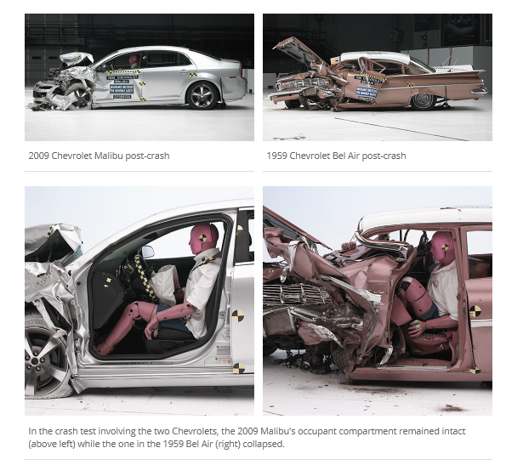
2009 Chevrolet Malibu vs.1959 Chevrolet Bel Air
Insurance Institute for Highway Safety
Notes:
40 mph frontal offset crash test 1959 and 2009 crashworthiness then and now.

Slide 16
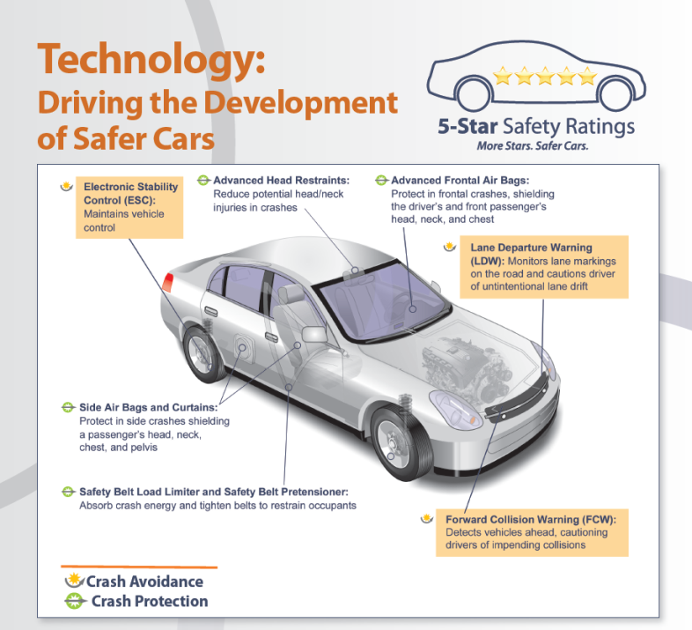
Notes:
IIHS Crash avoidance features are rapidly making their way into the vehicle fleet. Six of the most common new technologies are forward collision warning, auto brake, lane departure warning, lane departure prevention, adaptive headlights and blind spot detection.
Research continues to study how drivers respond to in-vehicle safety messages – audible, visual warnings and haptic feedback.
Graphics courtesy of http://www.safercar.org.

Slide 17
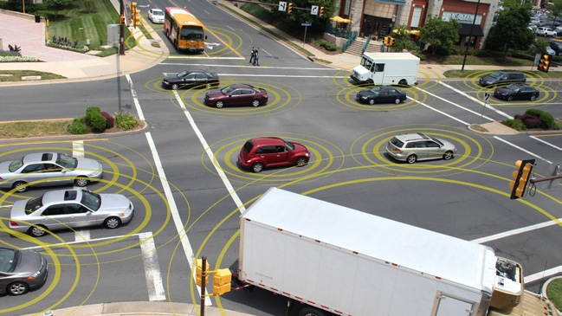
Will your next car or truck drive itself?
Notes:
Not Yet - When “self-driving” cars encounter complex situations like work zones the vehicle control shifts to the driver – who may be inattentive.
LIDAR – Google’ s self-driving car project employs Velodyne’s rooftop Light Detection and Ranging system which uses 64 lasers, spinning at upwards of 900 rpm to generate a point cloud that gives the car a 360 degree view.
Car is constantly acquiring targets - Analyzes and predicts the world 20 time a second. Relies on roadway marking and road rules.
Connected Vehicle Safety Pilot Program supports development of safety application based on vehicle–to-vehicle V2V and vehicle to infrastructure
Illustration from US Department of Transportation www.its.dot.gov
Research and Innovative Technology Administration

Slide 18
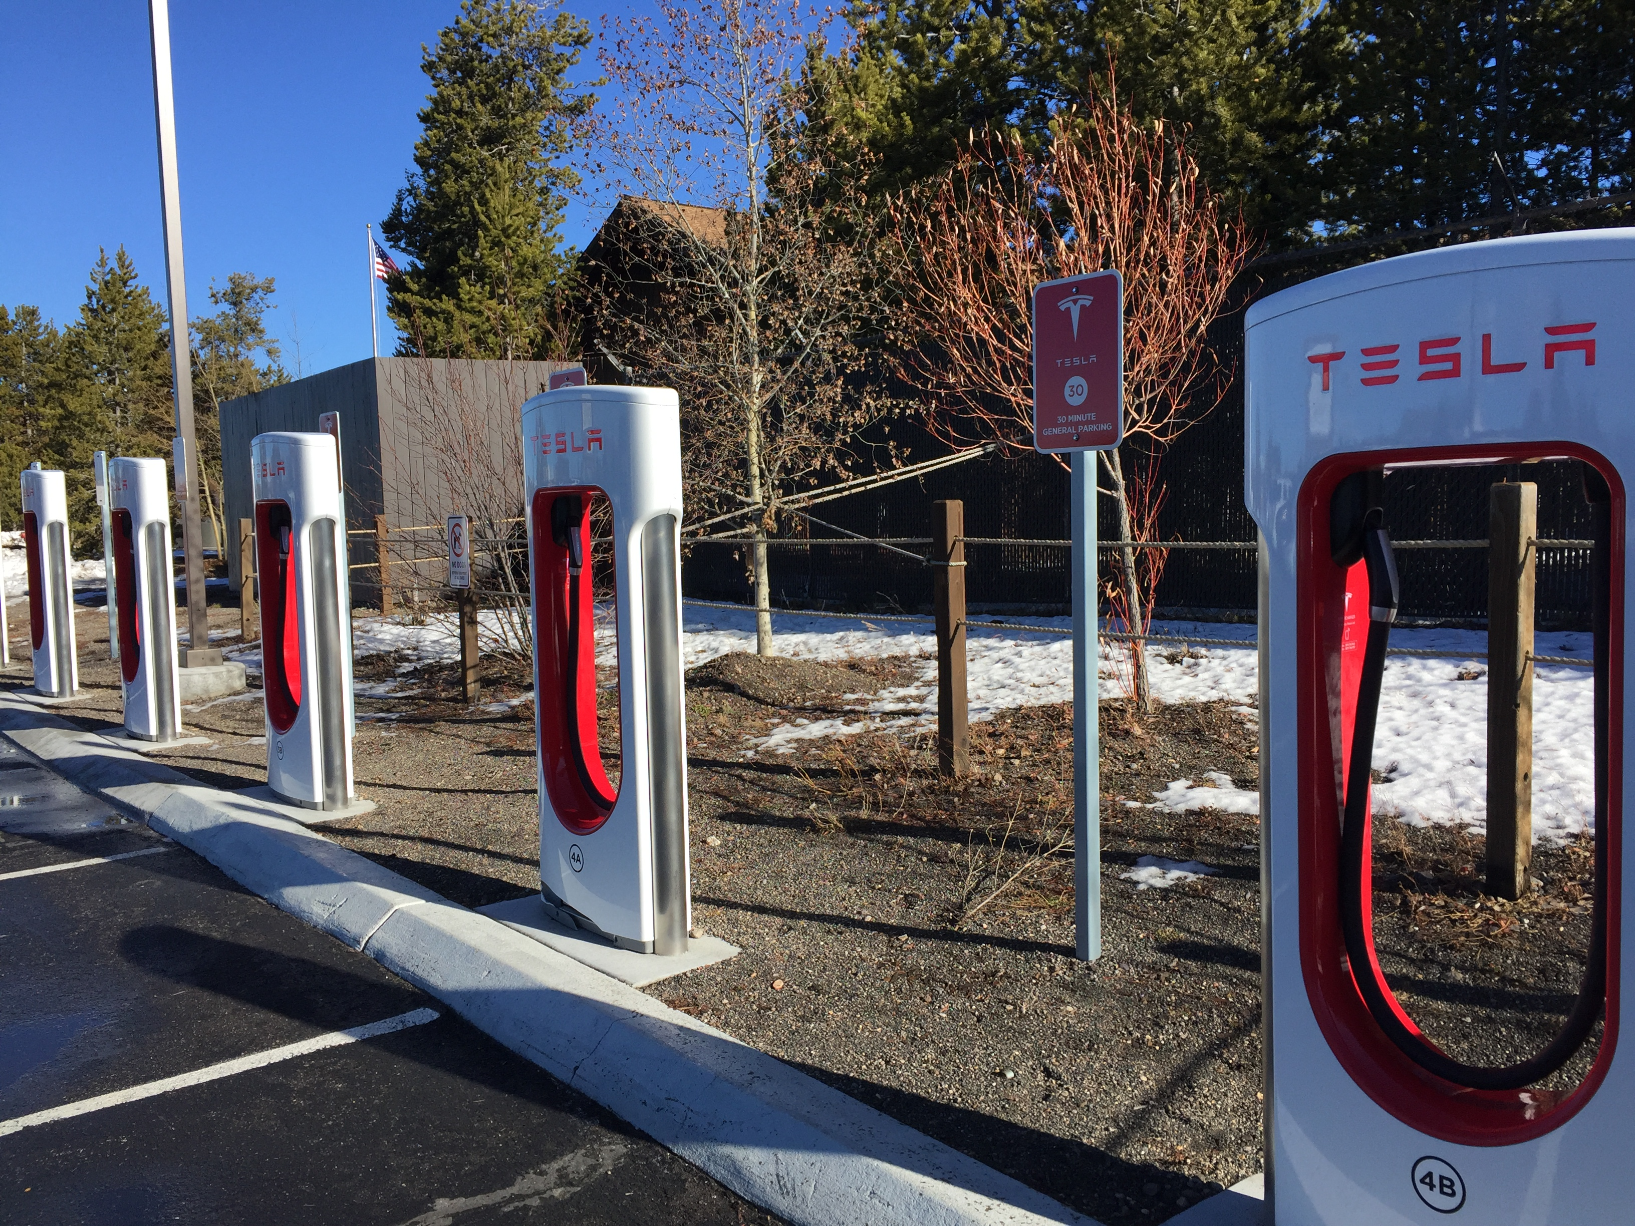
Developing Crash Prevention Technology
Self-driving cars* are
designed to assist drivers with specific tasks in limited environments.
Where do they work?
When do they fail?
*skilled & attentive drivers still required
Tesla Superchargers in West Yellowstone, MT, 2018
Electric Car Charging Stations
Notes:
2017 National Transportation Safety Board “Driver Errors, Overreliance on Automation, Lack of Safeguards, Led to Fatal Tesla Crash”
https://www.ntsb.gov/news/press-releases/Pages/PR20170912.aspx
2018 Insurance Institute for Highway Safety
http://www.iihs.org/iihs/topics/t/automation-and-crash-avoidance/topicoverview
2018 Wired.com review of recent autopilot car crashes
https://www.wired.com/story/tesla-autopilot-crash-dui/

Slide 19
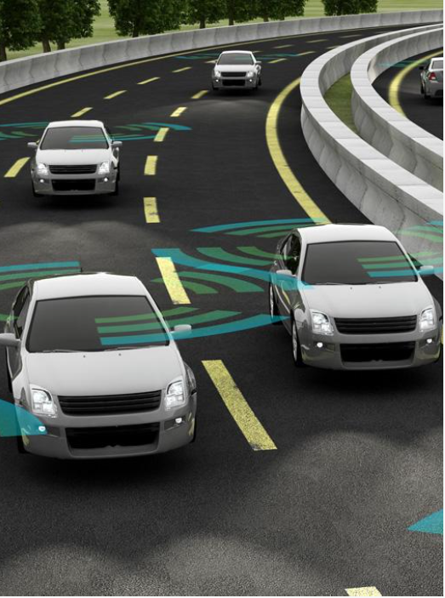
Automated Driving Systems*
Automatic Emergency Braking
Adaptive Cruise Control
Lane Keeping
Electronic Stability Control
ABS Brakes
Warnings
* Driver attention and engagement still required
Notes:
NHTSA
Adaptive Cruise Control designed to maintain a safe following distance and speed
Automatic Emergency Braking (AEB) on all new vehicle 2015
AEB systems use on-vehicle sensors such as radar, cameras or lasers to detect an imminent crash, warn the driver and, if the driver does not take sufficient action, engage the brakes.
Six of the most common new technologies are forward collision warning, auto brake, lane departure warning, lane departure prevention, adaptive headlights and blind spot detection.

Slide 20
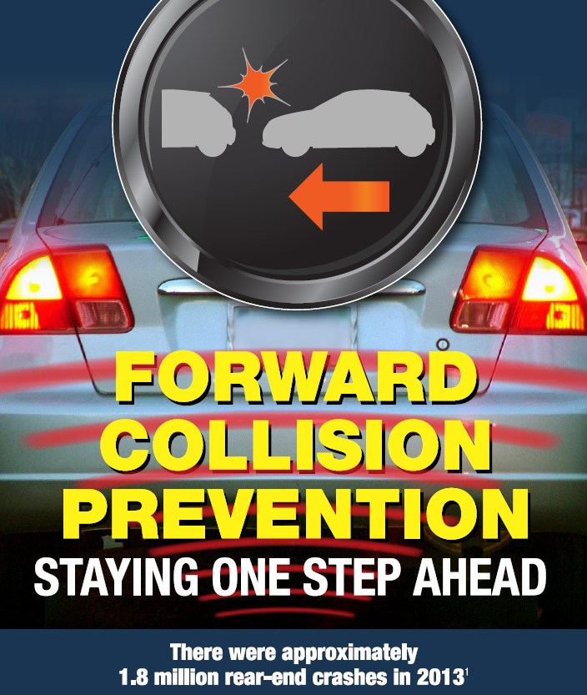

Forward Collision Prevention
How does it work?
Scans the road and detects how far and fast the vehicle in front of you may be moving.
Forward Collision Warning (FCW) –
Warns with beep or vibration.
Automatic Emergency Braking (AEB)
Warns driver and applies the brakes to slow or stop the vehicle if the driver does not.
It does not work when …
These features are camera- or radar-based and can be obstructed by buildups of ice and snow or “blinded” by sunrise and sunset glare.
Notes:
MyCarDoesWhat.org 2018
Permission to reprint granted by the National Safety Council)

Slide 21
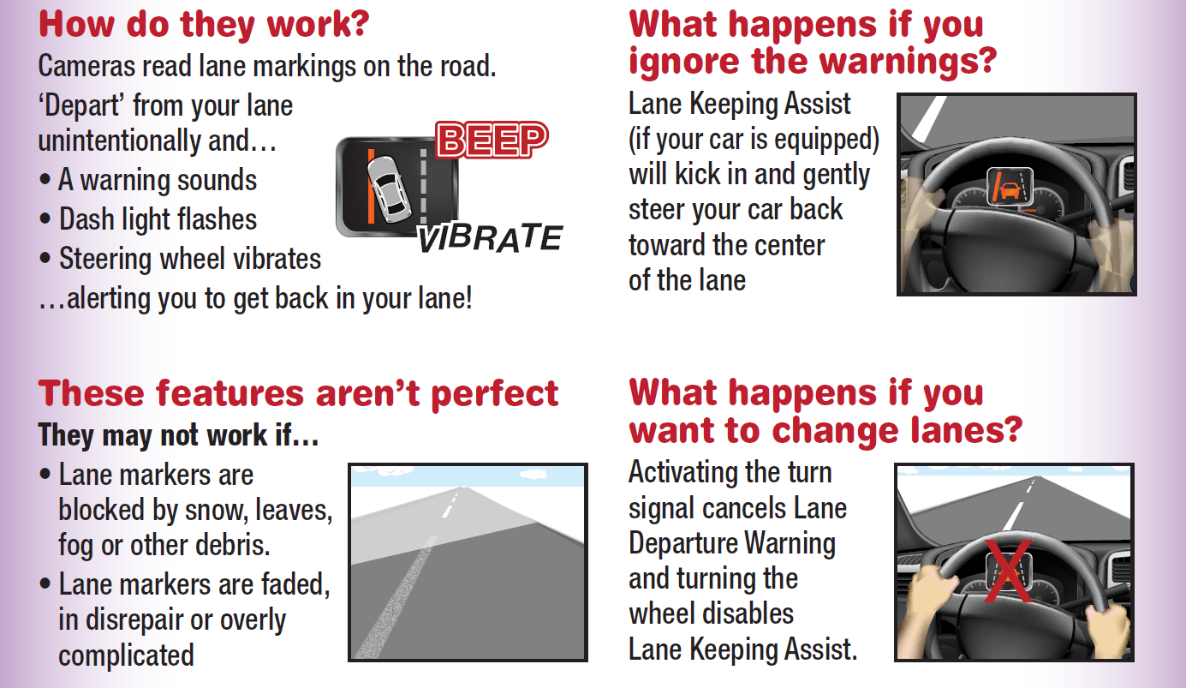
Keeping You In Line
Lane Departure Warning & Lane Keeping
Notes:
Permission to reprint granted by the National Safety Council
MyCarDoesWhat.org (2018)
Also discuss rumble strips along road edges and in center lines.

Slide 22
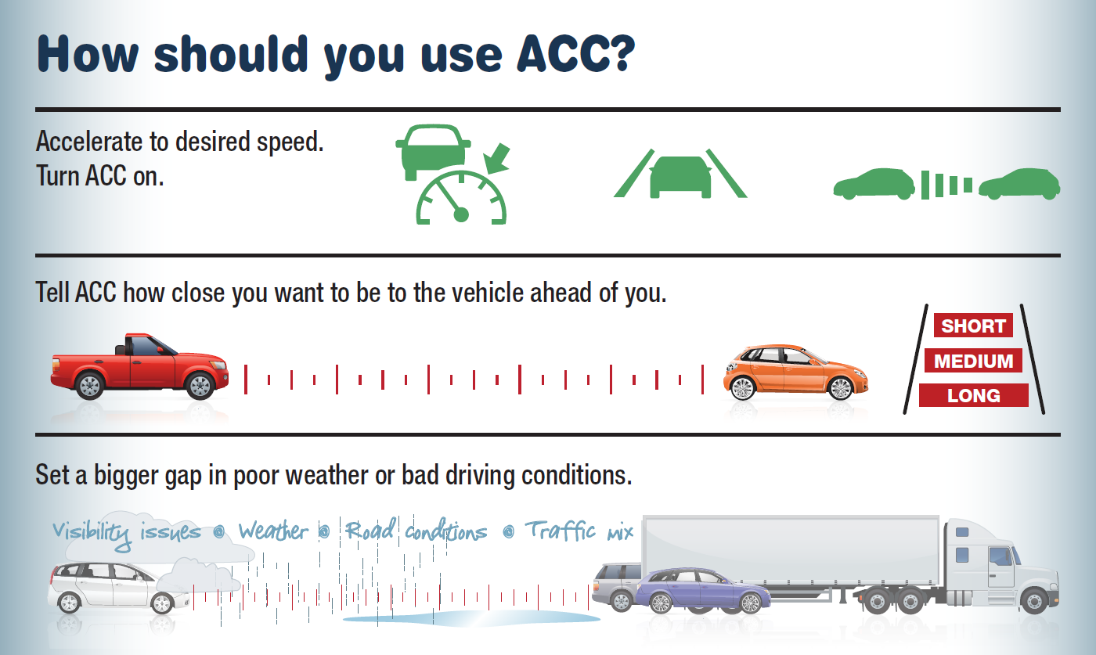
Adaptive Cruise Control (ACC)
Notes:
Permission to reprint granted by the National Safety Council
MyCarDoesWhat.org - Adaptive Cruise Control
Should work well: Clear day and night driving, light weather conditions.
May not work well: noisy open-air conditions, heavy rain, fog or snow, or when sensors are covered by ice, snow, dirt.
How does ACC work? Automatically speeds up and slows down your vehicle to keep a set distance between you and the vehicle ahead. Advanced version works in heavy traffic. When traffic stops, you stop. When traffic goes, you go.

Slide 23
Driver Decisions
What actions can you take to avoid and control crash consequences?
What will you do when a dashboard light flashes or a buzzer sounds?
When you feel the rumble strips on the road, what do you do?

Slide 24
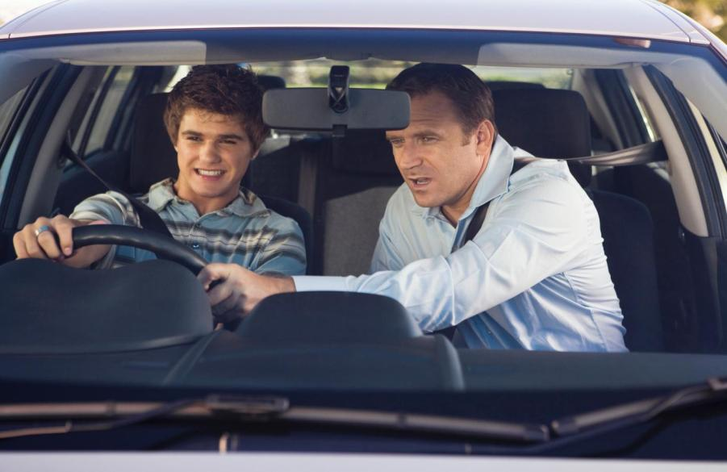
Highest lifetime crash risk
is in the first year of driving.
Notes:
Support greater parent involvement in the learning to drive process. Montana requires 50 hours of parent supervised driving. According to a recent naturalistic study, parents know their teens need lots of practice during the learner phase but cannot articulate specifics. Parents typically cover vehicle handling and maneuvering skills under benign conditions (i.e., little to no traffic, nice weather) but do not teach skills such as scanning for hazards or regulating speed for driving conditions. CHOP research shows these skill deficits lead to a significant portion of driver error-related teen crashes. Parents also need to have their teens practice in a variety of settings, including with commuter traffic, on rural and urban roads, and in inclement weather. Share the study with policymakers to advocate for greater parent involvement in the learning to drive process.
Support driver education/training policies that bolster the role of driver ed instructors (DEIs). In this expanded role, DEIs could continue to teach teens driving skills, as well as supervise parents in practicing those skills and promote the deliberate interaction between DEIs, parents, and teens to ensure new skills are assessed at each stage and mastered before the teens advance toward licensure.

Slide 25
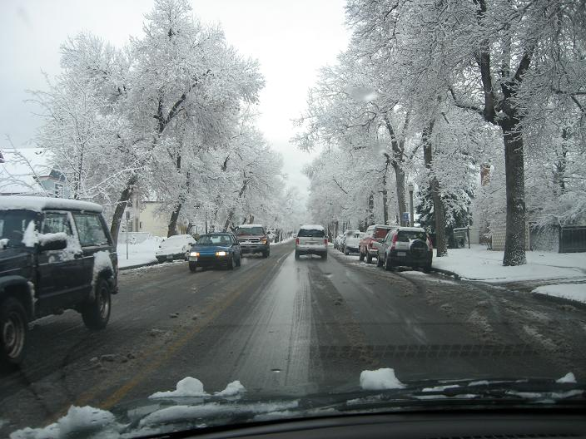
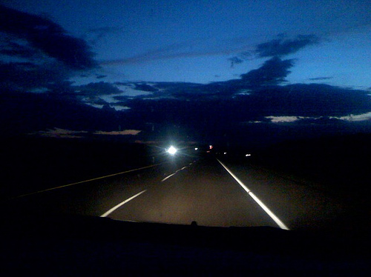
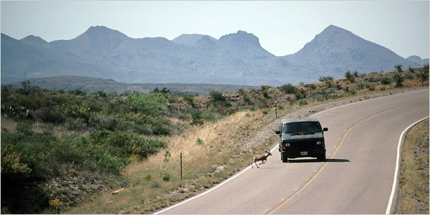
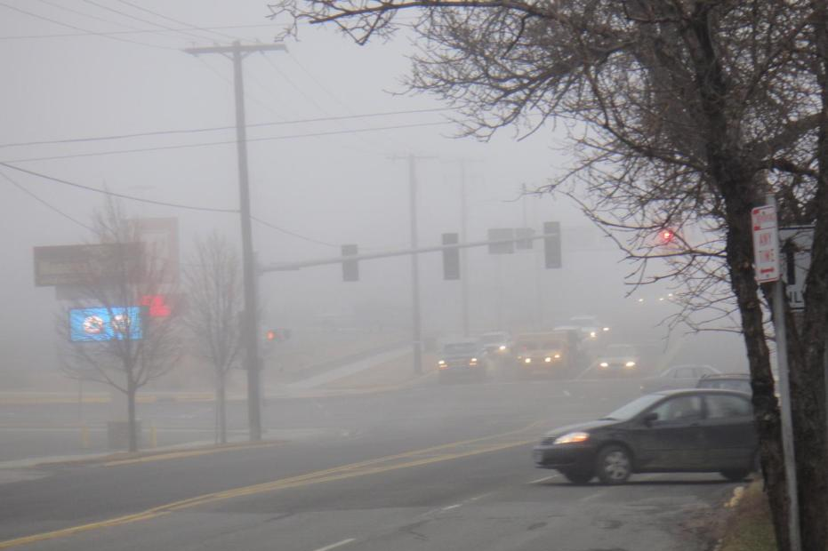
Practice, practice, practice!
Practice driving at night and in different road and weather conditions.
Notes:
Best Practices - Steering control, lane position, and speed control can be taught by using lightly traveled rural roads; good visual habits are essential to the development of all three skills. Practice in varied weather and road conditions
CHOP 2011
http://www.teendriversource.org/more_pages/page/_driver_ed_as_part_of_gdl/support_gov
Understand parents' crucial role. Teens who say their parents set rules and are highly supportive (known as “Authoritative”), are half as likely to crash and less likely to drive intoxicated, speed, or use a cell phone while driving. They also are more likely to buckle up than teens with less involved parents.

Slide 26
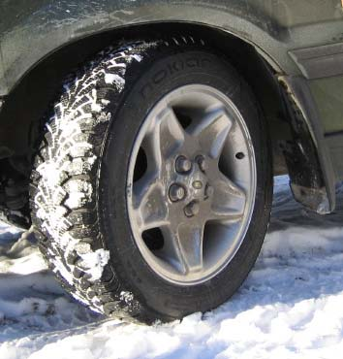
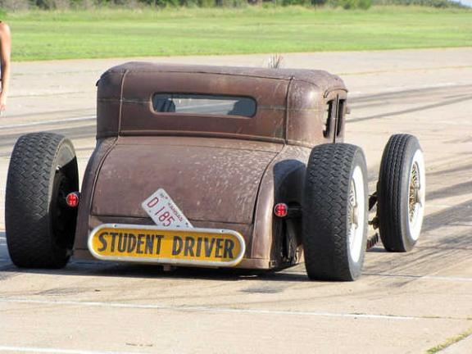
Friction and Traction
Worn tire tread can keep you from stopping quickly and from controlling your vehicle.
Notes:
Friction and traction
Worn tire tread can keep you from stopping quickly and from controlling your vehicle.

Slide 27
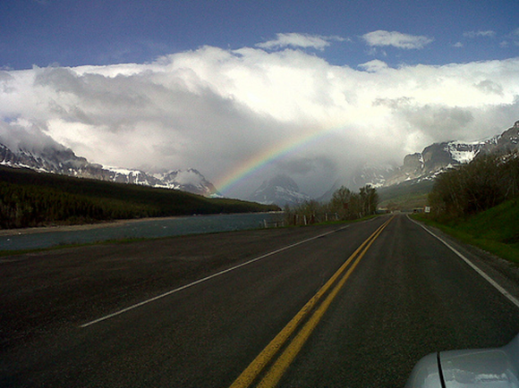
Five-Star Drivers Five-Star Vehicles
Five-Star Roads
Notes:
We need Five Star Drivers – Five Star Vehicles – Five Star Roads to travel safely

Slide 28
Montana Driver Education and Training
Standards and Benchmarks
1. Laws and Highway System
  1.1. know the laws outlined in the Montana Driver's manual;
  1.2. understand the laws outlined in the Montana Driver's Manual; and
  1.3. consistently demonstrate knowledge and understanding by responsible adherence to highway transportation system traffic laws and control devices.
2. Responsibility
  2.1. recognize the importance of making safe and responsible decisions for owning and operating a motor vehicle;
  2.2 demonstrate the ability to make appropriate decisions while operating a motor vehicle;
  2.3. consistently display respect for other users of the highway transportation system; and
  2.4. develop positive habits and attitudes for responsible driving.
3. Visual Skills
  3.1. know proper visual skills for operating a motor vehicle;
  3.2. communicate and explain proper visual skills for operating a motor vehicle;
  3.3. demonstrate the use of proper visual skills for operating a motor vehicle; and
  3.4. develop habits and attitudes with regard to proper visual skills.
4. Vehicle Control
  4.1. demonstrate smooth, safe and efficient operation of a motor vehicle; and
  4.2. develop positive habits and attitudes relative to safe, efficient and smooth vehicle operation.
5. Communication
  5.1. consistently communicate driving intentions (i.e., use of lights, vehicle position, and personal signals);
  5.2. adjust driver behavior based on observation of the highway transportation system and other roadway users;
  5.3. adjust communication (i.e., use of lights, vehicle position, and personal signals) based on observation of the highway transportation system and other users; and
  5.4. develop positive habits and attitudes for effective communication.
6. Risk Management
  6.1. understand driver risk-management principles;
  6.2. demonstrate driver risk-management strategies; and
  6.3. develop positive habits and attitudes for effective driver risk-management.
7. Lifelong Learning
  7.1. identify and use a range of learning strategies required to acquire or retain knowledge, positive driving habits, and driving skills for lifelong learning;
  7.2. establish learning goals that are based on an understanding of one’s own current and future learning needs; and
  7.3. demonstrate knowledge and ability to make informed decisions required for positive driving habits, effective performance, and adaptation to change.
8. Driving Experience
  8.1. acquire at least the minimum number of BTW hours over at least the minimum number of days, as required by law, with a Montana-approved driver education teacher; and
  8.2. acquire additional behind-the-wheel driving experience with a parent or guardian’s assistance in a variety of driving situations (i.e., night, adverse weather, gravel road, etc.).
Notes:
Standards and Benchmarks: This is for your reference and not to be read to the class verbatim. Please review prior to the lesson so you are aware of what the student will be required to know at the end of the module.

