Slide 1

Montana Teen Driver Education and Training
Module 6.2
How Alcohol and Other Drugs
Affect the Driving Task
Making Life-Saving Decisions
Notes:
REVISED 2018

Slide 2
Objectives:
Drinking, Drugs and Teen Driving
Responsibility and Risk Management
  Brain – still under construction
  Effects on brain
  Effects on body
  Alcohol, Blood Alcohol Concentration (BAC ) and elimination
  Other drugs
  Effect of alcohol and other drugs on the driver
  DUI-related crashes in Montana
  Keep impaired drivers off the road

Slide 3
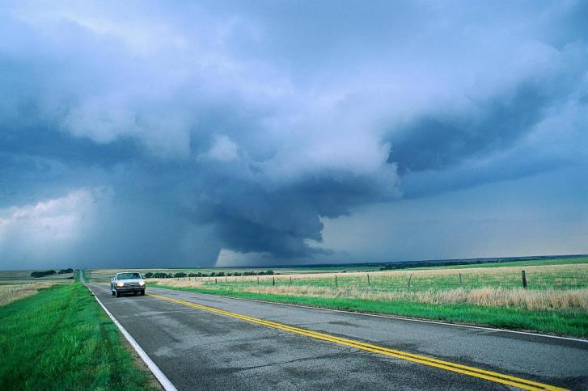
Let’s talk about the consequences of driving under the influence of alcohol and other drugs
In the U.S., about 5,000 people under age 21 die each year from injuries caused by underage drinking, nearly 40 percent (1,900) in car crashes.
Notes:
Drinking alcohol and using drugs results in a higher crash rate.
Drugs and alcohol impact human behavior and judgment.
No person is too skilled, too big or too clever to avoid the effects.
Research shows that a single drink increases the risk of death or serious injury by five times.
Data source: Underage Drinking: https://pubs.niaaa.nih.gov/publications/

Slide 4
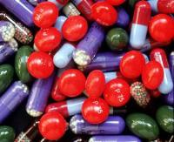
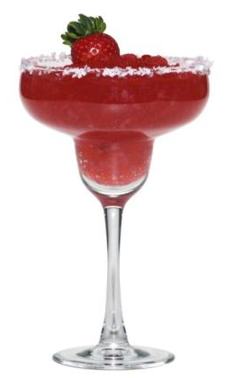
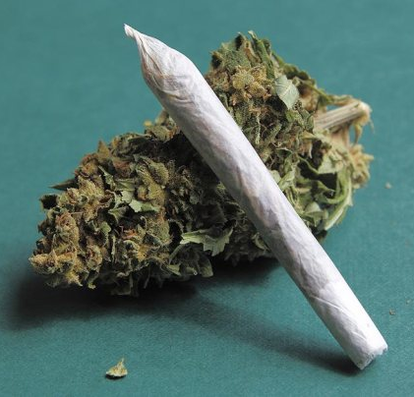
Different drugs do different things.
But all chemicals affect the brain—
that’s why drugs make you feel high, low, speeded up, slowed down, or see things that aren’t there.
All drugs affect your driving.
Notes:
Research shows that a single drink increases the risk of death or serious injury by five times.
Road Safety: Alcohol and Drink Driving. Adelaide, Department of Transport, Energy and Infrastructure, Government of South Australia. (www.dtei.sa.gov.au/roadsafety/Safer_behaviours/alcohol_drink_driving)
NIDA 2011 Drug Facts Shatter the Myths - http://teens.drugabuse.gov/
National Institute on Drug Abuse National Institute of Health 2011

Slide 5
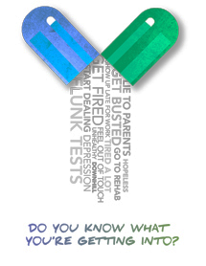
You know drugs make you feel Fuzzy, but why?
What do drugs do to your brain?
How can drugs affect your driving?
Notes:
NIDA 2011 Drug Facts Shatter the Myths - http://teens.drugabuse.gov/
National Institute on Drug Abuse National Institute of Health 2011

Slide 6
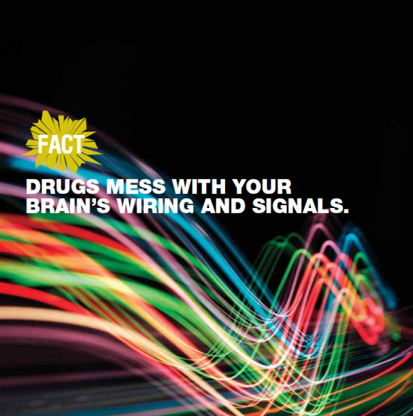
WATCH VIDEOS, PLAY GAMES, LEARN MORE
Shatter the Myths - http://teens.drugabuse.gov
Notes:
VISIT THIS SITE FOR FACTS, VIDEOS, GAMES FOR TEENS
Drug Facts - Shatter the Myths - http://teens.drugabuse.gov/
National Institute on Drug Abuse, National Institute of Health

Slide 7
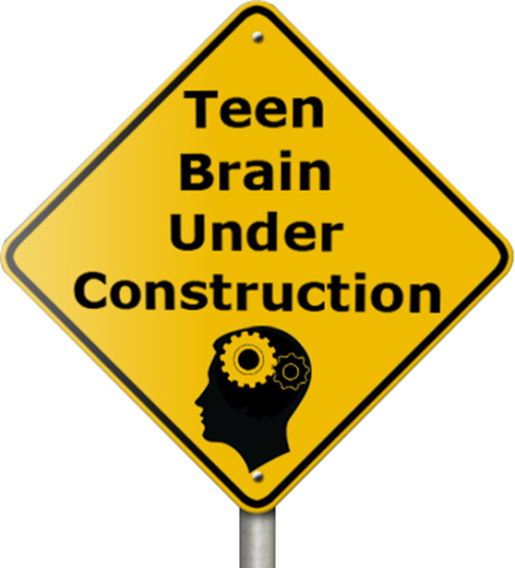
The brains and bodies of teens are still developing.
Notes:
The brains and bodies of teens are still developing; alcohol use can cause learning problems or lead to adult alcoholism.
For example, people who begin drinking before age 15 are four times more likely to develop alcoholism than those who begin after age 20.
Montana Prevention Resource Center 2010 Underage Alcohol Prevention Connection Newsletter
www.prevention.mt.gov

Slide 8
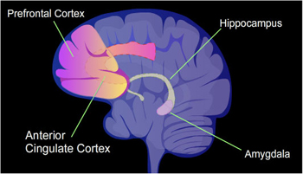
Your One and Only Brain
The Prefrontal Cortex is responsible for executive functioning. It is still developing beyond age 20.
The Prefrontal Cortex is responsible for:
Selective attention
Decision-making
Self-regulation
Judgment
Planning
Notes:
Photo and information from National Institute of Health nimh.nih.gov
Amygdala—The brain's "fear hub," which activates our natural "fight-or-flight" response to confront or escape from a dangerous situation. The amygdala also appears to be involved in learning to fear an event, such as touching a hot stove, and learning not to fear, such as overcoming a fear of spiders. Studying how the amygdala helps create memories of fear and safety may help improve treatments for anxiety disorders like phobias or post-traumatic stress disorder (PTSD).
Prefrontal cortex (PFC)—Seat of the brain's executive functions, such as judgment, decision making, and problem solving. Different parts of the PFC are involved in using short-term or "working" memory and in retrieving long-term memories. This area of the brain also helps to control the amygdala during stressful events. Some research shows that people who have PTSD or ADHD have reduced activity in their PFCs.
Anterior cingulate cortex (ACC)— the ACC has many different roles, from controlling blood pressure and heart rate to responding when we sense a mistake, helping us feel motivated and stay focused on a task, and managing proper emotional reactions. Reduced ACC activity or damage to this brain area has been linked to disorders such as ADHD, schizophrenia, and depression.
Hippocampus—Helps create and file new memories. When the hippocampus is damaged, a person can't create new memories, but can still remember past events and learned skills, and carry on a conversation, all which rely on different parts of the brain. The hippocampus may be involved in mood disorders through its control of a major mood circuit called the hypothalamic-pituitary-adrenal (HPA) axis.
http://www.nimh.nih.gov/health/educational-resources/brain-basics/brain-basics.shtml 2013

Slide 9
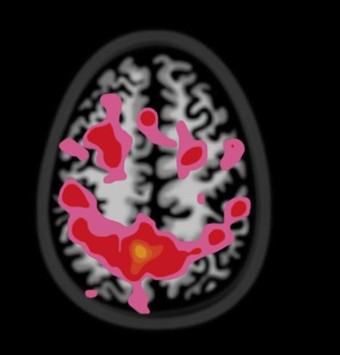
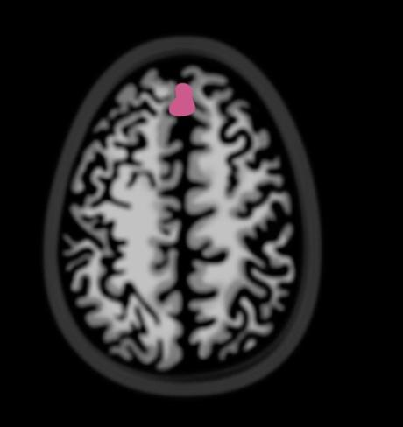
15-year-old Non-Drinker 15-year-old Heavy Drinker
Pink areas indicate brain activity during memory task
Positron emission tomography - PET Scan brain images
Susan Tapert, PhD - Used with permission
Notes:
A study was performed on teens and drinking. Scans illustrate that drinking might harm the ability of a teen’s brain to process information. This slide shows brain activity of a 15 year old with an alcohol problem versus the brain activity of a non-drinking 15 year old. The pink shows brain activity. It is clear that the teen who does not drink has much more activity.
So drinking relates to various short term and long term effects on the body. It could also have a long term effect in the sense that it could affect your future by decreasing brain function during prime learning periods.
2012 permission granted for photo use in this PowerPoint by Susan Tapert, PhD Acting Chief, Psychology Service, VASDHS Professor of Psychiatry, UCSD
Brown SA, Tapert SF, Granholm E, Delis DC (2000). Neurocognitive functioning of adolescents: effects of protracted alcohol use. Alcoholism: Clinical and Experimental Research. 24 (2): 164-171. [Cited 20 June 2005].
CDC SHER - http://apps.nccd.cdc.gov/sher/:

Slide 10
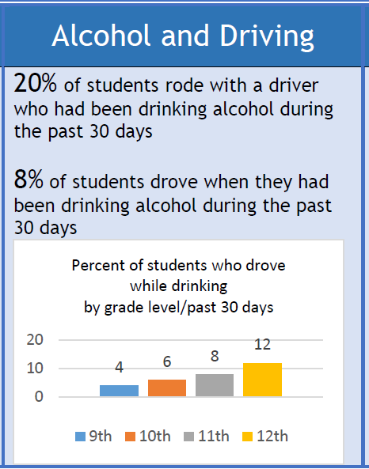
Montana Youth Risk Behavior Survey 2017
Notes:
Alcohol Use: While less than 10% of teens report drinking and driving within the prior month, nearly 4 out of every 10 teens behind the wheel who died in a crash had blood alcohol content (BAC) levels of > 0.01 percent.

Slide 11
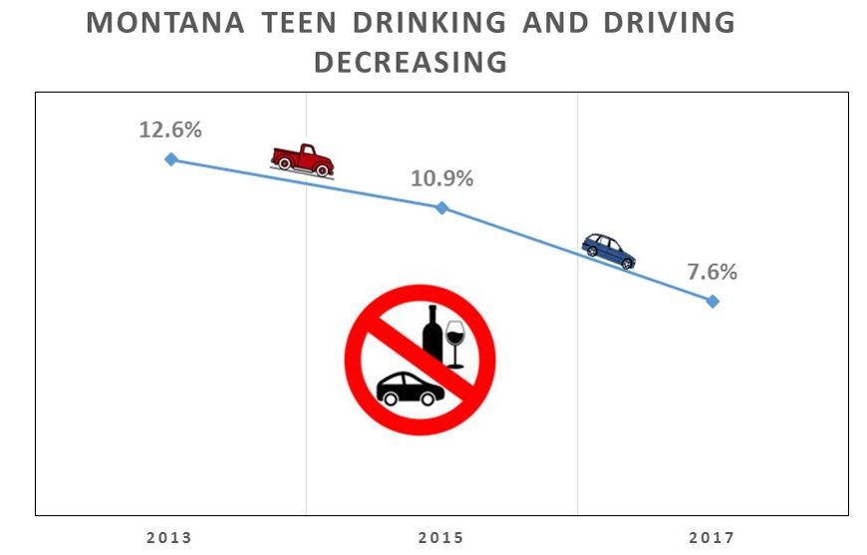
Montana Youth Risk Behavior Survey Trends 2017
Notes:
Montana teens are making smart choices about drinking and driving.
YRBS Trends QN10: Percentage of students who drove a car or other vehicle when they had been drinking alcohol (one or more times during the 30 days before the survey, among students who had driven a car or other vehicle during the 30 days before the survey)
In 2017 Montana YRBS reported one third of high school students( 33.1%) as the percentage of students who currently drank alcohol (at least one drink of alcohol, on at least 1 day during the 30 days before the survey)
http://opi.mt.gov/Portals/182/Page%20Files/YRBS/17AlcoholOtherDrugs.pdf
Montana citations for DUI under age 21 with BAC of 0.02 – liquor are decreasing:
2011- 159
2012 - 144
2013 – 116
2014 - 111
2015 – 115
2016 - 97

Slide 12

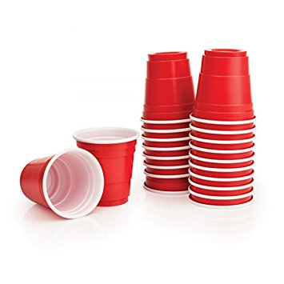

Our Drinking Culture
Notes:
Discuss the drinking culture in your community
Why do people drink?
Quench thirst
Get drunk (binge drinking)
Enjoy a social setting
As part of a religious or traditional ceremony
Before you risk it:
Know the law.
It is illegal to buy or possess alcohol if you are under age 21.
Get the facts.
One drink can make you fail a breath test. In Montana, people under age 21 can lose their driver's license, be subject to a heavy fine, or have their car permanently taken away.

Slide 13
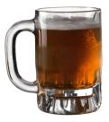

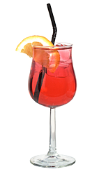
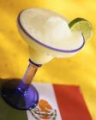
CRUNCHING THE NUMBERS
WHISKEY 80 Proof
1 oz.
0.40
0.40 ounces of ethyl alcohol
BEER 4.5%
12 oz.
0.045
0.54 ounces of ethyl alcohol
WINE COOLER 5.0%
12 oz.
0.05
0.60 ounces of ethyl alcohol
  MARGARITA
Tequila 80 Proof
Triple Sec 60 Proof
1.5 oz. 0.5 oz.
0.4 0.3
0.6 + 0.15 = 0.75 ounces of ethyl alcohol
MARGARITA = 88% more alcohol than a shot of whiskey
WINE COOLER = 50% more alcohol than a shot of whiskey
BEER = 35% more alcohol than a shot of whiskey
Notes:
Aren't beer and wine "safer" than liquor? No.
One 12-ounce beer has about as much alcohol as a 1.5-ounce shot of liquor, a 5-ounce glass of wine, or a wine cooler.

Slide 14
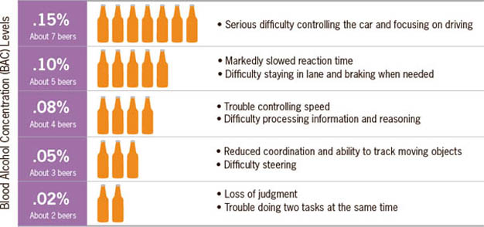
Likely BAC effects on driving
Notes:
Consuming several alcoholic drinks in one hour will raise blood alcohol concentration much more than having one drink over a longer period of time.
Source: CDC, 2012 - http://www.cdc.gov/vitalsigns/drinkinganddriving

Slide 15
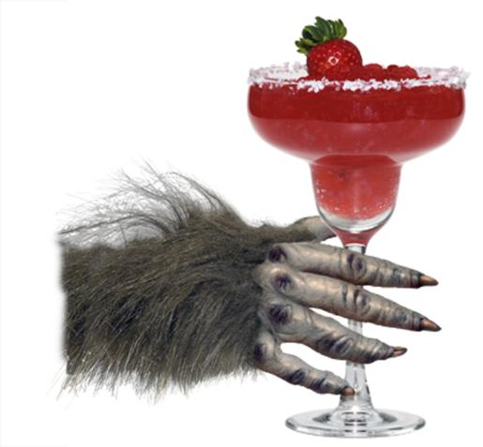
Binge Drinking
4 drinks for a woman, 5 for a man*
Drinking large amounts of alcohol at one time or very rapidly can cause alcohol poisoning, which can lead to coma or even death.
It can also lead to deadly car crashes.
Alcohol can hurt you--even if you're not the one drinking.
* Centers for Disease Control (CDC)
Notes:
Drinking large amounts of alcohol at one time or very rapidly can cause alcohol poisoning, which can lead to coma or even death. Driving and drinking also can be deadly. Alcohol can hurt you--even if you're not the one drinking.
If you're around people who are drinking, you have an increased risk of being seriously injured, involved in car crashes, or affected by violence. At the very least, you may have to deal with people who are sick, out of control, or unable to take care of themselves.
http://www.alcoholscreening.org/Learn-More.aspx?topicID=8&articleID=25
NHTSA photo and Binge Drinking definition CDC, 2012 http://www.cdc.gov/vitalsigns/drinkinganddriving/

Slide 16

What would you do?
At a party you notice someone has passed out.
What would you do?
Why?
Notes:
Knowing and understanding the signs of alcohol poisoning can save lives. Call 911.
Don’t wait for all the signs before seeking medical help.
Blood alcohol levels can continue to rise even when a person stops drinking or is passed out.
Signs of alcohol poisoning include:
Mental confusion or stupor – The person can’t speak or doesn’t make sense
Passed out and can’t be roused – The person may already be in a coma
Vomiting – Throwing up is not a normal result of drinking
Seizures – The body shakes or convulses
Slow breathing – Less than eight breaths per minute
Irregular breathing – Taking 10 seconds or more between breaths
Hypothermia – The person is cool to the touch, is pale or has bluish skin color

Slide 17
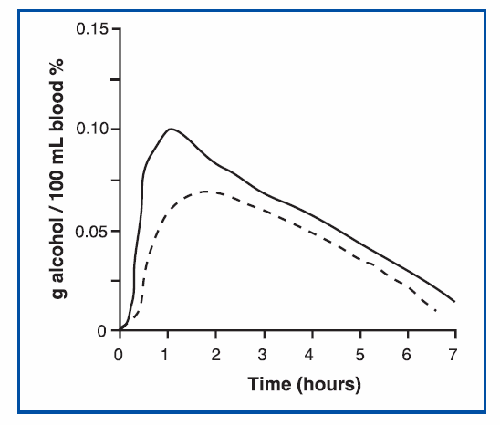
Elimination Time After Drinking
Concentration of alcohol in the breath and urine mirrors the concentration in the blood.
Breathalyzers can detect, measure and calculate a person’s blood alcohol concentration (BAC).
The Effect of Food on
Blood Alcohol Concentration
____ BAC after consuming alcohol following an overnight fast
- - - - - - BAC after consuming alcohol immediately after breakfast
Notes:
Understanding Alcohol: Investigations into Biology and Behavior page 29 – 30 figure 6
National Institute of Health 2003 Curriculum
Rate of alcohol elimination varies by individual and time is essential.
The body can eliminate about one dose of alcohol per hour.

Slide 18
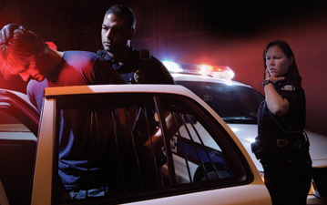
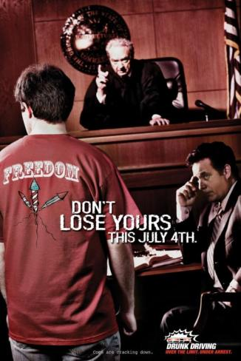
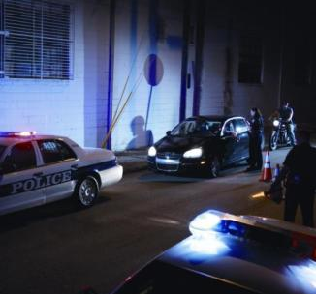
MIP and DUI Consequences
Notes:
Drinking alcohol or using drugs when driving is totally unacceptable, dangerous, illegal and it can cost you your license.
See the MDT-MIP Penalties factsheet in the Additional Resources folder
MDT PSA: https://youtu.be/sxS7wcKOtcM
Resource: http://www.abovetheinfluence.com

Slide 19
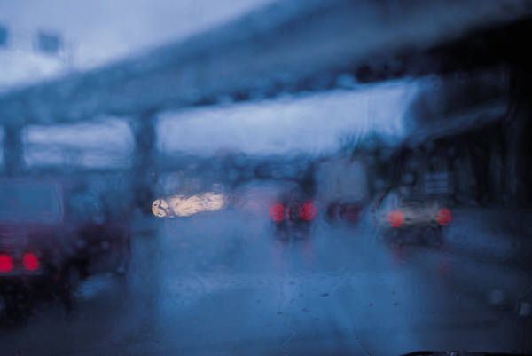
Make the Safe Decision
Never drink or use drugs before driving.
Read the news story about a 22-year-old who killed two people and spent the rest of her life in prison. Then ask yourself: Will I drink and drive?
http://helenair.com/news/local/schescke-sentenced-to-years-suspended-watch-video/article_4e8acbbc-2526-11e3-bb99-0019bb2963f4.html
Notes:
Research shows that a single drink increases the risk of death or serious injury by five times.
On average each year in Montana, alcohol/drug-related driving has been a factor in more than 50% of deaths on Montana’s roads – MDT http://www.mdt.mt.gov/visionzero/people/impairment.shtml
3. Drinking illegally combined with less driving experience results in a deadly combination.
Sources:
Drugs Shatter the Myths NIDA teens.drugabuse.gov
Centers for Disease Control. “Vital Signs: Alcohol-Impaired Driving Among Adults — United States, 2010.” Morbidity and Mortality Weekly Report. October 4, 2011. http://www.cdc.gov/mmwr/preview/mmwrhtml/mm6039a4.htm

Slide 20
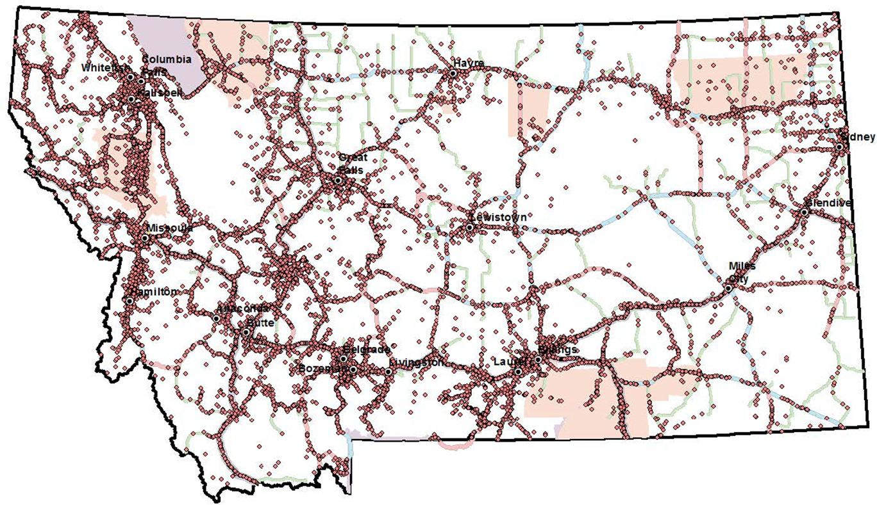
The red dots on this map represent ten years and 7,990 fatalities and severe injuries attributed to road departure crashes in Montana.
Impaired drivers are involved in over half of all fatal crashes and in 3 out of every 10 serious injury crashes.
Impact of Drug and Alcohol Impaired Driving
MDT Map:: Fatal and serious injury single vehicle road departure crashes 2005 - 2014
Notes:
Montana has one of the highest fatality rates in the nation for number of deaths caused by impaired drivers per vehicle mile traveled.
Impaired drivers are involved in over half of all fatal crashes and in 3 out of every 10 serious injury crashes.
Impaired driver involved crashes occur in rural areas 85% of the time and 57% occur on weekends.
Montana Highway Traffic Safety Problem Identification FFY 2017 - http://www.mdt.mt.gov/publications/docs/brochures/safety/probid.pdf
According to the 2017 Montana Highway Patrol Annual Report, alcohol contributed to 37% of all fatal crashes, followed closely by drugs which were present in one-third of all traffic fatality cases.
Source: https://media.dojmt.gov/wp-content/uploads/Substance-Use-in-Montana-DOJ-FINAL-September-19th.pdf (page 10)
Montana Map - The red dots on this map represent fatalities and severe injuries attributed to road departure crashes in Montana. In the years 2005 to 2014 there were 7990 single vehicle road departure crash fatalities and severe injuries.
Source: Road Departure Crashes and High Crash Corridors/High Crash Locations (MDT, October 2015)

Slide 21
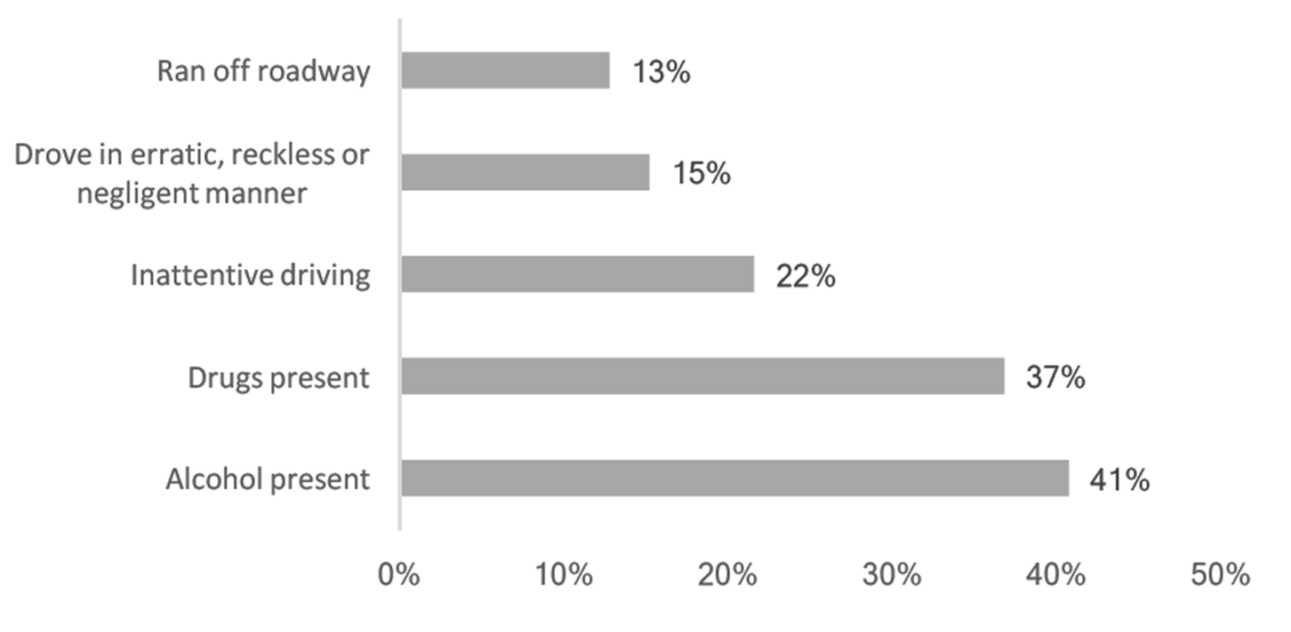
Top 5 Contributing Causes of Fatal Crashes
Montana 2015
Notes:
2017 Substance Use in Montana Report https://media.dojmt.gov/wp-content/uploads/Substance-Use-in-Montana-DOJ-FINAL-September-19th.pdf
Fatal crashes may have more than one contributing factor reported by Montana Highway Patrol .

Slide 22
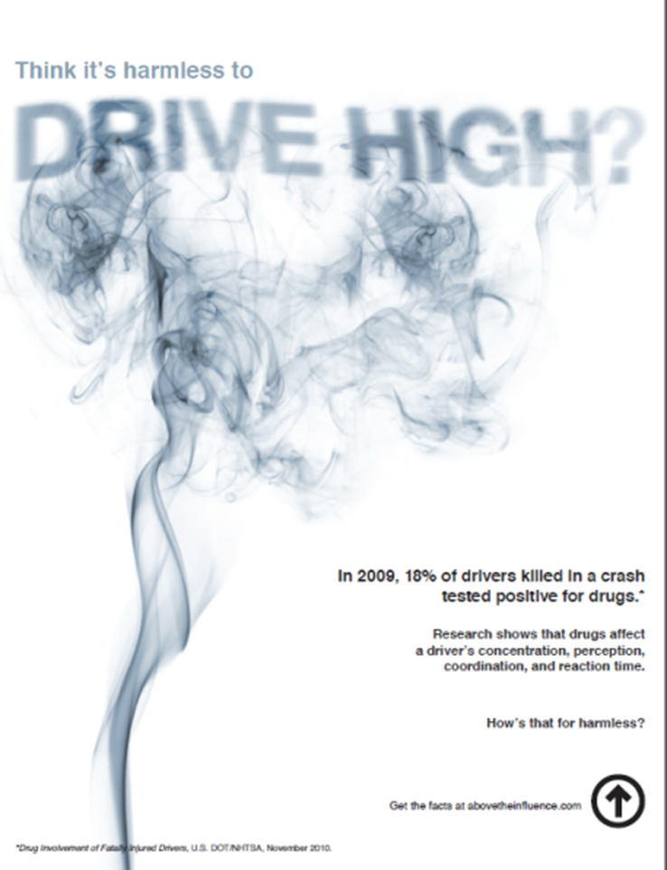
Research shows that drugs affect a driver’s concentration, perception, coordination and reaction time.
How’s that for harmless?
Notes:
*Drug Involvement of Fatally Injured Drivers, U.S. DOT/NHTSA, November 2010.

Slide 23
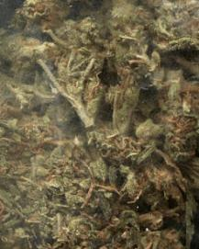
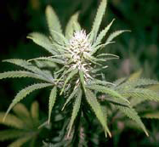
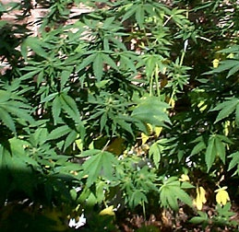
Marijuana
Marijuana is a green, brown, or gray mixture of dried, shredded flowers and leaves of the hemp plant (Cannabis sativa)
Research shows that drivers on marijuana have slower reaction times, impaired judgment, and problems responding to signals and sounds. DUI consequences apply.
National Institutes of Health
Notes:
Cannabis users feel relaxed and euphoric. They are ‘high’ or ‘stoned’. When translated into driving, this means their reaction time is longer, their coordination decreases, and their memory is affected
2013 Montana Impaired Driving statutes include marijuana :
MCA 61-8-411. Operation of noncommercial vehicle or commercial vehicle by person under influence of delta-9-tetrahydrocannabinol. (1) It is unlawful and punishable as provided in 61-8-442, 61-8-722, 61-8-723, and 61-8-731 through 61-8-734 for any person to drive or be in actual physical control of:
(a) a noncommercial vehicle upon the ways of this state open to the public while the person's delta-9-tetrahydrocannabinol level, excluding metabolites, as shown by analysis of the person's blood, is 5 ng/ml or more; or
(b) a commercial motor vehicle upon the ways of this state open to the public while the person's delta-9-tetrahydrocannabinol level, excluding metabolites, as shown by analysis of the person's blood, is 5 ng/ml or more.
(2) Absolute liability, as provided in 45-2-104, is imposed for a violation of this section.
History: En. Sec. 1, Ch. 153, L. 2013
http://www.drugabuse.gov/publications/research-reports/marijuana-abuse
NIH Pub Number: 10-3859
Published: October 2002
Revised: September 2010
Author: National Institute on Drug Abuse

Slide 24
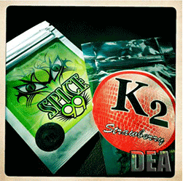
Synthetic Marijuana
Synthetic marijuana refers to a growing number of man-made mind-altering cannabinoid chemicals sprayed on dried, shredded plant material or vaporized to get high.
The effects of synthetic cannabinoids can be unpredictable and severe or even life-threatening.
Also called:
"K2," "Spice,"
"fake weed,"
"King Kong," "Yucatan Fire," "Skunk,"
"Moon Rocks
False Advertising
Synthetic cannabinoid products are often labeled "not for human consumption." Labels also often claim that they contain "natural" material taken from a variety of plants. However, the only parts of these products that are natural are the dried plant materials. Chemical tests show that the active, mind-altering ingredients are cannabinoid compounds made in laboratories.
Notes:
NIDA. (2015, November 9). Synthetic Cannabinoids. Retrieved from https://www.drugabuse.gov/publications/drugfacts/synthetic-cannabinoids on 2018, January 10

Slide 25
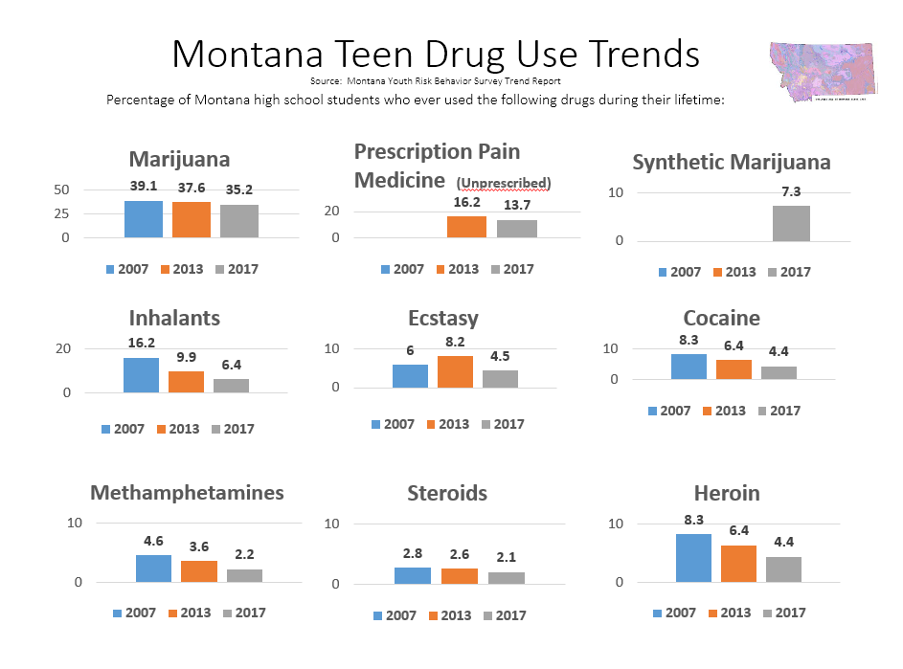
Notes:
Percentage of Montana high school students who ever used these drugs during their life.
Montana YRBS Trend Report - http://opi.mt.gov/Leadership/Data-Reporting/Youth-Risk-Behavior-Survey
The most commonly abused prescription drugs by teenagers include:
Painkillers (e.g. Vicodin; OxyContin, Hydrocodone and Percocet),
tranquilizers, (e.g. Valium), and stimulants (e.g. Adderall; Ritalin).

Slide 26
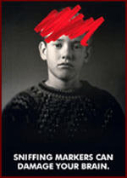
Inhalants
Inhalant vapors displace oxygen in the lungs.
Solvents or aerosol sprays can cause irregular or rapid heart rhythms and can lead to heart failure and death within minutes.
This "sudden sniffing death" is particularly associated with the abuse of butane, propane, and chemicals in aerosols.
While high on inhalants, people also can die by suffocation, choking on their own vomit or by fatal injury from accidents, including car crashes.
Notes:
http://teens.drugabuse.gov/facts

Slide 27
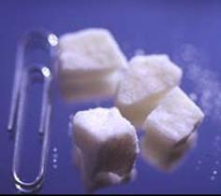
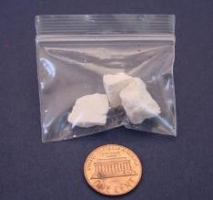
Cocaine
Cocaine is a white powder that comes from the leaves of the South American coca plant.
Highly addictive central nervous system stimulant increases risk of heart attacks, respiratory failure, strokes and seizures.

Slide 28
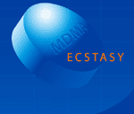
MDMA or Ecstasy
3,4-methylenedioxymethamphetamine
MDMA is chemically similar to stimulants and hallucinogens and can make a person feel energized and generate a sense of well-being.
It can also interfere with the body’s ability to regulate temperature, leading to hyperthermia (increased body temperature) and dehydration which can cause heart and kidney failure.
MDMA can also impair memory and generate depression for several days after taking it.
Notes:
Amphetamines, ecstasy, and cocaine are ‘uppers’ or stimulants; they make users feel more energetic and alert. So drivers drive faster and more aggressively and take more risks though their driving skills are reduced: they have less ability to control the vehicle, judge distances, coordinate their actions, and make sound decisions.

Slide 29
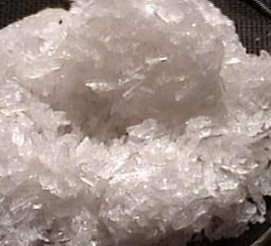
Methamphetamine
Commonly known as:
Meth
Speed
Chalk
Crystal
Crank
Glass
Ice
Short-term effects:
Dizziness
Twitching
Tremors
Itchy skin
Constipation
Dry mouth
Restlessness
Irritability
Violence
Obsessive compulsive behavior
Hallucinations
Skin deterioration
Open sores on the skin often caused by compulsive scratching
Long-term effects:
Heart disease
Psychosis
Anxiety
Brain damage
Impaired memory
Impaired attention
Notes:
A highly addictive central nervous system stimulant that causes rapid heart rate, irregular heartbeat, and increased blood pressure.
It also damages kidneys, lungs, and liver, and can cause psychotic behavior, hallucinations, and stroke.

Slide 30
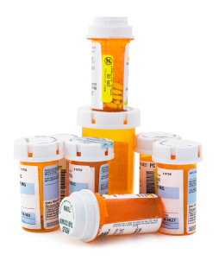
How can prescription drugs be harmful if they’re prescribed by doctors?
Medicines such as codeine and benzodiazepines (sleeping pills, tranquilizers, and anti-anxiety medications) can cause:
absent-mindedness
poor coordination and judgment
reduced ability to control a vehicle
Notes:
Prescription Opioid Abuse: A First Step to Heroin Use?
Prescription opioid pain medications such as Oxycontin and Vicodin can have effects similar to heroin when taken in doses or in ways other than prescribed, and they are currently among the most commonly abused drugs in the United States. Research now suggests that abuse of these drugs may open the door to heroin abuse.
Nearly half of young people who inject heroin surveyed in three recent studies reported abusing prescription opioids before starting to use heroin. Some individuals reported taking up heroin because it is cheaper and easier to obtain than prescription opioids.
Many of these young people also report that crushing prescription opioid pills to snort or inject the powder provided their initiation into these methods of drug administration.
Drugs_Shatter_the_Myths teen brochure (NIDA 2011)
Teens.drugabuse.gov
http://www.drugabuse.gov/publications/drugfacts/heroin

Slide 31
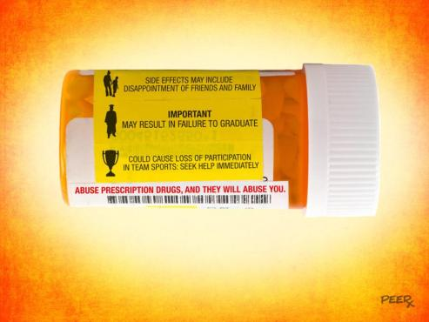
Deaths from prescription painkillers have reached epidemic levels in the past decade.
PRESCRIPTION DRUG ABUSE
Notes:
"Prescription painkillers" refers to opioid or narcotic pain relievers, including drugs such as Vicodin (hydrocodone), OxyContin (oxycodone), Opana (oxymorphone), and methadone.
The poisoning death rate among teens aged 15–19 years nearly doubled, from 1.7 to 3.3 per 100,000, in part because of an increase in prescription drug overdoses (e.g., opioid pain relievers). Vital Signs: Unintentional Injury Deaths Among Persons Aged 0–19 Years — United States, 2000–2009
Taking just one large dose of an opioid (such as Vicodin, OxyContin or Percocet) could cause severe breathing complications or death.
The link between prescription painkiller abuse and subsequent or simultaneous heroin abuse continues to grow. Across the country, 80% of
“recent heroin initiates had previously used prescription opioids non‐medically,” according to the Center for Behavioral Health Statistics andQuality
Photo: http://teens.drugabuse.gov/peerx/downloads/poster.php

Slide 32
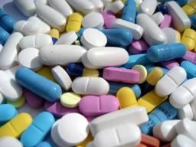
Over-the-counter drugs (OTC)
Examples of non-prescription OTC
drugs include:
  Aspirin or other pain relievers.
  Cold and allergy remedies.
  Arthritis and back pain medication.
Physical effects of OTC drugs:
  Drowsiness, dizziness, slowed reaction times, poor judgment.
  Always read the labels and know the effects that could occur.

Slide 33
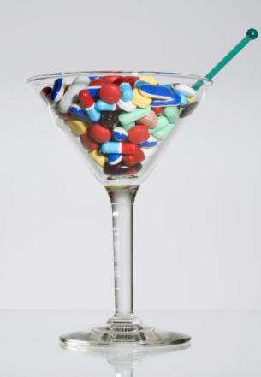
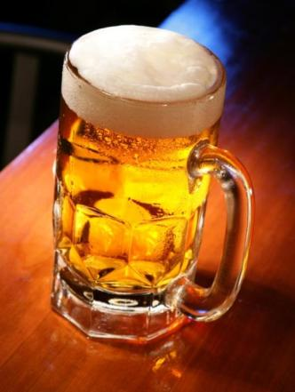
At a party, a friend offers you alcohol and a pill.
What would you do and why?
Notes:
Know the risks.
Alcohol is a drug. Mixing it with any other drug can be extremely dangerous. Alcohol and acetaminophen--a common ingredient in OTC pain and fever reducers--can damage your liver. Alcohol mixed with other drugs can cause nausea, vomiting, fainting, heart problems, and difficulty breathing. Mixing alcohol and drugs also can lead to coma and death.
Using drugs with or after drinking alcohol is never a good idea. People who combine alcohol and drugs are twice as likely to be involved in a crash as those drinking alcohol alone. Drivers with a BAC of more than 0.08 g/100 ml who combine drugs with alcohol are a hundred times more likely to be injured in a road crash.
NHTSA photo – NIH question

Slide 34

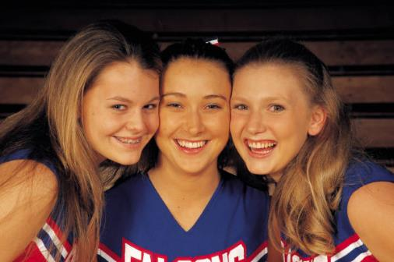
DID YOU KNOW?
Alcohol is a depressant, or downer, because it reduces brain activity. If you are depressed before you start drinking, alcohol can make
you feel worse.
Repeated drug use can reset the brain’s pleasure meter, so that without the drug, you feel hopeless and sad.
Eventually, everyday fun stuff like spending time with friends or playing with your dog doesn’t make you happy anymore.
Notes:
NIDA 2011 Drug Facts, Shatter the Myths - http://teens.drugabuse.gov/
National Institute on Drug Abuse, National Institutes of Health, 2011

Slide 35
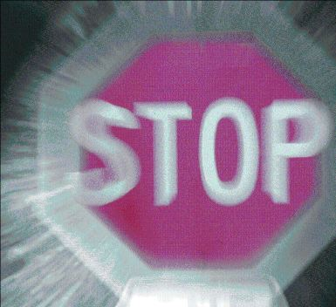
You can prevent a tragedy …
How would you convince a friend impaired by alcohol or other drugs to not drive and to give you the keys?
Notes:
Consequences matter – Focus on how their drinking affects you and others they are close too.
Plan a safe ride home.
Vision Zero has videos which show extreme ways to keep your friends from driving under the influence:
http://www.mdt.mt.gov/visionzero/mythcrashers.shtml
http://www.mdt.mt.gov/visionzero/people/impairment.shtml

Slide 36

No thanks -- It’s easier to say than you think.
How do you say no to alcohol when someone offers you a drink?
It's easier to refuse than you think. Try: “No thanks,” “I don't drink,” or “I'm not interested.” Or, “I’m driving, better not.”
Remember that the majority of teens don't drink alcohol. You're in good company when you're one of them.
Notes:
Discuss how to say no to alcohol when someone say “I'm afraid I won't fit in.”
It's easier to refuse than you think. Try: "No thanks," "I don't drink," or "I'm not interested."
Remember that the majority of teens don't drink alcohol. You're in good company when you're one of them.

Slide 37
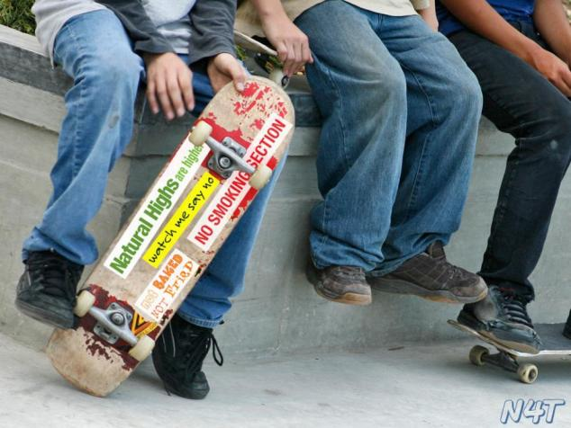
What choice will you make?
http://teens.drugabuse.gov/peerx/
Notes:
http://teens.drugabuse.gov/

Slide 38
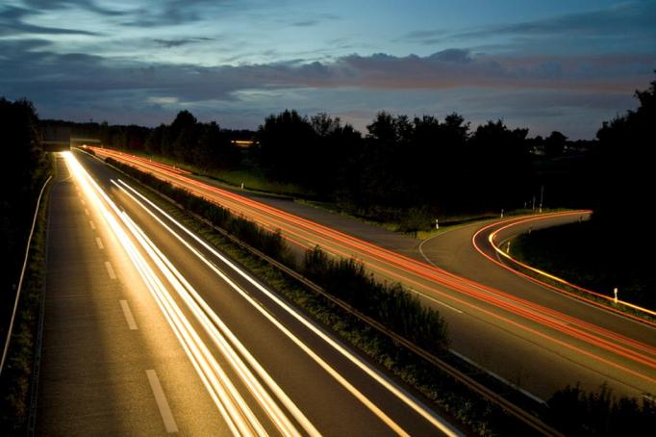
Most Montana teens – 92.4% – don’t drink and drive
What else can you do to stay safe on the road?
Notes:
Source: Montana YRBS Trend Data 2011

Slide 39


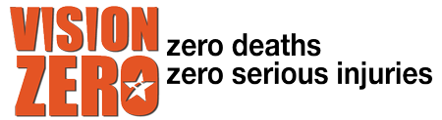
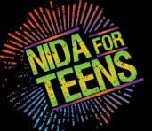


Alcohol & Drugs Research Sites
Office of Public Instruction: Youth Risk Behavior Survey
Montana Department of Transportation - Vision Zero
National Institute on Drug Abuse for Teens - http://teens.drugabuse.gov/
Alcohol Screening – Tips for Teens: The Truth about Alcohol
Centers for Disease Control - Alcohol and Public Health
Mothers Against Drunk Driving – Safe Roads Warm Hearts
NHTSA – Drunk Driving

Slide 40
Montana Driver Education and Training
Standards and Benchmarks
1. Laws and Highway System
  1.1. know the laws outlined in the Montana Driver's manual;
  1.2. understand the laws outlined in the Montana Driver's Manual; and
  1.3. consistently demonstrate knowledge and understanding by responsible adherence to highway transportation system traffic laws and control devices.
2. Responsibility
  2.1. recognize the importance of making safe and responsible decisions for owning and operating a motor vehicle;
  2.2 demonstrate the ability to make appropriate decisions while operating a motor vehicle;
  2.3. consistently display respect for other users of the highway transportation system; and
  2.4. develop positive habits and attitudes for responsible driving.
3. Visual Skills
  3.1. know proper visual skills for operating a motor vehicle;
  3.2. communicate and explain proper visual skills for operating a motor vehicle;
  3.3. demonstrate the use of proper visual skills for operating a motor vehicle; and
  3.4. develop habits and attitudes with regard to proper visual skills.
4. Vehicle Control
  4.1. demonstrate smooth, safe and efficient operation of a motor vehicle; and
  4.2. develop positive habits and attitudes relative to safe, efficient and smooth vehicle operation.
5. Communication
  5.1. consistently communicate driving intentions (i.e., use of lights, vehicle position, and personal signals);
  5.2. adjust driver behavior based on observation of the highway transportation system and other roadway users;
  5.3. adjust communication (i.e., use of lights, vehicle position, and personal signals) based on observation of the highway transportation system and other users; and
  5.4. develop positive habits and attitudes for effective communication.
6. Risk Management
  6.1. understand driver risk-management principles;
  6.2. demonstrate driver risk-management strategies; and
  6.3. develop positive habits and attitudes for effective driver risk-management.
7. Lifelong Learning
  7.1. identify and use a range of learning strategies required to acquire or retain knowledge, positive driving habits, and driving skills for lifelong learning;
  7.2. establish learning goals that are based on an understanding of one’s own current and future learning needs; and
  7.3. demonstrate knowledge and ability to make informed decisions required for positive driving habits, effective performance, and adaptation to change.
8. Driving Experience
  8.1. acquire at least the minimum number of BTW hours over at least the minimum number of days, as required by law, with a Montana-approved driver education teacher; and
  8.2. acquire additional behind-the-wheel driving experience with a parent or guardian’s assistance in a variety of driving situations (i.e., night, adverse weather, gravel road, etc.).
Notes:
Standards and Benchmarks: This is for your reference and not to be read to the class verbatim. Please review prior to the lesson so you are aware of what the student will be required to know at the end of the module.

