Slide 1

Montana Teen Driver Education and Training
Module 6.3
Drowsy Driving
Arrive Alive
Notes:
REVISED 2018

Slide 2
Objectives – Drowsy Driving
Students will understand and be able to explain:
The physical and mental effects of fatigue on driver behavior.
The importance of sleep and its effect on driving performance.
The physical and mental symptoms of fatigue on the driving task.
The driving hazards associated with drowsy driving.
Methods to delay or avoid driving while fatigued and drowsy.
Notes:
National Sleep Institute
Check for teacher resources

Slide 3
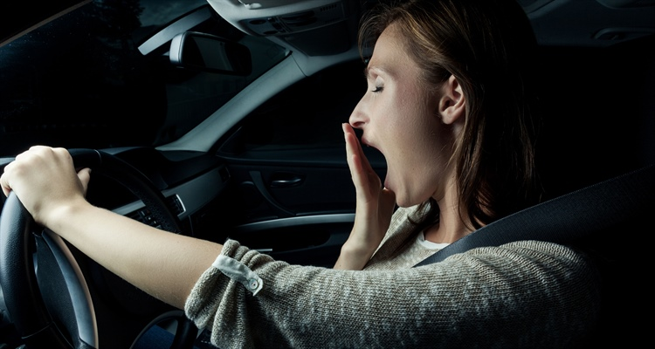
What is Driver Fatigue?
Fatigue is:
  tiredness
  drowsiness
  exhaustion
  Fatigue can impair your driving long before you “nod off” at the wheel.
Notes:
Falling asleep is actually an extreme form of fatigue.
When we don't get adequate sleep, we accumulate a sleep debt that can be difficult to "pay back" if it becomes too big.
The resulting sleep deprivation has been linked to health problems such as obesity and high blood pressure, negative mood and behavior, decreased productivity, and safety issues in the home, at school, on the job, and on the road.
Photo credit: http://www.jbsa.mil/News/Photos/igphoto/2001846499/

Slide 4
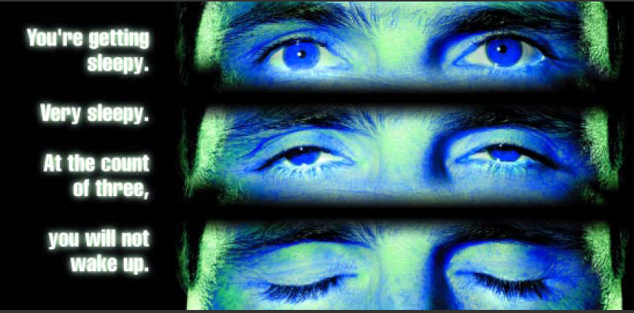
Why is driving drowsy dangerous?
Notes:
It is dangerous to drive drowsy because:
your reactions are much slower,
your ability to concentrate is reduced,
it takes longer to interpret and understand the traffic situation.

Slide 5

Drowsy Driving is Impaired Driving
Being awake for 18 hours straight is equal to a blood alcohol concentration of 0.08%, which is legally drunk.
If you don’t get the sleep you need, you could be as impaired as someone who is drunk behind the wheel.

Slide 6
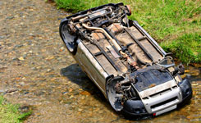
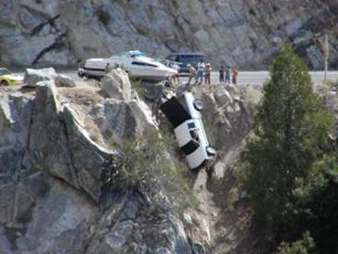
Why is driving fatigued a problem?
Fatigued drivers can have poor
concentration and judgment.
Sleepy drivers drift out of their lanes or off the road.
Fatigued drivers are also likely to be in rear-end and head-on collisions.

Slide 7
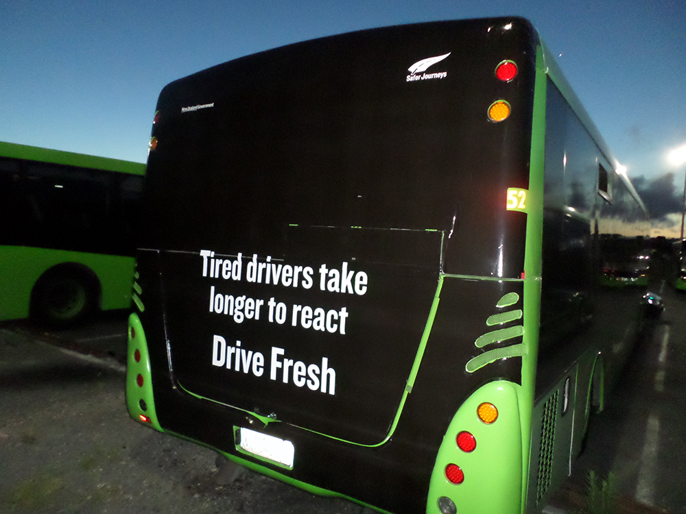
Notes:
http://www.nzta.govt.nz/site-resources/content/about/img/advertising/fatigue-bus-back.jpg

Slide 8

Teens Need Sleep
Why are young drivers more likely to drive drowsy?
Teens need at least 8 to 9
hours of sleep each night.
Lifestyle habits (socializing, video games, etc.)
Demands of school, sports and work schedules.
Teens’ internal biological clocks keep them awake later in the evening and keep them sleeping later in the morning.
Notes:
Sleep Tips: Get Better sleep on a regular basis
During your breaks, try exercising, walking or even napping if possible.
Know the side effects of medications–sleepiness is commonly overlooked.
If you’re sleepy at the end of your school day or work shift, take a short nap and/or drink two cups of coffee before driving home.

Slide 9
Student Activity 1:
How much sleep did you get last night?
Everyone stand up.
The teacher or a student calls out 10 hours, 9 hours, 8 hours, 7 hours, 6 hours or less.
Students sit when they hear the number of hours they slept the night before.
Discuss the consequences of sleep deficit on school performance, driving, sports, etc.

Slide 10
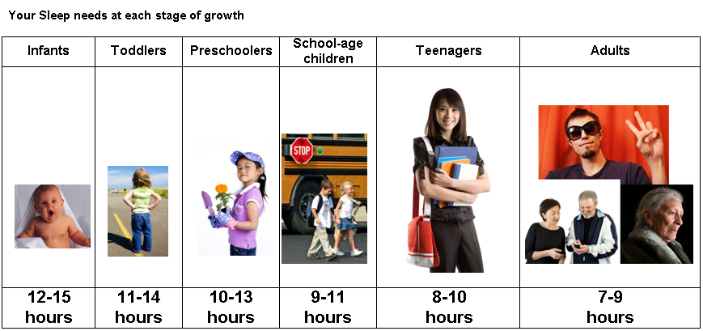
How much sleep do you need?
Sleep debt is the difference between the amount of sleep you need and the amount you actually get.
Notes:
Sleep debt is the difference between the amount of sleep you need and the amount you actually get.
The American Academy of Sleep Medicine recommends the illustrated amounts of sleep at each stage of growth.
“Studies show that such short-term sleep deprivation leads to a foggy brain, worsened vision, impaired driving, and trouble remembering.”
To recover lost sleep - tack on an extra hour or two of sleep each night to catch up. Go to bed when you are tired and wake in the morning without an alarm.” Source: http://www.scientificamerican.com/article/fact-or-fiction-can-you-catch-up-on-sleep/ May 2008
Researchers found that college students who pull all-nighters to prepare for tests tend to have lower grade point averages than those who get regular sleep.
Snooze, you win? Stanford University researchers monitored members of the school's men's basketball team during two weeks of regular sleep cycles and then two weeks with extra sleep. With extra sleep the athletes reported increased energy; faster sprint times; and better free-throw shooting. Source: http://med.stanford.edu/ism/2011/july/sleep.html

Slide 11
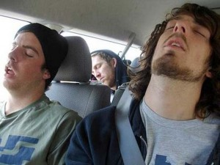
How Serious is Drowsy Driving?
Nationally,100,000
crashes each year are
caused by fatigued drivers.
One in eight fatal crashes
is due to drowsy driving.
Young drivers (16-24) are
twice as likely to be involved
in a drowsy driving crash as drivers age 40-59.
Men have twice as many drowsy driving crashes as women.
Source: AAA Foundation for Traffic Safety
Notes:
Nationally, 100,000 crashes each year are caused by fatigued drivers.
One in eight fatal crashes is due to drowsy driving.
Young drivers (16-24) are twice as likely to be involved in a drowsy driving crash as drivers age 40-59.
Men have twice as many drowsy driving crashes as women.
http://www.nzta.govt.nz/about/advertising/fatigue/index.html#print

Slide 12
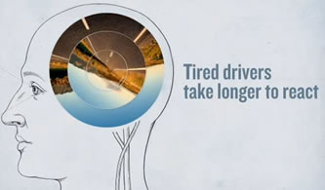
100,000 Crashes Each Year
Notes:
Nationally, 100,000 crashes each year are caused by fatigued drivers.
One in eight fatal crashes is due to drowsy driving.
Young drivers (16-24) are twice as likely to be involved in a drowsy driving crash as drivers age 40-59.
Men have twice as many drowsy driving crashes as women.
http://www.nzta.govt.nz/about/advertising/fatigue/index.html#print

Slide 13


Are you at risk of driving drowsy?
Before you drive, ask yourself:
Did I get enough sleep last night?
Am I driving a long way without many rest stops?
Am I going to drive when
I’m usually sleeping?
Am I taking medications?
Am I driving alone?
Is the driving environment boring or interesting?
Notes:
Six hours of sleep or less triples your risk of a crash.
It’s important to have places to pull over or stop to rest if you’re driving more than two hours in one stretch.
Most people get sleepy in the late afternoon and early hours of the morning, or whenever you would normally be sleeping.
Anti-depressants, cold tablets, and antihistamines carry warnings against driving while under their influence.
Working more than one job, and your main job involves shift work. Working more than 60 hours a week increases your risk by 40%.

Slide 14
Student Discussion
In groups of 3-4 discuss the symptoms of fatigue.
Share a time you needed to stay awake, but could not.
Why did this happen and what did you do about it?
What are the most effective ways to avoid driving drowsy?
What should you do if you can’t avoid it?

Slide 15
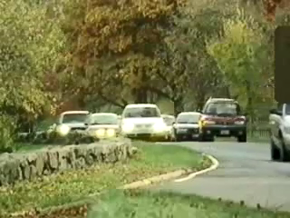
Video: Almost Home
PLAY VIDEO (18:00)
Notes:
This video includes four different stories about the tragic consequences of drowsy driving. You can play the entire video or just show a portion of it.
Source: National Road Safety Foundation - http://www.nationalroadsafety.org/teenlane/programs/drowsy-driving.

Slide 16
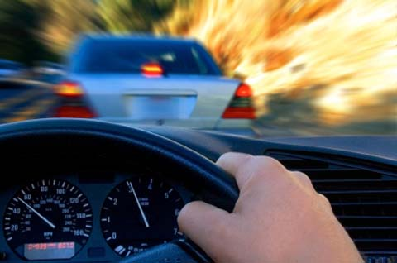

You snooze, you lose …
37% of drivers admit to falling asleep while
driving.
Drowsy drivers drift out of their lane or off the road.
Most people get sleepy in the late afternoon and early morning, or whenever they would normally be sleeping.
You snooze, you lose your life, your mom, your friend, someone’s son.
Notes:
https://www.aaafoundation.org/drowsy-driving

Slide 17

Warning Signs You’re Driving Drowsy
You yawn frequently.
Your eyes feel sore or tired.
You’re bored, irritable, or restless.
It takes you longer to react.
It’s difficult to concentrate.
You don’t check your driving mirrors as frequently.
You have difficulty keeping your head up or eyes open.
Notes:
It’s easy to convince yourself that you can still concentrate on the road despite being tired. Only older people and truck drivers fall asleep behind the wheel, right?
Unfortunately, this is not true. Research has shown that fatigue also affects young people and can cause crashes by slowing reaction time, reducing awareness, and impairing judgment.
Let the warning signs be a warning to take a break from driving and rest.

Slide 18
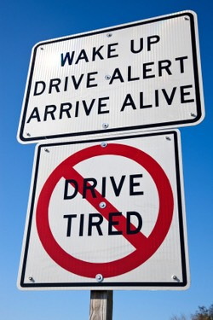
More Warning Signs You’re Driving Drowsy
You weave and wander out of your lane.
Your driving speed is inconsistent -- you’re driving faster or slower.
You brake suddenly.
You miss an exit or a turn.
You start “seeing things.”
Notes:
It’s easy to convince yourself that you can still concentrate on the road despite being tired. Only older people and truck drivers fall asleep behind the wheel, right?
Unfortunately, this is not true. Research has shown that fatigue also affects young people and can cause crashes by slowing reaction time, reducing awareness, and impairing judgment.
Let the warning signs be a warning to take a break from driving and rest.

Slide 19

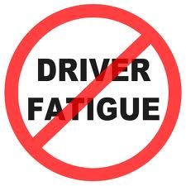
Staying awake while driving
Strategies to help overcome fatigue:
Get enough sleep before your trip.
Change drivers.
Take driving breaks and rest.
Drink coffee or caffeinated drinks or take caffeine pills.
Talk to passengers.
Notes:
Caffeine and other quick fixes might give you a boost of energy or alertness for a very short time, but their effect will soon wear off and you will feel as tired and drowsy as before – if not more.
The only thing that works is getting enough sleep before your trip and if that’s not possible, taking regular nap breaks on the way.

Slide 20
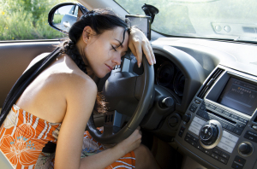
Always Drive Rested and Alert
Take a break and drive awake.
Notes:
If you are tired, listen to your body and get some rest before you endanger yourself and others by driving drowsy.

Slide 21
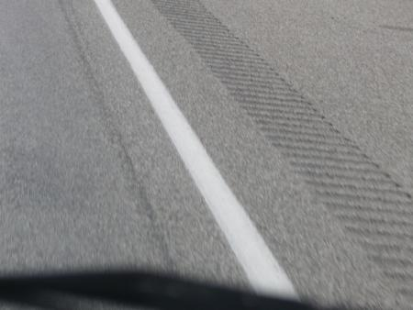

Rumble Strips
An early warning system to reduce road departure crashes.
Stay alert!
Do not panic.
Stay in your travel lane.
Center line rumble strip photo source: Transportation Research Board
Notes:
Rumble strips are deep grooves placed on high-speed roads to alert drowsy drivers and prevent them from veering off the roadway or across the centerline.
If you wander to the shoulder of the road and feel the sudden bumps of a rumble strip, don’t panic. Stay in your lane. You might be too drowsy to drive. Pull off the road as soon as possible

Slide 22
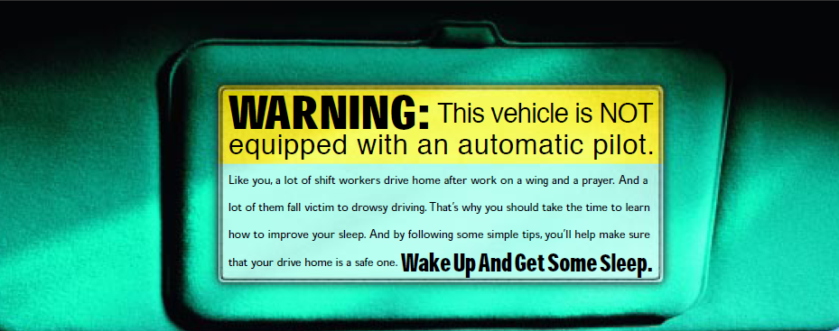
Too tired to drive?
Rumble strips might jar you awake, but it won’t keep you awake. Only a good night’s sleep keeps you alert.
If you can, join a car pool or drive with a passenger who will help you stay awake.

Slide 23
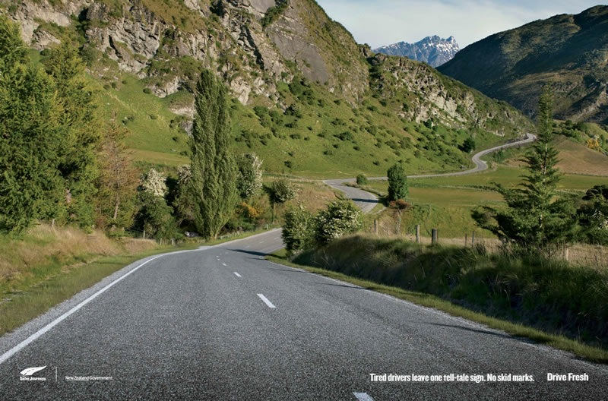
Drive Fresh
Tired drivers leave one tell-tale sign. No skid marks.
Notes:
New Zealand

Slide 24
Montana Driver Education and Training
Standards and Benchmarks
1. Laws and Highway System
  1.1. know the laws outlined in the Montana Driver's manual;
  1.2. understand the laws outlined in the Montana Driver's Manual; and
  1.3. consistently demonstrate knowledge and understanding by responsible adherence to highway transportation system traffic laws and control devices.
2. Responsibility
  2.1. recognize the importance of making safe and responsible decisions for owning and operating a motor vehicle;
  2.2 demonstrate the ability to make appropriate decisions while operating a motor vehicle;
  2.3. consistently display respect for other users of the highway transportation system; and
  2.4. develop positive habits and attitudes for responsible driving.
3. Visual Skills
  3.1. know proper visual skills for operating a motor vehicle;
  3.2. communicate and explain proper visual skills for operating a motor vehicle;
  3.3. demonstrate the use of proper visual skills for operating a motor vehicle; and
  3.4. develop habits and attitudes with regard to proper visual skills.
4. Vehicle Control
  4.1. demonstrate smooth, safe and efficient operation of a motor vehicle; and
  4.2. develop positive habits and attitudes relative to safe, efficient and smooth vehicle operation.
5. Communication
  5.1. consistently communicate driving intentions (i.e., use of lights, vehicle position, and personal signals);
  5.2. adjust driver behavior based on observation of the highway transportation system and other roadway users;
  5.3. adjust communication (i.e., use of lights, vehicle position, and personal signals) based on observation of the highway transportation system and other users; and
  5.4. develop positive habits and attitudes for effective communication.
6. Risk Management
  6.1. understand driver risk-management principles;
  6.2. demonstrate driver risk-management strategies; and
  6.3. develop positive habits and attitudes for effective driver risk-management.
7. Lifelong Learning
  7.1. identify and use a range of learning strategies required to acquire or retain knowledge, positive driving habits, and driving skills for lifelong learning;
  7.2. establish learning goals that are based on an understanding of one’s own current and future learning needs; and
  7.3. demonstrate knowledge and ability to make informed decisions required for positive driving habits, effective performance, and adaptation to change.
8. Driving Experience
  8.1. acquire at least the minimum number of BTW hours over at least the minimum number of days, as required by law, with a Montana-approved driver education teacher; and
  8.2. acquire additional behind-the-wheel driving experience with a parent or guardian’s assistance in a variety of driving situations (i.e., night, adverse weather, gravel road, etc.).
Notes:
Standards and Benchmarks: This is for your reference and not to be read to the class verbatim. Please review prior to the lesson so you are aware of what the student will be required to know at the end of the module.

