Slide 1

Montana Teen Driver Education and Training
Module 6.4
Dangerous Emotions
Keep your cool and keep in control.

Slide 2
Objectives – Dangerous Emotions
Students will understand and be able to explain:
Emotions and their effect on driver behavior.
How the senses are used while driving.
Ways to compensate for temporary and permanent disabilities while driving.
Strategies to reduce conflicts while driving.
Aggressive driving that can escalate road rage.
Ways to control emotions and manage anger while driving.

Slide 3

How do Emotions Affect your Driving?
Anger Anxiety Joy & Happiness Fear Hate Grief Love
Notes:
Your thoughts, feelings, and emotions can impact your driving focus and decisions.
Don’t drive when you are grieving, upset, angry or overly tired.
Take some time to breathe and relax before you drive.
Make safe choices and always put the safety of yourself and others first.
Every driver is responsible for operating their vehicle in a safe and courteous manner.

Slide 4
Dangerous Emotions when Driving:
Interfere with your ability to think
Create mental distractions and inattentiveness
Can cause you to act out your emotions
Increase risk taking
Interrupts ability to process information
Control Emotions when Driving:
Understand your own emotional stress triggers.
Expect other drivers to make mistakes.
Direct emotions toward actions, not people.
Delay driving when upset.
Take a moment to calm down and breathe.
Notes:
Your thoughts, feelings, and emotions can impact your driving focus and decisions.
Don’t drive when you are grieving, upset, angry or overly tired.
Take some time to breathe and relax before you drive.
Make safe choices and always put the safety of yourself and others first.
Every driver is responsible for operating their vehicle in a safe and courteous manner.
61-8-302. Careless driving. (1) A person operating or driving a vehicle on a public highway shall drive it in a careful and prudent manner that does not unduly or unreasonably endanger the life, limb, property, or other rights of a person entitled to the use of the highway.
(2) A person who is convicted of the offense of careless driving is subject to the penalties provided in 61-8-711 or 61-8-716.
61-8-303. Speed Restrictions. a person shall operate a vehicle in a careful and prudent manner and at a reduced rate of speed no greater than is reasonable and prudent under the conditions existing at the point of operation, taking into account the amount and character of traffic, visibility, weather, and roadway conditions.

Slide 5











Attitudes and Emotions
Notes:
Worry, concern, envy, sadness, excitement, disappointment, frustration, a new love or a broken heart will affect your driving focus and decisions.
How can you control your emotions while driving?
Recognize the emotion you’re dealing with and identify at least two options and alternatives to respond – you have a choice.
Change your perspective - consider other ways to look at a situation.
Don’t take your frustrations out on other drivers. Let it go.

Slide 6





Driving Senses
Your mind
Your eyes
Your nose
Your ears
Your touch
Notes:
How are the senses of touch, hearing, smelling and seeing used while driving?

Slide 7
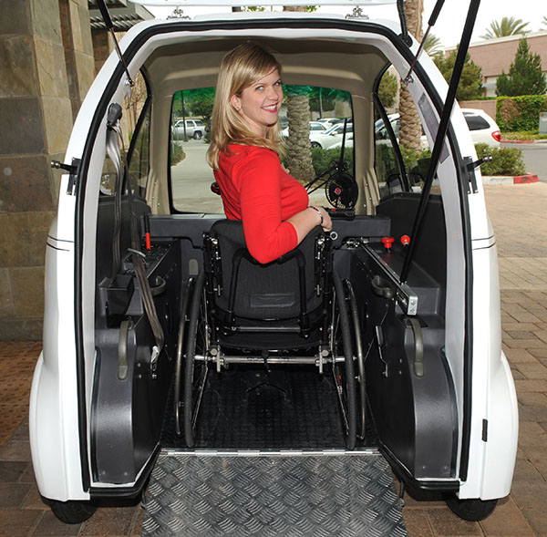
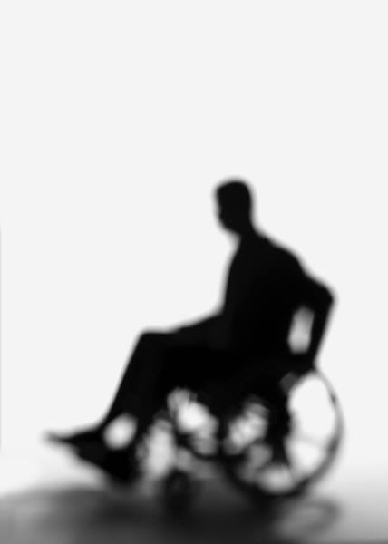
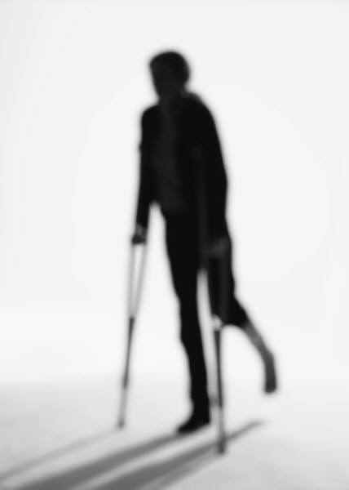
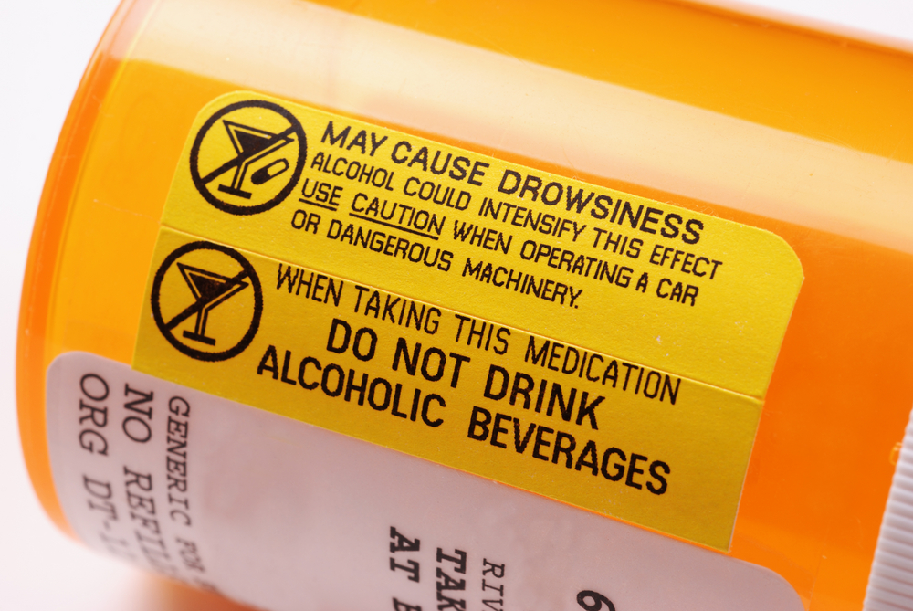
Disabilities and Injuries
Is the driver able to:
manipulate vehicle controls (steering wheel, floor pedals, dashboard)
see and understand important information
stay on task and refrain from distractions
Handle vehicle so occupants and roadway users are not put at risk.
Notes:
How do injuries and disabilities affect the driving task?
What actions can drivers take to compensate for disabilities while driving?
Disabilities may be temporary or permanent and medications may be a consideration.
Evaluate the effects on:
ability to manipulate controls;
ability to see and collect important information, including ability to stay on task and refrain from distractions;
ability to respond correctly and timely to instructor directions; and
other operational issues that can reasonably be determined to put vehicle occupants and roadway users at undue risk.
Some individuals with severe and profound physical disabilities may be accommodated to drive safely using high tech solutions in specially equipped vehicles, but not all. An advanced rehabilitation center providing driver services is likely to be necessary.

Slide 8
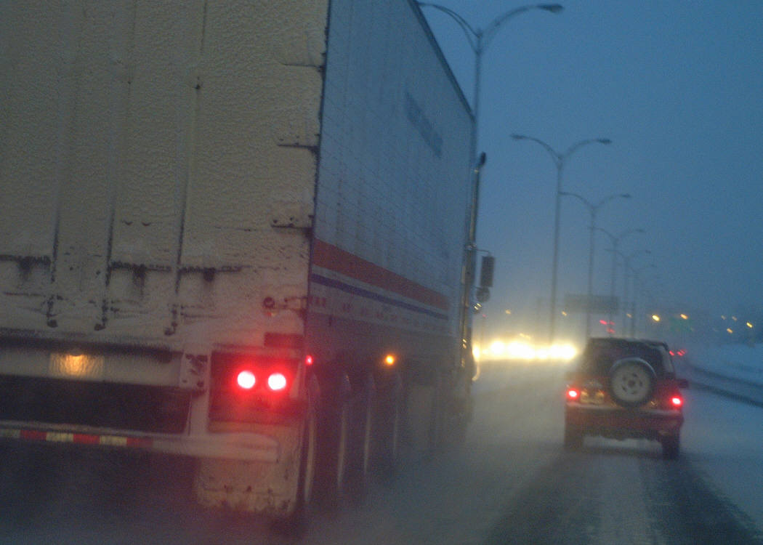
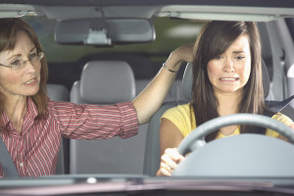
Making Smart Driving Decisions
Can you handle the driving conditions?
Are you calm, focused and alert?
Can you drive in a “careful and prudent” manner?
Notes:
Evaluate and decide before each drive if you are ready for the weather and road conditions.
Are you calm, focused and alert?
61-8-302. Careless driving. (1) A person operating or driving a vehicle on a public highway shall drive it in a careful and prudent manner that does not unduly or unreasonably endanger the life, limb, property, or other rights of a person entitled to the use of the highway.
(2) A person who is convicted of the offense of careless driving is subject to the penalties provided in 61-8-711 or 61-8-716.
61-8-303. Speed Restrictions. a person shall operate a vehicle in a careful and prudent manner and at a reduced rate of speed no greater than is reasonable and prudent under the conditions existing at the point of operation, taking into account the amount and character of traffic, visibility, weather, and roadway conditions.

Slide 9
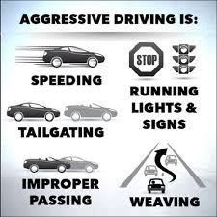
Who are the aggressive drivers?
Consider anger, patience, competing and punishing.
Notes:
When does annoyance lead to irritation, anger or rage? It’s normal to feel anger when we think something is wrong but it doesn’t justify reckless driving or violence.
Are you an Aggressive Driver?
Source: AAA Foundation for Traffic Safety

Slide 10
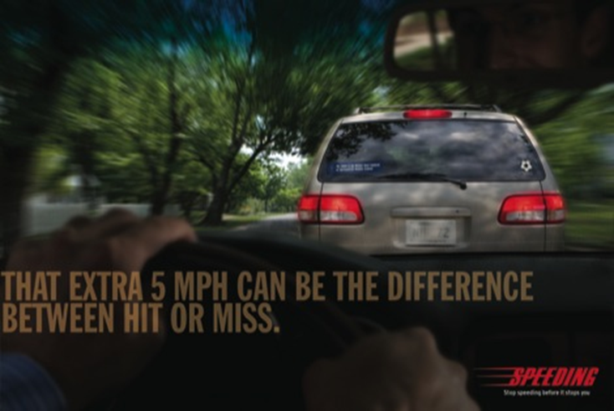
Speeding
Notes:
Is speeding aggressive driving?

Slide 11
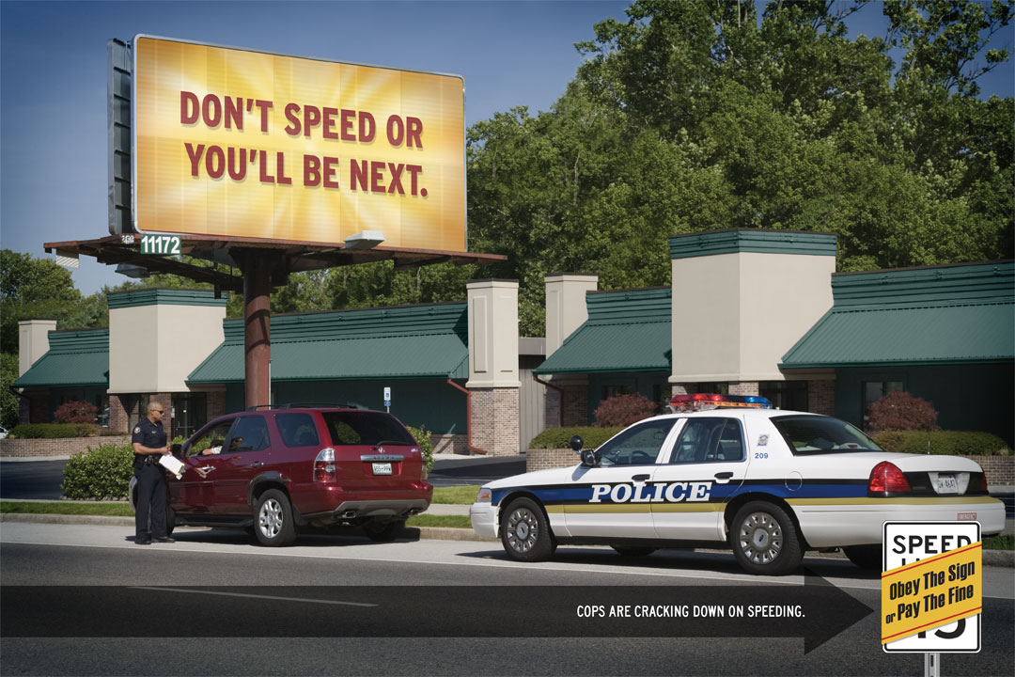
Notes:
Leave plenty of time and drive attentively. Speeding is the most common aggressive driving violation.
Keep at or below the posted speed limits – signs show the maximum safe speed in optimum conditions.

Slide 12
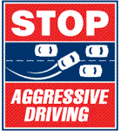
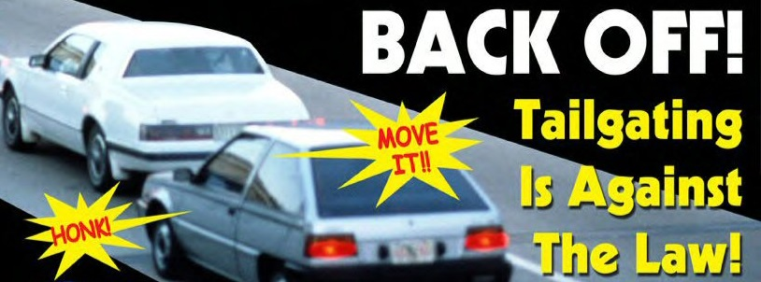
Aggressive Driving Actions
Aggressive drivers endanger other drivers, pedestrians and property by:
  Cutting off other drivers
  Passing too close
  Running red lights
  Excessive lane changing
  Tailgating
  Failing to signal
  Speeding
  Honking
  Yelling

Slide 13

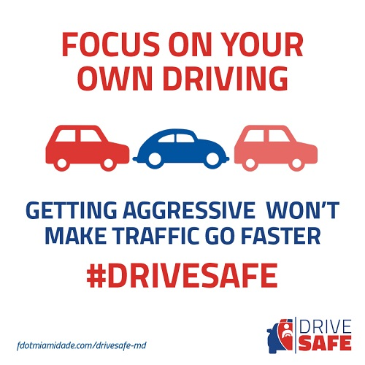
When you make a mistake …
Communication is key. Let other drivers know when you’re sorry you made a driving error.
Notes:
If you accidentally cut someone off or didn’t see a pedestrian about to cross the street, show you’re sorry that you made a mistake.
What leads to aggressive driving?
Aggression can be sparked by errors and trivial events.
“He stole my parking space”
“She cut me off”
“He’s tailgating me and pressuring me to speed up.”
It is often the cumulative result of a series of stressors and troubles in the driver’s life.
It’s often “the straw that broke the camel's back.”
It can start with a misunderstanding that gets out of control.

Slide 14
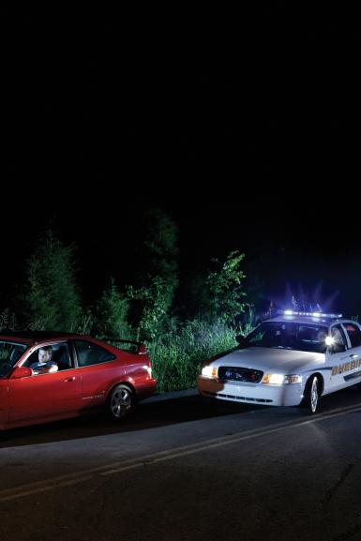
Aggressive Driving vs. Road Rage
There is a difference
Aggressive driving is a traffic offense
Road rage is a criminal offense
Notes:
Aggressive driving creates unsafe situations. Anger can lead to rage if a driver or passenger feels they have been violated or their safety has been threatened. Road rage includes using a vehicle as a weapon with the intent to harm.

Slide 15
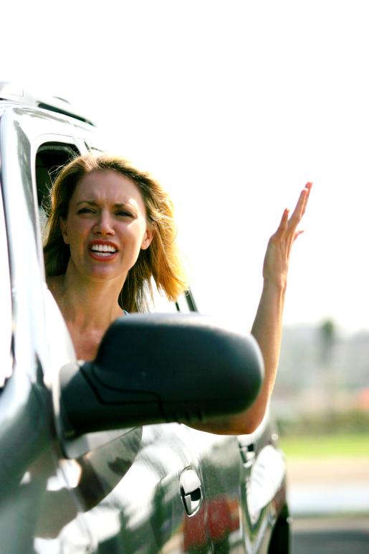
Irrational Actions of the Aggressive Driver
Believes the vehicle hides him from other drivers so he is unseen by others.
Thinks others are out to get her.
Critical about the other driver’s appearance or their vehicle.
Thoughts of violence against others.
Believes his driving is not part of the problem.
Doesn’t observes laws she disagrees with.

Slide 16
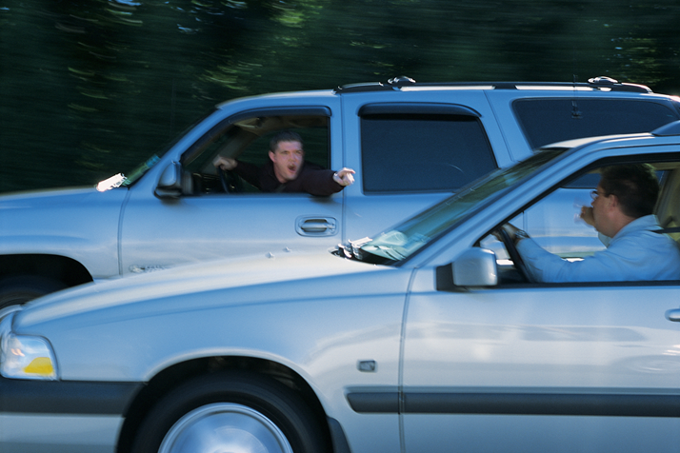
The Road Rage Driver
Notes:
Drivers that escalate minor driving situations into full-blown road rage have negative attitudes about others.
Want to retaliate against others
Wants to injure other roadway users
Has no regard for the feelings and rights of other users
Believes rage is caused by others
Does not accept criticism of his own driving behavior
Disregards the comfort and safety of passengers
For additional information on Road rage and Intermittent Explosive Disorder (IED) visit Mayo Clinic’s web resources.

Slide 17
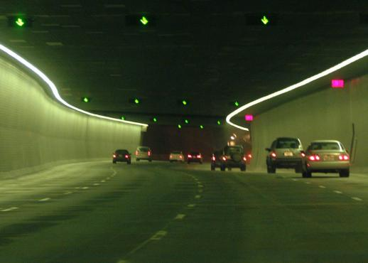
What is road rage?
Intermittent explosive disorder (IED) is marked by episodes of unwarranted anger, impulsive aggressiveness and road rage.
Assault with a motor vehicle that occurs as a direct result of a disagreement between drivers.
Notes:
Road rage is defined as "an assault with a motor vehicle or other dangerous weapon by the operator or passenger(s) of another motor vehicle or an assault precipitated by an incident that occurred on a roadway.” Source: http://www.nhtsa.gov/Aggressive
Drivers that escalate minor driving situations into full-blown road rage have negative attitudes about others. Some may have Intermittent Explosive Disorder (IED) which is marked by episodes of unwarranted anger and impulsive aggressiveness leading to attacks on others and their property. (Visit Mayo Clinic’s web resources for more information.)

Slide 18
Student Activity: Anger Awareness
List driver actions that annoy, frustrate or make other drivers angry.
Small group discussion – 3 minutes
Identify poor driving habits which can lead to aggression.
List all the ones you have seen or can imagine.
What strategies can you use to deal with these situations?
Notes:
Ask the students to works in groups of two or three and generate a list of actions that annoy, frustrate or make other drivers angry
Discuss why they came up with their list.
What about if they were a passenger in car with someone who was angry, emotional and driving erratically etc.
How can they change the outcome of that situation?
List of Aggressive actions:
Passing traffic on the right shoulder of the road
Blocking traffic by driving slow in the outside lane
Failing to yield to faster traffic by moving to the right
Pressuring others by tailgating
Passing then cutting back in sharply in front of the other driver
Not yielding to pedestrians and bicyclists
Not coming to a complete stop at stop signs
Running red lights
Driving through a yellow light
Failing to follow right of way rules
Driving 10 miles below the speed limit when conditions don’t warrant slow speeds
Speeding
Failing to use turn signals
Source: AAA Foundation for Traffic Safety

Slide 19
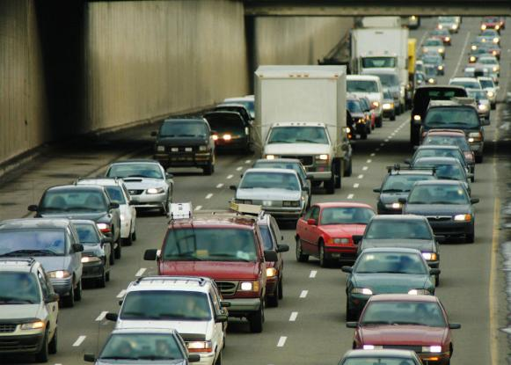
How to make other drivers angry
Reducing a gap to prevent others
from entering your lane.
Failing to turn off high beams
for oncoming drivers.
Flashing high beams to the driver
in front.
Long blasts of the horn.
Weaving in and out of traffic lanes at high speed.
Returning inappropriate gestures to other drivers.
Failing to signal.
Notes:
The common thread when drivers get into an altercation is traffic congestion and frustration.

Slide 20
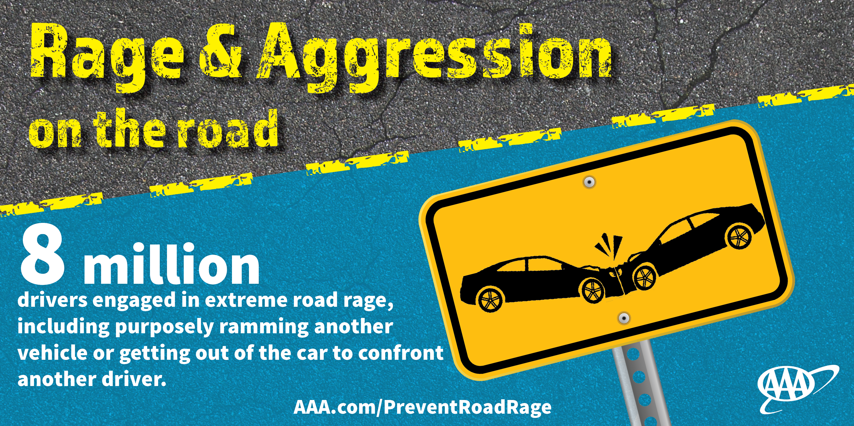
Emotions and Aggressive Drivers
Drivers or passengers can be angry, upset or impatient.
Aggressions become inflamed due to traffic dispute, altercation, or grievance.
Conflicts sometimes lead to violent and life-threatening encounters.
Notes:
NHTSA definition: an individual commits a combination of moving traffic offenses so as to endanger other persons or property.
The "aggressive driver" fails to consider the human element involved. The anonymity of being behind the wheel gives aggressive drivers a false sense of control and power; therefore, they seldom take into account the consequences of their actions.

Slide 21
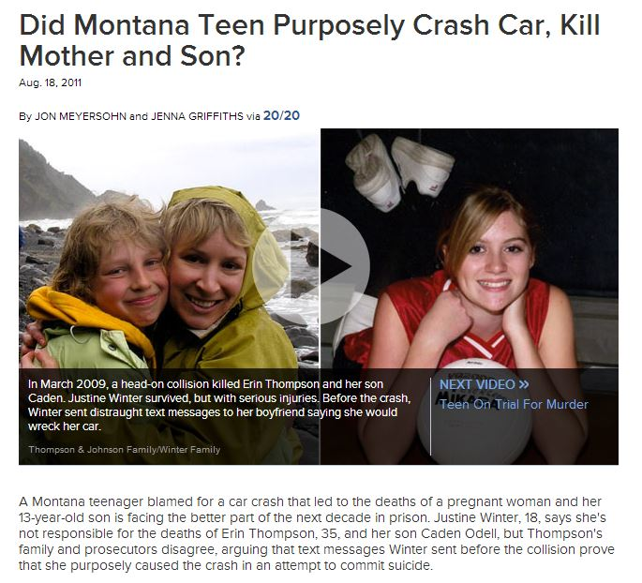
Tragedy on Highway 93
Notes:
A distraught, suicidal teen driving at night, texting and speeding causes a tragic crash. She is now serving a 15-year sentence for the double homicide.
http://abcnews.go.com/US/montana-teen-purposely-crash-car-kill-mother-son/story?id=14268311

Slide 22
Anxieties
“I’m going to be late if I don’t hurry up”
“Why is traffic going so slow?”
“I’ll never make it”
“If only I had gone a little faster, I could’ve made it”
“Oh no! Red light”
“All of these cars are trying to squeeze in!”
“Ha! I’ll speed up and show him a lesson!”
“Everyone else is speeding”
Notes:
Any driver can enter a situation with variable amounts of anxiety which can negatively influence driver behavior and lead to dangerous driving .
Give yourself time- leave early and account for road conditions so you will arrive safely.

Slide 23

What is Anger?
Anger is a warning bell that tells a person something is wrong in a situation.
It's a natural response to perceived threats.
Being angry isn’t always a bad thing.
It can prevent others from taking advantage.
It can motivate people to change societal issues.
Anger is a warning bell that tells a person something is wrong in a situation
It's a natural response to perceived threats
Being angry isn’t always a bad thing
It can prevent others from taking advantage
It can motivate people to change societal issues
The problem is how people handle anger
The problem is how people handle anger.
Notes:
Anger is a feeling of displeasure or hostility which could lead to aggressive driving.
Anger is also a normal, healthy emotion, just like any other feeling such as sadness, disappointment or frustration. The body responds to anger, with muscle tension or an increase in heart rate and blood pressure as the body releases adrenaline — the fight-or-flight hormone. What a person thinks about anger can acknowledge that it's OK to be frustrated, or, on the other end, think that the world is out to get them or that friends "never" do what you ask.
Sources: Anger Research Consortium; American Psychological Association

Slide 24


Anger Management
If you are driving and feel anxious or angry:
Breathe deeply
Slowly repeat calming words such as “relax,”
“let it go,” “take it easy”
Stay off the road until calmed down.
Remember everyone makes mistakes and wants to be treated fairly.
Change the way you think – practice patience and forgiveness.
Out-of-control anger is a learned behavior that can be unlearned.
Notes:
The American Psychological Association has strategies to control anger: http://www.apa.org/topics/anger/control.aspx.
Closing your eyes to visualize a calm relaxing place could work in a parking lot, but not while driving. State your concerns and needs without hurting others.
“Serenity now” – Frank Costanza in Seinfeld, 1997

Slide 25
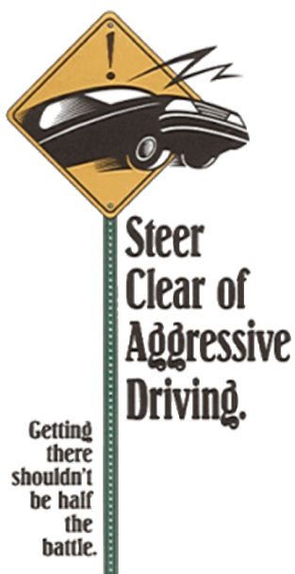
Reduce conflict to avoid confrontation
Don’t respond.
Avoid eye contact with hostile drivers.
Get out of the way but do not acknowledge the other driver.
Don’t up the ante.
Swallow your pride.
Choose the road “less traveled”
Notes:
Ignore gestures and name calling – refuse to return them
Be tolerant and forgiving – the other driver may be having a bad day

Slide 26
Avoid confrontation to reduce conflict
If an angry driver pursues you, do not go home and do not get out of your car.
Drive to a police station, convenience store, or other location where you can get help and there will be witnesses.
Call 911 if you’re concerned for your safety.
Notes:
Do not get out of your vehicle – lock the doors

Slide 27
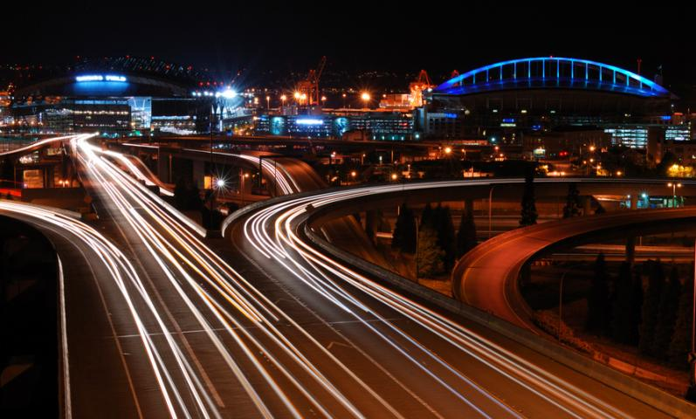
Golden Rules of the Highway
Obey traffic laws
Drive courteously
Show respect for all drivers and other roadway users
Notes:
Expect mistakes and keep a safe following distance. You will need space if something unexpected happens.
Patience is a virtue especially while driving.

Slide 28
Aggressive Driving - Research
https://www.geico.com/more/driving/auto/car-safety-insurance/7-ways-to-avoid-road-rage/
http://newsroom.aaa.com/2016/07/nearly-80-percent-of-drivers-express-significant-anger-aggression-or-road-rage/
https://www.psychologytoday.com/blog/all-the-rage/201112/why-driving-makes-us-so-mad

Slide 29
Montana Driver Education and Training
Standards and Benchmarks
1. Laws and Highway System
  1.1. know the laws outlined in the Montana Driver's manual;
  1.2. understand the laws outlined in the Montana Driver's Manual; and
  1.3. consistently demonstrate knowledge and understanding by responsible adherence to highway transportation system traffic laws and control devices.
2. Responsibility
  2.1. recognize the importance of making safe and responsible decisions for owning and operating a motor vehicle;
  2.2 demonstrate the ability to make appropriate decisions while operating a motor vehicle;
  2.3. consistently display respect for other users of the highway transportation system; and
  2.4. develop positive habits and attitudes for responsible driving.
3. Visual Skills
  3.1. know proper visual skills for operating a motor vehicle;
  3.2. communicate and explain proper visual skills for operating a motor vehicle;
  3.3. demonstrate the use of proper visual skills for operating a motor vehicle; and
  3.4. develop habits and attitudes with regard to proper visual skills.
4. Vehicle Control
  4.1. demonstrate smooth, safe and efficient operation of a motor vehicle; and
  4.2. develop positive habits and attitudes relative to safe, efficient and smooth vehicle operation.
5. Communication
  5.1. consistently communicate driving intentions (i.e., use of lights, vehicle position, and personal signals);
  5.2. adjust driver behavior based on observation of the highway transportation system and other roadway users;
  5.3. adjust communication (i.e., use of lights, vehicle position, and personal signals) based on observation of the highway transportation system and other users; and
  5.4. develop positive habits and attitudes for effective communication.
6. Risk Management
  6.1. understand driver risk-management principles;
  6.2. demonstrate driver risk-management strategies; and
  6.3. develop positive habits and attitudes for effective driver risk-management.
7. Lifelong Learning
  7.1. identify and use a range of learning strategies required to acquire or retain knowledge, positive driving habits, and driving skills for lifelong learning;
  7.2. establish learning goals that are based on an understanding of one’s own current and future learning needs; and
  7.3. demonstrate knowledge and ability to make informed decisions required for positive driving habits, effective performance, and adaptation to change.
8. Driving Experience
  8.1. acquire at least the minimum number of BTW hours over at least the minimum number of days, as required by law, with a Montana-approved driver education teacher; and
  8.2. acquire additional behind-the-wheel driving experience with a parent or guardian’s assistance in a variety of driving situations (i.e., night, adverse weather, gravel road, etc.).
Notes:
Standards and Benchmarks: This is for your reference and not to be read to the class verbatim. Please review prior to the lesson so you are aware of what the student will be required to know at the end of the module.

