Slide 1

Montana Teen Driver Education and Training
Module 7.1
Your Driver’s License
Getting it and keeping it
Notes:
THIS MODULE REVISED FEBRUARY 2018

Slide 2
Driver Licensing - Objectives
Students recognize driver education and training as the foundation for assisting them and the parent or supervising driver to continue the lifelong learning process of reduced risk driving. Students understand the requirements for complying with the Graduated Driver Licensing (GDL) requirements and how to get and keep a driver’s license.
Students are expected to:
describe the process of obtaining and maintaining a Montana driver license;
recognize the types of driver licenses and instruction permits;
understand licensing restrictions, suspensions, and revocations and renewals
understand the requirements and consequences during a GDL period;
understand the Graduated Driver Licensing process, the purpose and use of parent resource materials, ways to effectively practice driving during the learning phase;
develop strategies to continue and accept personal responsibility for the lifelong learning process of reduced risk driving.

Slide 3
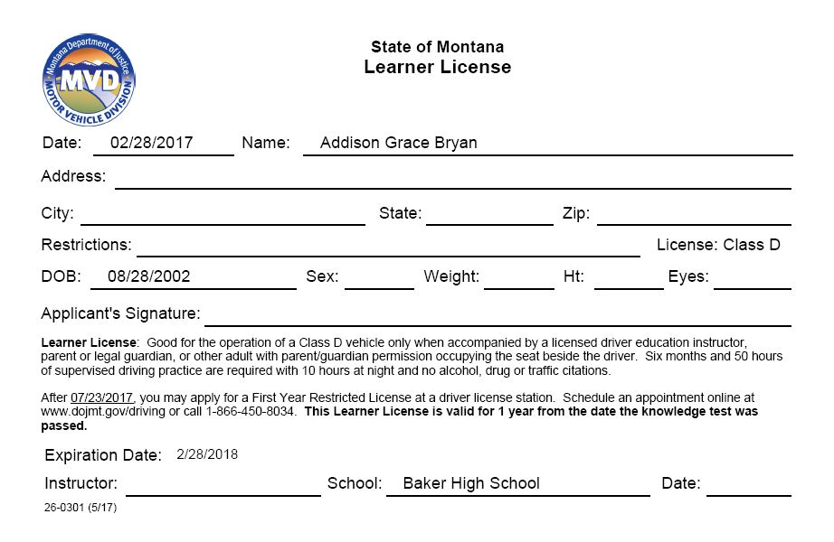
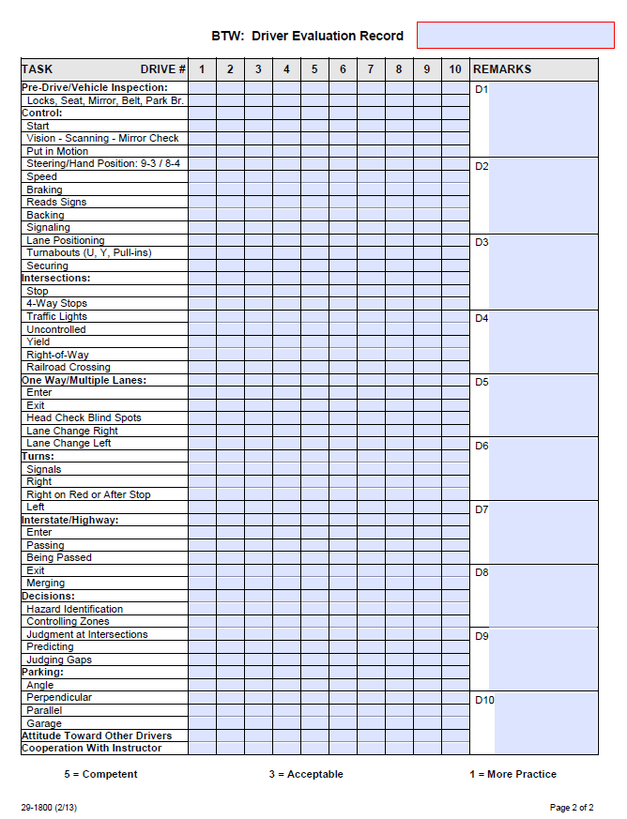
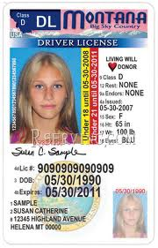
Driver Education and your Learner License
Traffic Education Permit = To drive only with instructor
After GDL 50 hours and 6 months
of supervised driving practice
Notes:
One of the incentives for teens to enroll in driver education is to qualify for a driver license before age 16. Parents value the professional instruction and guided practice to help their teens develop safe driving skills and habits.
Generally teachers cover the first few modules on Preparing to Drive, Basic Control and Traffic Laws before administering the CDTP tests.
Students must be age 14.5 and participating in traffic education to be eligible to take the DOJ/MVD Knowledge Test.
Passing the DOJ Knowledge Test could create the illusion that they know how to drive even though the MT Driver Manual says:
“SECTION 6 - SAFE DRIVING TIPS: No manual can teach you how to operate a vehicle or be a safe driver. Driving requires skill you can only gain through instruction and practice, and even then it all depends on how you choose to apply what you have learned.”

Slide 4
Applying for your Learner License
If you don’t get your Learner License before your driver education class ends, the 6-month GDL practice period starts over.
The items on this list are required to apply for a learner license or a driver’s license.
Bring to the Driver Exam Station or your Driver Education class:
Certified Birth certificate
Social Security card
Proof of Montana residency
Eyeglasses
Money
Mom or Dad, or guardian
Notes:
Many of you will obtain your Learner’s License during your driver’s education course, but if you don’t, here’s what you need to bring to the Driver Exam Station.
From the Montana Driver Manual:
A Learner License may be issued to any person who is at least 14 ½ years of age and who is participating in or successfully completed a traffic education course approved by the Department of Justice and the Superintendent of Public Instruction. A Learner License entitles the licensee to operate a motor vehicle only when accompanied by an approved instructor, licensed parent or guardian or other licensed adults authorized by the parent/legal guardian.
When you take driver education and are able to get a learner license from your teacher, the six-month practice period usually starts close to the beginning of your driver education class.

Slide 5
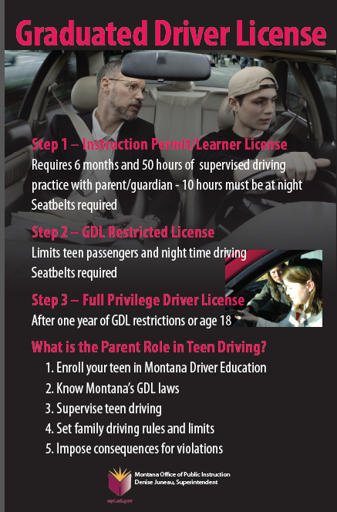
GDL First-Year
Restricted License
Seatbelts required
for everyone – all the time
Passengers
First 6 months – only one
Second 6 months – up to 3
Best Practices: No passengers
Night restrictions
11:00 PM – 5:00 AM
Best Practices: The real risk is darkness
Parents are the key to
teen driver safety.
Notes:
Montana GDL Restrictions:
Seatbelts required – for everyone – all the time
Passengers – First 6 months – only one who is not a family member
Second 6 months – up to 3 passengers who are not family members
Best Practices: No passengers
Night restrictions – teens can’t drive between 11:00PM and 5:00AM unless it’s an emergency, or you’re travelling to school, church, work or farm activities.
Best Practices: The real risk is darkness.

Slide 6
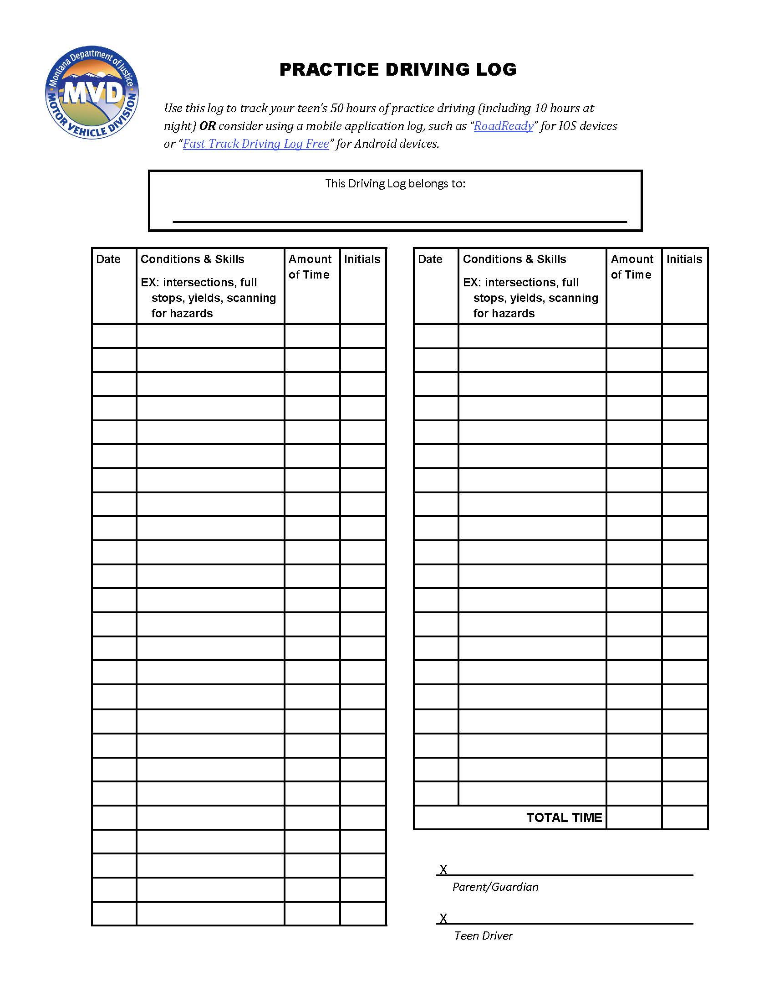
GDL Driving Practice Log
  Log to track 50 hours of supervised practice time.
  Parent, legal guardian or licensed adult driver (authorized by parent/ guardian) can supervise the teen driver with a learner license.
  Practice in varied traffic, weather and road conditions
Develop a Parent/Teen contract.
  Bring practice log to driver examiner when applying for restricted license; they will ask for it.
Notes:
From the Montana Driver Manual:
The Graduated Driver Licensing (GDL) program is a three-step progressive program that allows new drivers under 18 to develop and improve their driving skills in the safest environment possible. Motor vehicle crashes are the leading cause of death and injury for teenagers because teens lack driving experience. All new drivers – even honor roll students and “good kids” – are likelier than experienced drivers to be involved in crashes due to driver errors, scanning, and speed. The GDL program limits the number of passengers and driving in the dark, which helps reduce the crash risk for teen drivers.
Each step is designed to progressively increase the skills, privileges, and responsibilities of a new driver. The GDL program includes the learner license, first-year restricted license, and full-privilege driver license.

Slide 7

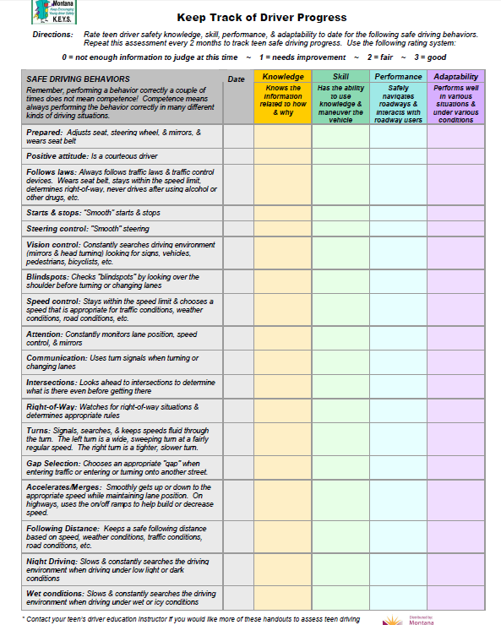
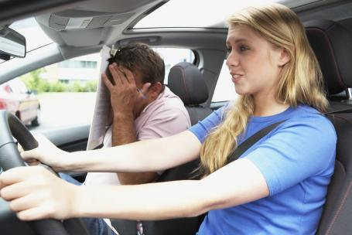
Practice with your parents to develop safe driving skills
www.OPI.mt.gov
Driver Education Curriculum
Notes:
Keep Encouraging Young Driver Safety: KEYS Project 2009
What is KEYS? Homework assignments and activities for parents and teen drivers developed by the Montana Department of Transportation, Montana State University-Northern, and the Montana Office of Public Instruction.
Download the assignments from OPI’s website or order pre-printed full-color packets from MSU-Northern.

Slide 8
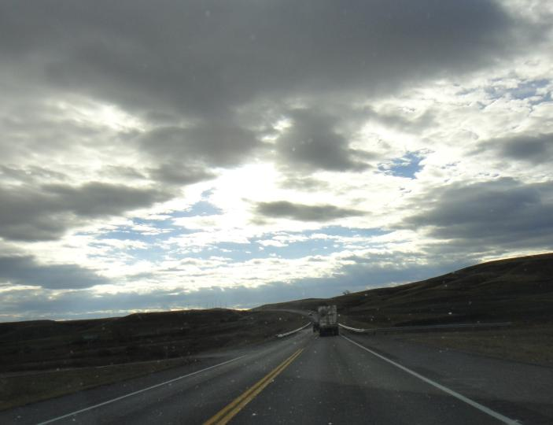
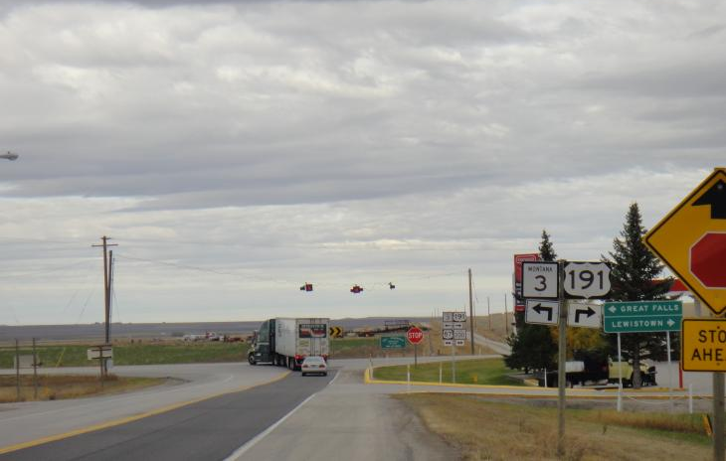
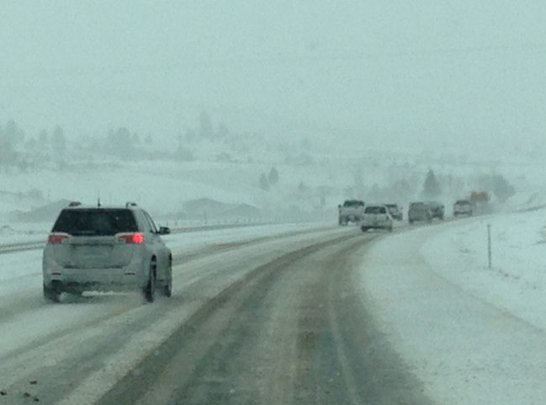
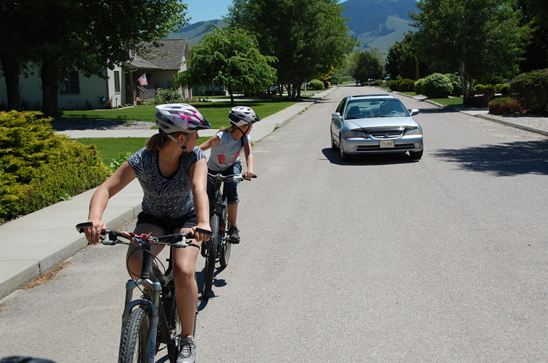
Notes:
Practice driving in varied weather and road conditions to develop skills and strategies to control speed and vehicle balance during adverse weather.

Slide 9
Driving Solo: Getting your Restricted Montana driver’s license
Verifying your identity is required to prevent fraud.
Check this website to make driver license station appointments:
https://dojmt.gov/driving/appointment-scheduling
Bring:
CERTIFIED BIRTH CERTIFICATE (not a copy)
SOCIAL SECURITY CARD* (not a copy)
Cancelled mail showing your name and mailing address (can’t be a post office box)
Parent/legal guardian to sign consent
Driving practice GDL log
* Name and birth date registered with the Social Security Administration must match name and date on driver’s license application.
Notes:
Driver Licensing Stations require TWO forms of identification. The list of additional documents which are accepted ONLY at Driver Licensing Stations can be found at http://www.dojmt.gov/driving.
You’ve put in your six months and 50 hours (10 at night) of driving with your parents or legal guardian, and you’re ready for your restricted license.

Slide 10
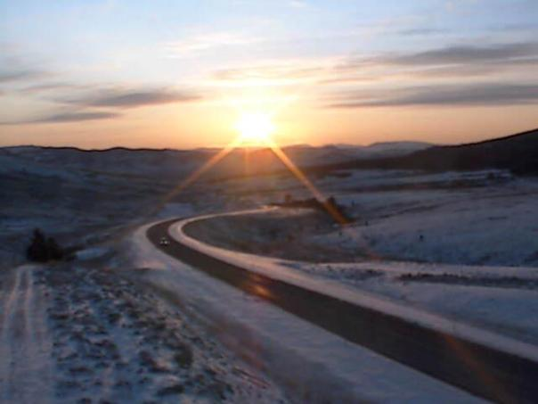
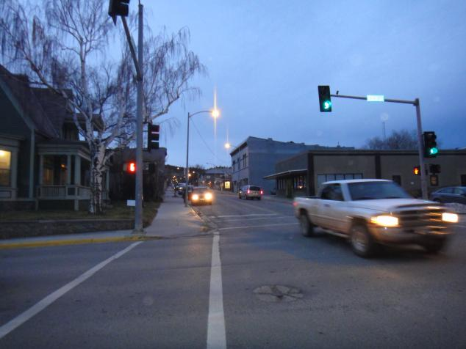
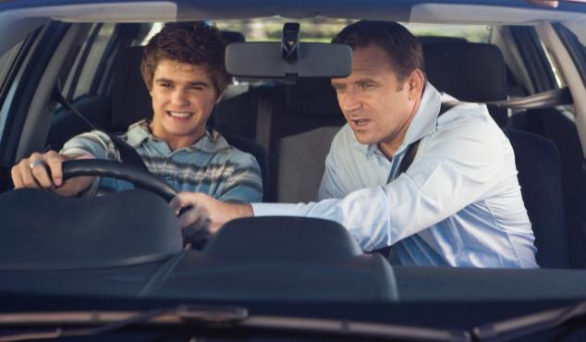
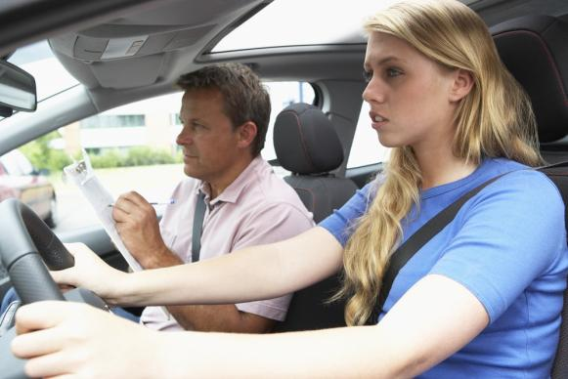
Highest lifetime crash risk is in the first year of independent driving.
Lowest risk is when driving with your parent or guardian.
Notes:
Transition to Unsupervised Driving
In the early months of unsupervised driving, the majority of teens exhibit good driving habits however the study did find instances of texting behind the wheel, horseplay with passengers and running red lights.
While a very small number of instances of deliberate risk‐taking behavior were observed, the vast majority of “close calls” involved judgment errors that seemed to be indicative of inexperience and failure to anticipate changes in the traffic environment. A common scenario involved the teen braking hard after having initially failed to notice that traffic ahead was slowing or stopped.
2011 AAA Foundation for Traffic Safety Report
Authors: Arthur Goodwin
Robert Foss
Natalie O’Brien
UNC Highway Safety Research Center

Slide 11
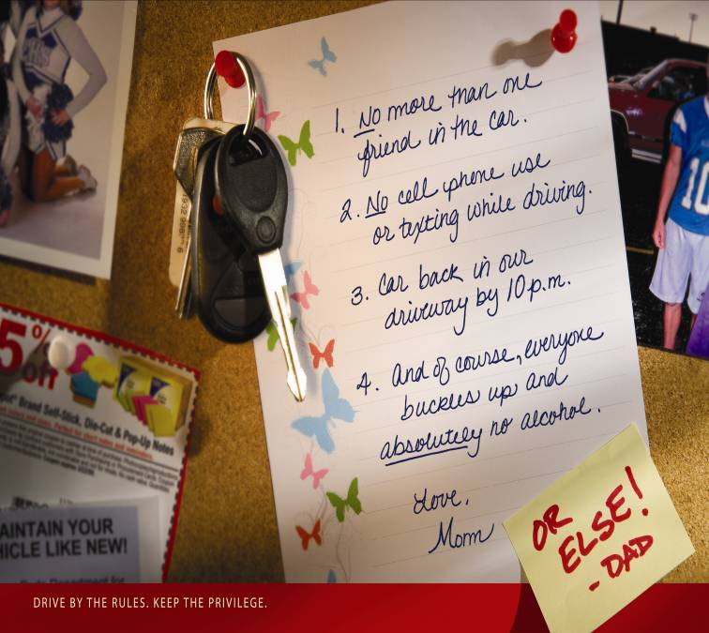
Drive by the rules. Keep the privilege.
Family rules and limits are about safety, not control.
Notes:
Family rules and limits are about safety, not control.
Montana’s GDL places limits on teens during their crucial first year of solo driving. Agreements like this between you and your parents are an excellent way to be held accountable while you are beginning to drive without supervision. Your driving privileges will increase as you gain driving skills and competence, and show you can drive responsibly.

Slide 12
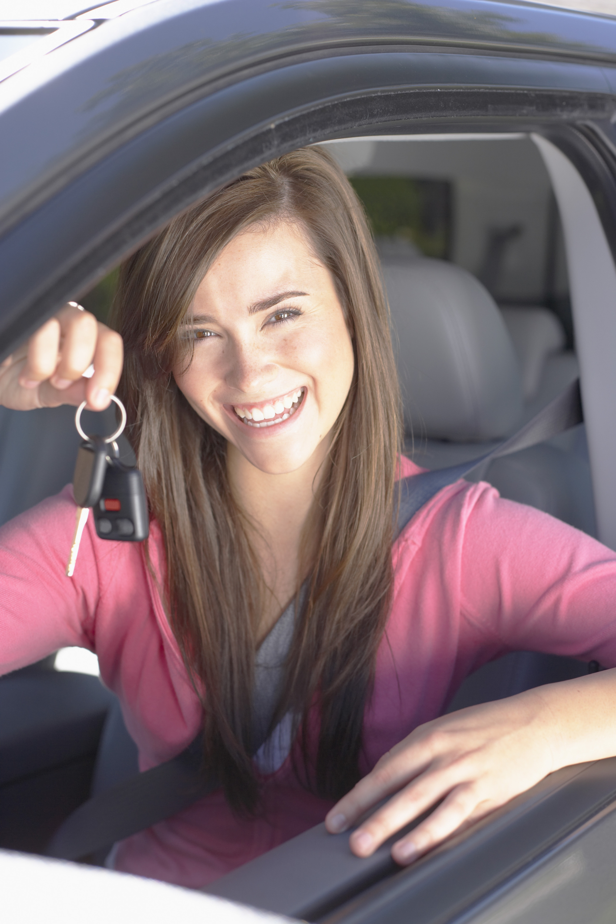
As a licensed driver, you:
can operate a motor vehicle on public roadways in Montana in a careful and responsible manner.
must carry proof of mandatory vehicle liability insurance.
must have your license with you whenever you drive.
must not loan your driver license to anyone.
Notes:
In addition:
Drivers may have only one valid driver’s license at any time.
A license from another state is good for 60 days in Montana.
Under Montana law, motorists stopped for a traffic violation or involvement in a motor vehicle collision are required to show proof of insurance to law enforcement, in addition to displaying their driver license and vehicle registration.

Slide 13
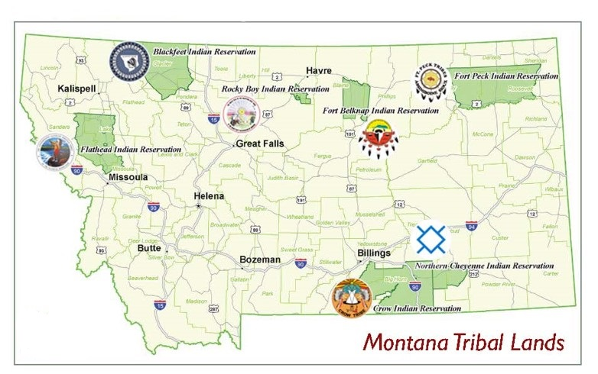
Driving on Montana Tribal Lands
Notes:
Montana Codes and Tribal Codes Regulate Traffic
American Indians driving on some reservation roads and highways may follow tribal traffic codes, which may not require a driver license and insurance. Consider inviting a tribal officer or a representative from the tribal court to discuss the traffic codes which apply in specific areas.
The Tribal Council of the Confederated Salish and Kootenai Tribes adopted the Montana traffic laws in MCA Title 61.

Slide 14
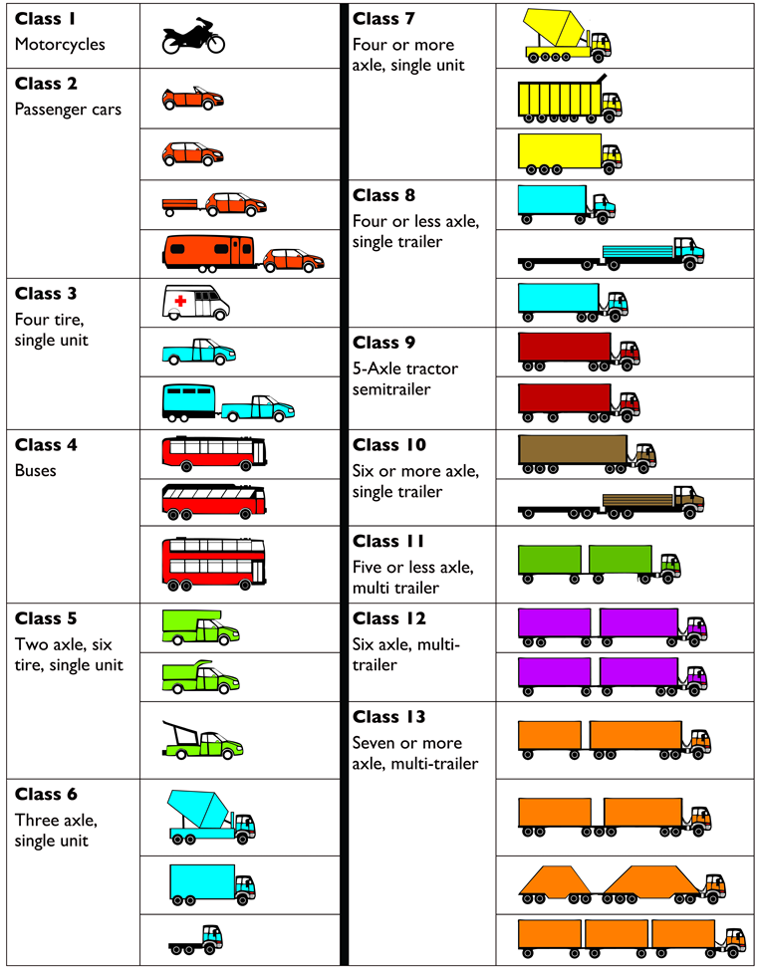
What type of driver license is required?
Notes:
Which vehicles can you drive?
Class 2 and Class 3 are the only vehicle classes you can drive with a TELL or Class D driver license.
Federal Highway Administration Vehicle Classification are based on axles.
Vehicle and trailer weight determine the type of Commercial Driver License required.
Class 1 Motorcycle Endorsement on Class D Driver License
Class 2 Class D Driver License
Class 3 Class D Driver License
Class 4 CDL Class B or C for 16 passengers or more
Class 5 Class D Driver License or CDL for commercial
Class 6 CDL Class B
Class 7 CDL Class B
Class 8 – 13 CDL Class A or B depending on weight
Class A License allows the holder to operate any combination of vehicles, including: a vehicle
exceeding 26,000 GVWR that is towing a trailer over 10,000 pounds
Class B License allows the holder to operate a vehicle exceeding 26,000 GVWR that is towing a trailer at/or under 10,000 pounds GVWR
Class C License allows the holder to operate a single vehicle under 26,000 pounds
Federal Highway Administration Vehicle Classification - http://www.fhwa.dot.gov/policyinformation/tmguide/ (2013)

Slide 15
Replacing a lost learner license…
Change of address …
If your learner license is lost or destroyed:
Costs $10 to replace at the driver license station.
Take an original or certified copy of my birth certificate.
Change of name or address
Tell the driver license station within 10 days!

Slide 16
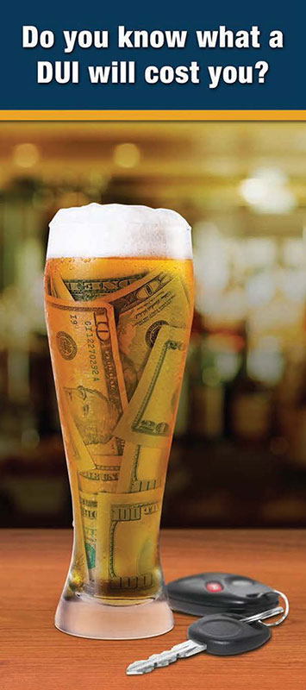
Minor in Possession (MIP) of Alcohol
Under Age 21 – It is illegal to possess or consume any alcoholic beverage.
MIP convictions:
Learner license: Supervised practice driving extended until teen has six months with no alcohol/drug or traffic offenses.
Driver license will be confiscated:
First MIP offense – 30-day confiscation.
6-month confiscation for second or subsequent MIP offense.
Notes:
MIPs are not recorded on an individual’s Montana Driving Record, however, judges have the authority to order the suspension of an offender’s driver license. The Motor Vehicle Division will suspend the offender’s driver’s license for the number of days ordered by the court and permanently record the withdrawal on the offender’s driving record.

Slide 17
Montana Driver Record
Your driving record is for life
Montana Driver Records Sample Conviction Points | MCA 61-11-203 | Montana Code Annotated (MCA) Title 61
No driver’s license | 2 points | 61-5-102
Speeding | 3 points | 61-8-303
Other moving violations - Failure to obey stop signs and traffic signals, following too closely, improper passing | 2 points | 61-8-207 61-8-320 to 340
Car insurance violations | 5 points | 61-6-301
Illegal drag racing | 5 points | 61-8-308
Hit and run (property) | 4 points | 61-7-107
Reckless driving - driving with willful and wanton disregard for safety of persons and property | 5 points | 61-8-301
Failure to stop and help or give information when involved in a crash | 4 or 8 points | 61-7-103 61-7-105
Driving with your license suspended or revoked Second offense penalty - vehicle may be seized | 6 points | 61-11-213 61-5-212
DUI - driving while intoxicated or drugged with narcotics | 10 points | 61-8-401
Other felony when a motor vehicle is used | 12 points | 61-11-203
Seat belt violation - | $20 fine | 61-13-104
Notes:
Your driving record is for life. It starts when you start driving.

Slide 18
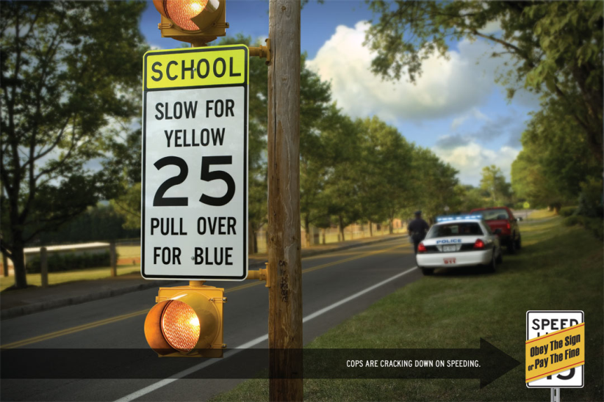
Your Driving Record is for Life
Ten speeding tickets = 30 points = revoked license
Habitual Traffic Offender: 30 or more convictions points in 3 years (MCA 61-11-212). License revoked and no driver license for 3 years.

Slide 19
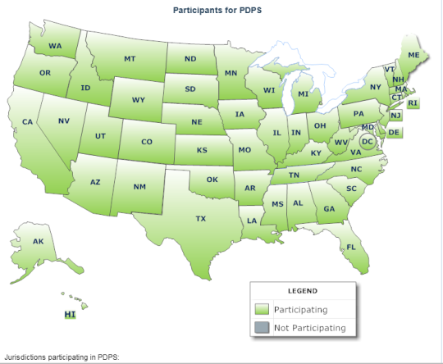
Nationwide Problem Driver System
Montana is linked to a nationwide system to detect individuals who are suspended, revoked, disqualified, or denied a license to drive in another state.
Problem Driver Pointer System (PDPS)
Notes:
A person cannot apply for, be issued, or retain a Montana driver license if he/she is suspended or revoked in any other state or jurisdiction.
Upon application for a license, the computer record system is checked to see if you have a driving record in another state(s). If your status is not eligible, you will not be allowed to obtain a Montana’s driver’s license until your status returns to eligible.

Slide 20

License Cancellation
  Violations resulting in a cancellation include:
  removal of parental consent to drive. (Yes, they can)
  Other examples:
  fraud, and/or falsifying information on application for a license to drive.
  paying for a driver license with a non-sufficient funds check.
  voluntary surrender of license.
  suspended or revoked in another state.
Notes:
Also a minor’s driver license will be cancelled upon the death of the person who signed the minor’s application.

Slide 21
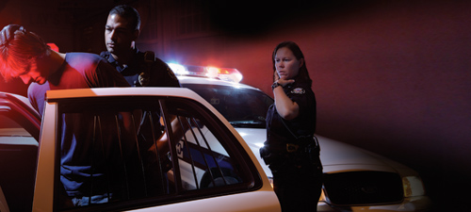
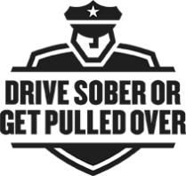
License Suspension
License suspensions occur when a teen drives under the influence (DUI) or operates a motor vehicle with a blood alcohol content of 0.02% or greater.
A probationary license may be issued to drive to school or work while the license is suspended.
Notes:
BAC 0.02% is the lowest detectable limit
Under age 21 It is illegal to possess or consume alcohol

Slide 22
License Suspension (continued)
A driver’s license will be suspended for 30 days to one year (or in some cases indefinitely) due to:
Conviction of three reckless driving offenses within a 12-month period.
Using a motor vehicle in the theft of motor vehicle fuel.
Medically unsafe driver.
Failure to obtain required medical evaluation or submit to testing.
Making a fraudulent application for a license.
Falsifying a date of birth on a driver license application.
Altering a driver license or identification card to obtain alcohol.
Authorizing someone else to use your driver license or identification card to obtain alcohol.
Any unlawful use of a driver license.
Notes:
In addition, your license can be suspended for:
Non-payment of fines or not appearing when given a notice to appear in court
Indefinite suspension for failing to pay child support until child support obligations are met
Default on a student loan

Slide 23
License Revocation or Termination
A driver license can be terminated for one year or more when the driver has:
A conviction for negligent homicide with a vehicle.
A conviction for any felony in which a motor vehicle is used.
Failure to stop and render aid as required in the event of a motor vehicle accident resulting in the death or personal injury of another.
Perjury or the making of a false affidavit or statement under oath relating to the ownership or operation of motor vehicles.
Negligent vehicular assault involving a motor vehicle.
To reinstate driver license, driver will have to pay all required fees and take and pass all the tests again.

Slide 24
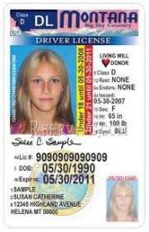
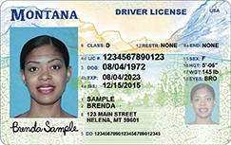
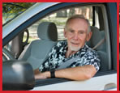
When to Renew Your Driver License
If you are under the age of 21, your license will expire on your 21st birthday.
If you are between the ages of 21 and 75, your license will expire on your birthday eight years or less after the date
At age 75 or older, your license will expire on your birthday four years or less after the date of issuance.
Notes:
The length of time a driver’s license will be valid depends on several factors, such as your age at the time of initial licensure and the date of your birth.

Slide 25

Don’t let your license expire
Renewal: You may renew up to six months before the expiration date of your license on your birthday.
Expired License: If your birthday passes and
you have not renewed, your driving privilege stops on your birthday. If you are found driving after your birthday, you are driving in violation of the law and are eligible for a citation.
If your license is more than three months expired, you must take and pass the written and driving test.

Slide 26
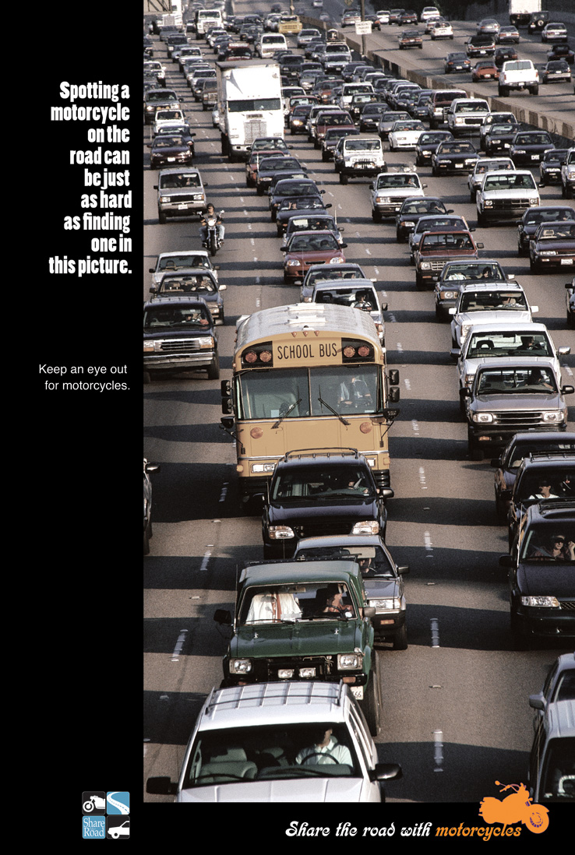
Motorcycle Endorsement
Motorcycle Learner License
Valid for one year to practice under supervision of a motorcycle-endorsed licensed adult driver.
Motorcycle Endorsement on a Class D License
Pass vision, knowledge and skills tests.
Motorcyclists who successfully complete a Montana motorcycle rider course are exempt from the skills test.
Notes:
A motorcycle endorsement is required to legally operate a motorcycle or scooter on Montana's streets and highways.
Montana Motorcycle Rider Safety Courses are offered through MSU- Northern
http://motorcycle.msun.edu/index.htm

Slide 27
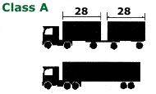
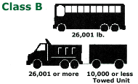
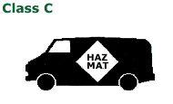
Commercial Driver License (CDL) Classifications
Class A – Combination Vehicle
Class B – Heavy straight vehicle
Class C – Small commercial vehicle transporting 16 or more passengers or hazardous materials
CDL – can be interstate or intrastate
GVWR* over 26,000
Trailer over 10,000 lbs.
GVWR under 26,000
*GVWR – gross vehicle weight rating
Notes:
Type 1 Certification allows a driver to operate a commercial motor vehicle in interstate commerce, you must be at least 21 years old
Type 2 Certification allows a driver to operate a commercial motor vehicle in intrastate commerce (only within the state of Montana),
Class A License allows the holder to operate any combination of vehicles, including:
a vehicle exceeding 26,000 GVWR that is towing a trailer over 10,000 pounds
articulated buses with a GCVWR exceeding 26,000 pounds
any vehicle authorized to be driven under Class B, C or D
Class B License allows the holder to operate:
a vehicle exceeding 26,000 GVWR that is towing a trailer at/or under 10,000 pounds GVWR
a school bus, or any bus or other vehicle hauling 16 or more passengers, including the driver
all vehicles under Class C or D
Class C License allows the holder to operate:
a single vehicle under 26,000 pounds
a vehicle that hauls hazardous materials in an amount sufficient to require placarding under Title 49 Code of Federal Regulations (CFR) Part 391
a school bus, or any vehicle that hauls 16 or more passengers, including the driver

Slide 28
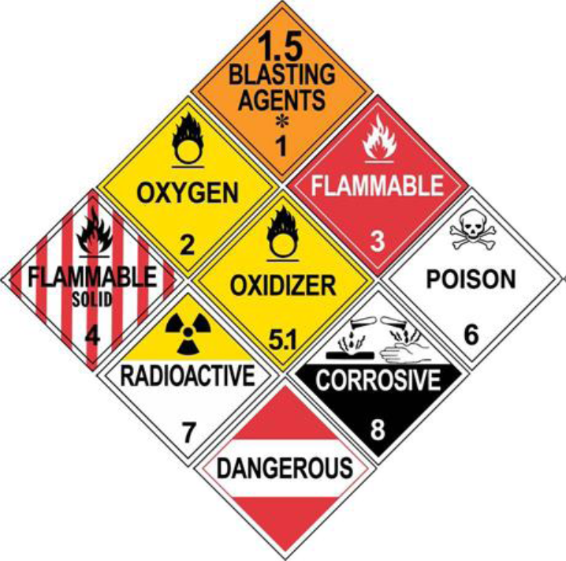
Driving with Hazardous Materials
Notes:
CDL Hazardous Materials endorsement is required of placarded hazardous materials haulers operating commercial vehicles in Vehicle Class A, B, or C. In compliance with federal law, drivers wishing to obtain, transfer or renew a Hazardous Materials endorsement must first have a Security Threat Assessment (STA) completed by the Transportation Security Administration (TSA). This assessment includes but is not limited to fingerprinting and a criminal background check. For TSA office locations, fees, and appointment information, logon to www.hazprints.com or call toll free 1-877-429-7746.

Slide 29
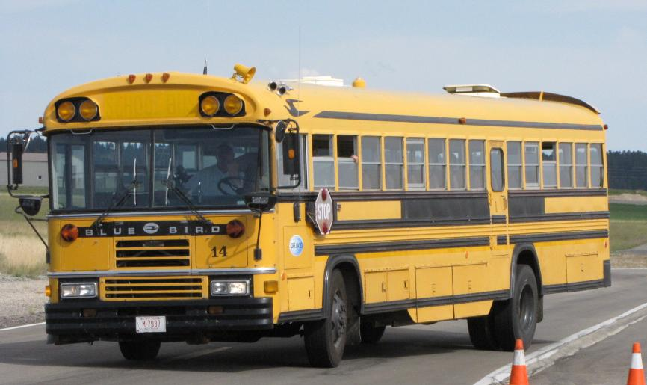
CDL School Bus Endorsement
Notes:
CDL with School Bus Endorsement - The S endorsement applies to the operation of any commercial vehicle or school bus that carries 16 passengers or more, including the driver, and is used to transport pre-primary, primary or secondary students from:
home to school
school to home
to and from school-sponsored events
A bus used as a common carrier is not considered to be a school bus.
School bus drivers must have a Passenger Endorsement and pass the knowledge exam covering:
• Danger Zones and Use of Mirrors
• Loading and Unloading
• Emergency Exit and Evacuation
• Railroad-highway Grade Crossings
• Student Management
• Antilock Braking Systems
• Special Safety Situations

Slide 30
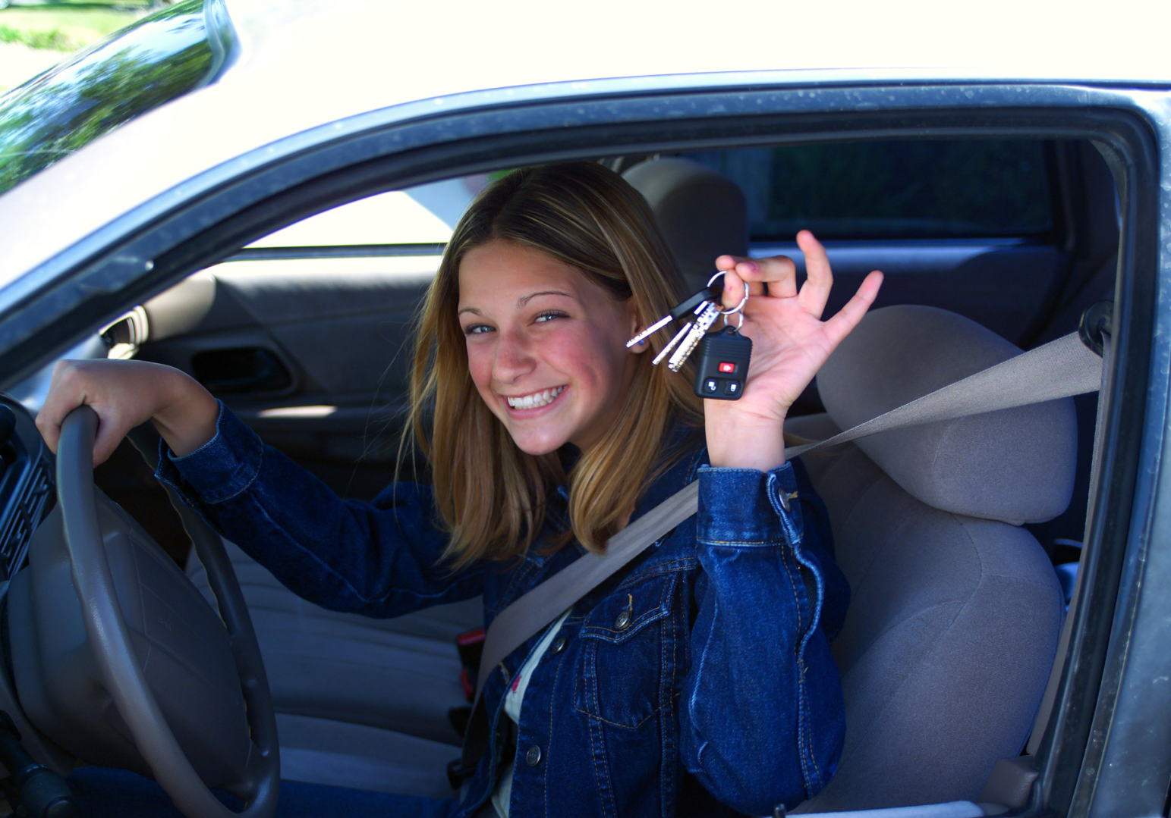
Driving is a Privilege.
Not a Right.
It's a common misconception that everyone has a right to drive. In reality, operating a motor vehicle is a serious responsibility; it's a privilege not a right.
Everyone who drives by the rules keeps the privilege. Those who don't can lose their license.
http://www.mdt.mt.gov/visionzero/people/buckleup/privilege.shtml

Slide 31
Montana Driver Education and Training
Standards and Benchmarks
1. Laws and Highway System
  1.1. know the laws outlined in the Montana Driver's manual;
  1.2. understand the laws outlined in the Montana Driver's Manual; and
  1.3. consistently demonstrate knowledge and understanding by responsible adherence to highway transportation system traffic laws and control devices.
2. Responsibility
  2.1. recognize the importance of making safe and responsible decisions for owning and operating a motor vehicle;
  2.2 demonstrate the ability to make appropriate decisions while operating a motor vehicle;
  2.3. consistently display respect for other users of the highway transportation system; and
  2.4. develop positive habits and attitudes for responsible driving.
3. Visual Skills
  3.1. know proper visual skills for operating a motor vehicle;
  3.2. communicate and explain proper visual skills for operating a motor vehicle;
  3.3. demonstrate the use of proper visual skills for operating a motor vehicle; and
  3.4. develop habits and attitudes with regard to proper visual skills.
4. Vehicle Control
  4.1. demonstrate smooth, safe and efficient operation of a motor vehicle; and
  4.2. develop positive habits and attitudes relative to safe, efficient and smooth vehicle operation.
5. Communication
  5.1. consistently communicate driving intentions (i.e., use of lights, vehicle position, and personal signals);
  5.2. adjust driver behavior based on observation of the highway transportation system and other roadway users;
  5.3. adjust communication (i.e., use of lights, vehicle position, and personal signals) based on observation of the highway transportation system and other users; and
  5.4. develop positive habits and attitudes for effective communication.
6. Risk Management
  6.1. understand driver risk-management principles;
  6.2. demonstrate driver risk-management strategies; and
  6.3. develop positive habits and attitudes for effective driver risk-management.
7. Lifelong Learning
  7.1. identify and use a range of learning strategies required to acquire or retain knowledge, positive driving habits, and driving skills for lifelong learning;
  7.2. establish learning goals that are based on an understanding of one’s own current and future learning needs; and
  7.3. demonstrate knowledge and ability to make informed decisions required for positive driving habits, effective performance, and adaptation to change.
8. Driving Experience
  8.1. acquire at least the minimum number of BTW hours over at least the minimum number of days, as required by law, with a Montana-approved driver education teacher; and
  8.2. acquire additional behind-the-wheel driving experience with a parent or guardian’s assistance in a variety of driving situations (i.e., night, adverse weather, gravel road, etc.).
Notes:
Standards and Benchmarks: This is for your reference and not to be read to the class verbatim. Please review prior to the lesson so you are aware of what the student will be required to know at the end of the module.

