Slide 1

Montana Teen Driver Education and Training
Module 7.2
Owning a Vehicle and
Trip Planning
Responsible driving
Notes:
REVISED 2018

Slide 2
Owning Vehicle – Trip Planning Objectives
Responsibilities for owning and operating a vehicle:
Insurance Requirements
Purchasing a Vehicle
Maintaining a Vehicle
Planning a Trip
Conserving Resources

Slide 3
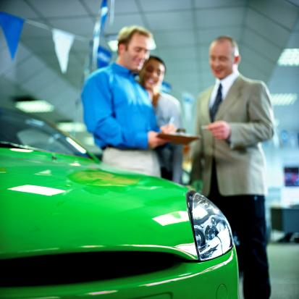

Buying and Maintaining a Vehicle
Before taking the first step toward ownership, know what you will need and the true cost to operate the vehicle.
Vehicle Purchase Cost
Monthly payments and interest
Insurance payments
Repair and maintenance expenses
Fuel mileage and costs
Registration fees

Slide 4

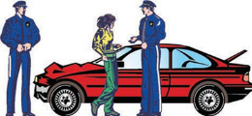
Vehicle Insurance Required
Montana’s Required Auto Liability Insurance
$25,000 Bodily injury or death of one person in any one accident
$50,000 Bodily injury or death of two persons in any one accident
$20,000 Injury to or destruction of property of others in any one accident
Notes:
Montana’s minimum liability insurance law for motor vehicles MCA 61-6-103
Liability: Covers the other person’s insurance assuming you are the driver and you cause a crash
Property Damage: Covers the property damage of any vehicle involved except yours
Bodily Injury: Covers expenses for injury to anyone involved in the crash other than you, up to the limit of coverage

Slide 5
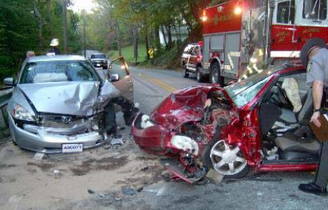
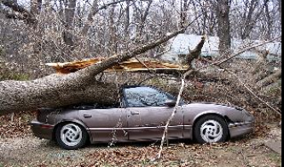
Types of Vehicle Insurance
Collision
Covers the cost to repair damage to your vehicle if you are in a collision regardless of who caused the crash; a deductible usually applies.
Comprehensive
Covers the cost to repair damage to your vehicle by causes other than collision, such as fire, vandalism, theft of part or all of your vehicle, and colliding with a bird or animal; a deductible usually applies.

Slide 6

Vehicle Insurance Coverage
Auto Medical Payment
Covers you and your occupants in your vehicle who are injured in an crash; does not usually cover time loss from work.
Towing and Road Service
Covers towing and road service if the vehicle is disabled; usually only covers the cost of labor at the scene.
Rental Reimbursement
Covers the cost of renting a vehicle while your vehicle is being repaired; usually covers up to a certain amount per day and for a maximum number of days.

Slide 7
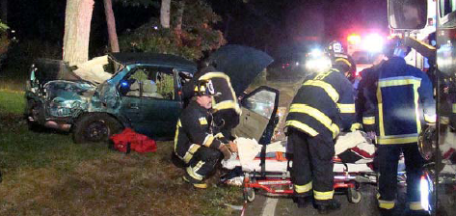
Vehicle Insurance Coverage
Uninsured/Underinsured Motorist
Covers you and occupants of your vehicle who are injured if the other driver caused the crash and does not have liability insurance or their insurance is insufficient to cover your loss.

Slide 8

Vehicle Insurance Cost
Premium
This is the amount paid for the
insurance policy.
A teen’s premium will be much
higher than a driver 35 years of age.
Keeping your premiums low
Good Student discounts can be as much as 20-30%.
  Usually requires a minimum 3.0 GPA.
Zero tickets or “at fault” collisions
Successfully complete state-approved Driver Education

Slide 9

High-Risk Drivers
Each insurance company
has its own rules, called
underwriting guidelines,
for deciding whether to
insure drivers.
The following factors may
cause an insurance company
to deny an application or raise your premium:
1. Tickets and crashes 3. Type of vehicle
2. Driving record 4. Credit rating
Insurance can be denied or revoked.
High-risk drivers pay the highest insurance premiums.
Notes:
If a driver is involved in an accident, his/her license and registration can be suspended if found liable for damages in a court of law and failed to pay the fine within 60 days of the judgment. The suspension is automatic and remains in force until the judgment is paid or for the next six years.

Slide 10
Insurance Cancellation
Failure to pay premium.
Filing a fraudulent claim.
Driver license is suspended or revoked.
(Poor driving choices may be the reason your family’s auto insurance could be cancelled.)
Insurance Cancelled
Notes:
What could cause your insurance to be cancelled?
If it’s cancelled, it is no longer in effect. If you were involved in a collision, you would be left without insurance coverage.

Slide 11
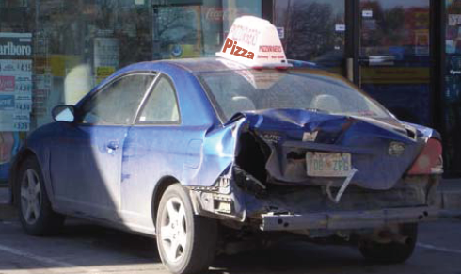
Reportable Crashes
Contact law enforcement and insurance agent/company
Before taking a job as a delivery driver – always check with your insurance company to be sure they will cover you.
Call your insurance company to report crash damage, take photos, and expect to complete an accident report form.
Your insurance company needs to agree to pay your car’s repair costs, and until then, any repair costs are your responsibility.
Don't take your car in for repairs and hope they'll be paid for.
Report crashes with $1,000 damage or more to law enforcement.
Notes:
61-7-108. Immediate notice of accidents. The driver of a vehicle who knows or reasonably should have known that the driver has been involved in an accident resulting in injury to or death of any person, striking the body of a deceased person, or property damage to an apparent extent of $1,000 or more shall immediately by the quickest means of communication give notice of the accident to the local police department if the accident occurs within a municipality, otherwise to the office of the county sheriff or the nearest office of the highway patrol.
History: En. Sec. 8, Ch. 210, L. 1939; amd. Sec. 4, Ch. 256, L. 1959; R.C.M. 1947, 32-1207; amd. Sec. 1, Ch. 59, L. 1987; amd. Sec. 1, Ch. 115, L. 1999; amd. Sec. 5, Ch. 235, L. 2011; amd. Sec. 1, Ch. 314, L. 2013.

Slide 12
Vehicle Types
Full Size Vans
Sport Utility Vehicles
Convertibles
Sport cars
Luxury
Hybrids
Pickups
4-Door Sedans
2-Door Coupes
Economy cars
Station Wagons
Four-wheel drive
Mini-Vans

Slide 13
Vehicle Specifications
Consider Safety Features and Load Capacity
Traction control
Skid control
Electronic stability control (ESC)
Anti-lock brakes (ABS)
Lane Departure Warning (LDW)
Forward Collision Warning (FCW)
Safety belts
Air bags, front and sides
Crumple zones
Head restraints
Safety glass
Back up sensors
Notes:
MORE FEATURES/SPECS:
Electric /hybrids
Ergonomics and Comfort
Daytime running lights
Interior trunk release
Retractable steering column
Sliding door auto stop
Night vision system
Navigation systems
Cargo net and hooks
Heated side mirrors/with turn signals
Audio controls in the steering wheel
Child safety seats
Window switches

Slide 14

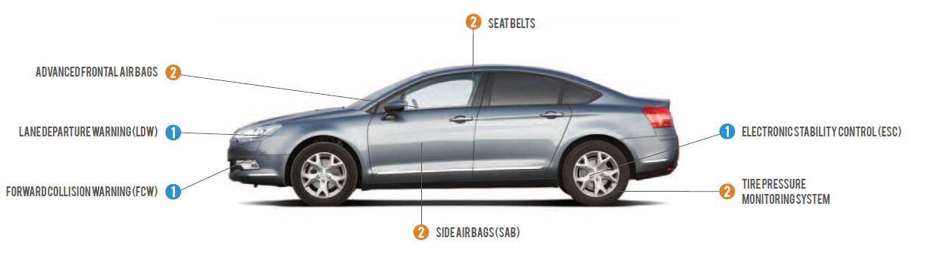
New Car Advantages
More safety features.
Warranty
Financed for up to seven years.
Lower maintenance costs.
Holds up better under heavy use.
Replacement parts are usually easier to find.
Notes:
Leasing may have lower monthly payments and can be more expensive than buying a vehicle
Security deposit required
After the lease is completed, you will not have ownership equity
A penalty may have to be paid for accumulating more miles than provided in the lease agreement
Terminating the lease early may incur penalties that can amount to thousands of dollars

Slide 15


Pros and Cons: Used Vehicles
Lower purchase price – Beware of scams.
Vehicles damaged in a flood can have
  hidden electrical and corrosion problems.
Repair costs and maintenance history
uncertain.
Have a certified mechanic perform a thorough inspection prior to purchase.
Cheaper to register and insure in general.
Notes:
Ask for the car’s maintenance record from the owner, dealer, or repair shop.
Test drive the car on hills, highways, and in stop-and-go traffic.
Have a mechanic inspect the vehicle.
Check out the dealer with local consumer protection officials.
If possible, talk to the previous owner.
If you buy a car "as is," you’ll have to pay for anything that goes wrong after the sale. Vehicles damaged in a flood can have electrical and corrosion problems hidden.
Understand the vehicle registration and titling process.

Slide 16
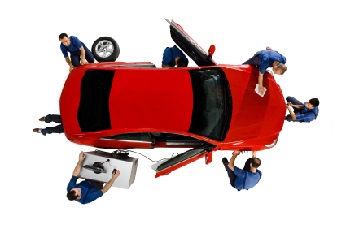
Vehicle Inspection
What should you check before purchasing a used vehicle?
As much as you possibly can …
Notes:
Check vehicle history online with your 17 digit Vehicle Identification Number (VIN)
https://www.nicb.org/how-we-help/vincheck , CarFax or other

Slide 17
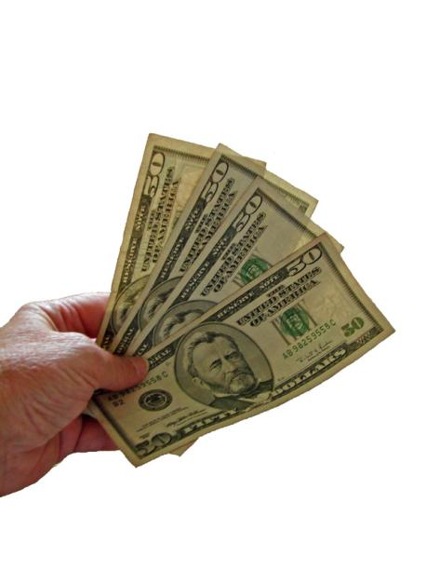
Calculate Cost to Own a Vehicle
Fixed Costs: loan payments, insurance, registration
Flexible Costs:
Gas
Oil
Tires
Preventive maintenance
Repairs
Parking fees
Now, how much can you afford?
Notes:
You’ll have fixed costs to acquire the vehicle and then flexible, but required, costs to run and maintain it.

Slide 18
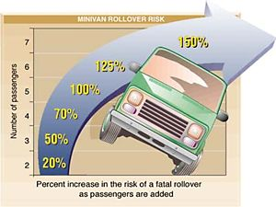
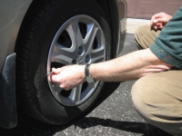

NHTSA Rollover Resistance Rating
You can reduce your chance of being killed in a rollover by about 75% just by wearing your seat belt.
Check tire pressure and tread on all four tires to maintain balance and control
Rollovers have a higher fatality rate than other kinds of crashes.
Notes:
NHTSA Rollover Resistance Ratings https://www.nhtsa.gov/ratings
The rollover resistance rating essentially measures vehicle characteristics of center of gravity and track width to determine how “top heavy” a vehicle is
Vehicles are rated on their risk of rolling over in a single vehicle crash. The more top-heavy the vehicle, the more likely it will roll over.
Vehicles are assigned stars that identify their rating. The low-rated vehicles (one star) are at least four times more likely to roll over than the highest rated vehicles (five stars). Even the highest rated vehicle can rollover, but you can reduce your chance of being killed in a rollover by about 75% just by wearing your seat belt.
https://www.safercar.gov/Vehicle-Shoppers/Rollover
NHTSA = National Highway Traffic Safety Administration

Slide 19
Around-the-Vehicle
Maintenance Checks
Check around the vehicle to:
Inspect windshield wiper blades.
Check lights are clean and working.
Keep tires inflated.
Look for signs of oil seepage.
Look underneath the vehicle for loose or broken exhaust clamps
and supports.
Notes:
It’s important to monitor your vehicle’s maintenance needs to make sure it always runs smoothly and safely, and is less likely to break down, pollute or create unsafe driving conditions.

Slide 20
Under-the-Hood Maintenance Checks
Check the antifreeze/coolant level weekly
Keep windshield washer fluid reservoir full
Check oil every other fill up
Check the air filter every other month
Check the battery with every oil change
Monthly:
Inspect belts and hoses
Check power steering fluid level
Check brake fluid
Check transmission fluid with engine warm and running, and parking brake on
Recycle old oil, fluids and tires
Notes:
In addition to checking around the outside of the vehicle, take a peek under the hood on a regular basis. The engine is the heart of your vehicle.

Slide 21
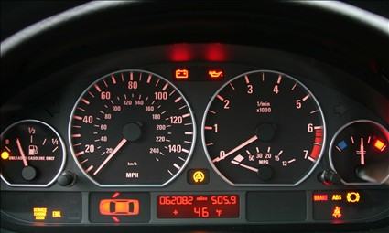
Dash Lights
The warning and alert symbols should be monitored and action taken when the dash lights come on and remain on.
STOP THE CAR if the red oil light stays on.
Notes:
Recognize dashboard warning symbols and respond to an activated warning symbol.
Review check engine light causes – often O2 sensor and emissions.

Slide 22
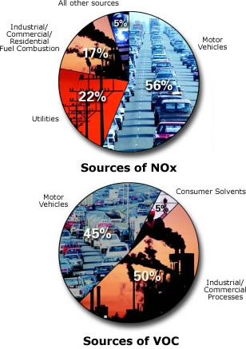
Air Quality and Fuel Combustion
For every 100 miles driven, here is what is expelled into the air:
5.5 pounds of carbon monoxide
80 pounds of carbon dioxide
67 pounds of hydrocarbons
4 pounds of nitrogen oxide
Older cars generally pollute our environment more than newer cars. Maintenance, not age, is the most important factor.
NOx – nitrogen oxide
VOC – volatile organic compounds
Notes:
Ozone acts as a protective layer high above the earth, but it can be harmful to breathe. What causes “bad" ozone?
Ground-level or "bad" ozone is not emitted directly into the air, but is created by chemical reactions between oxides of nitrogen (NOx) and volatile organic compounds (VOC) in the presence of sunlight.
Emissions from industrial facilities and electric utilities, motor vehicle exhaust, gasoline vapors, and chemical solvents are some of the major sources of NOx and VOC.
http://www.epa.gov/oar/oaqps/gooduphigh

Slide 23
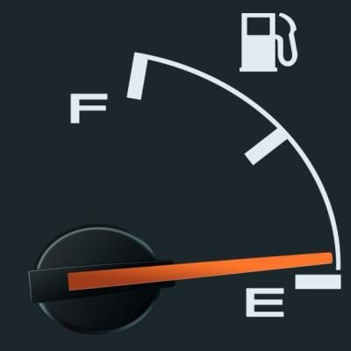

Conserve Fuel and Reduce Emissions
Three easy things you can do to help keep
emissions as low as possible and increase gas mileage:
Avoid unnecessary driving – Plan and combine trips.
Maintain your car properly - Recycle old oil, fluids and tires.
Accelerate gently, maintain a steady speed and avoid thrust acceleration.
Driving situations likely to increase air pollution and fuel consumption include:
  speeding
  Idling
  Stop-and-go driving
www.fueleconomy.gov
Notes:
Some fuels are inherently cleaner than gasoline; they emit less nitrogen oxides or hydrocarbons─the hydrocarbons they do emit are less likely to form ozone. Methanol (made from natural gas, coal, or biomass) and ethanol (made from grains or sugar) are high-octane liquid fuels
Cars designed to run on pure alcohol fuels have the potential to emit 80% to 90% less reactive hydrocarbons. Battery-powered cars have the potential for zero tailpipe and evaporative hydrocarbon and nitrogen oxide emissions.

Slide 24

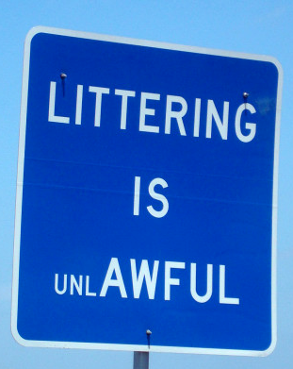
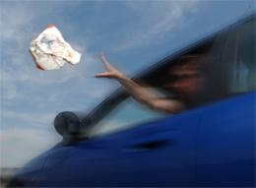

Littering and Illegal Dumping
What is the problem with littering?
Every little piece of litter damages our environment.
What have you found along the road?
MCA 61-8-372: fines up to $250, but other littering offenses command fines as high as $1,000.
PUT LITTER IN ITS PLACE
Illegal dumping of radioactive oil filter socks from drilling is a toxic waste problem in the Bakken Oilfield. Who pays?
Notes:
Littering occurs when individuals dispose of waste products improperly in an inappropriate location.
There are costs involved in littering: street sweeping, emptying trash containers, cleaning up litter and dumped rubbish.
What are some ways to reduce litter on Montana roadways? Why does reducing littering matter? Consider MCA 61-8-372. Littering with lighted matches, cigarettes, and other burning material and dumping ashtray prohibited
Oil filter socks concentrate naturally-occurring radiation when they filter wastewater and silica dust at drilling sites. In 2014 North Dakota found illegal dumping of oil filter socks with radiation two to five times more concentrated than background levels. http://bismarcktribune.com/bakken/state-gets-tough-on-filter-socks/article_373b07dc-c031-11e3-b3a8-001a4bcf887a.html
MCA 61-8-365. Putting refuse on highway prohibited. (1) A person may not throw or deposit upon a highway glass bottles, glass, nails, tacks, wire, cans, plastic bottles, plastic, paper, or any other debris. A person may not throw or deposit upon a highway any substance likely to injure a person or animal or damage a vehicle upon the highway.
(2) A person who drops or permits to be dropped or thrown upon a highway destructive or injurious material shall immediately remove the material or cause it to be removed.
(3) A person who removes a wrecked or damaged vehicle from a highway shall remove glass or any other injurious substance dropped upon the highway from the vehicle.
(4) Except as provided in 61-8-372 and subsection (5) of this section, a person convicted of violating this section shall be fined not more than $250. Except for the maximum fine of $250 as provided in this subsection and except for the maximum fine of $500 as provided in 61-8-372, the penalty provisions of 61-8-711 apply to this section.
(5) A person may not throw or deposit upon a highway plastic bottles or any other containers in which urine or feces have been deposited. A person convicted of violating this subsection shall be fined not more than $1,000. The department shall make information about this subsection available at all weigh stations.
History: En. Sec. 108, Ch. 263, L. 1955; R.C.M. 1947, 32-21-111; amd. Sec. 1, Ch. 510, L. 1979; amd. Sec. 4, Ch. 67, L. 1997; amd. Sec. 1, Ch. 513, L. 2001; amd. Sec. 42, Ch. 352, L. 2003.
61-8-372. Littering with lighted matches, cigarettes, and other burning material and dumping ashtray prohibited -- penalty -- posting. (1) A person may not throw away lighted matches, tobacco, cigarettes, cigars, or other lighted material on a forest road, private road, city street, county road, public highway, or railroad right-of-way, except lighted materials used as safety signaling devices, in this state.
(2) A person may not empty an ashtray containing matches, ashes, cigarette or cigar refuse, or other related material on a forest road, private road, city street, county road, public highway, or railroad right-of-way in this state.
(3) A person convicted of violating subsection (1) or (2) shall be fined a maximum of $500.
(4) Municipalities, the forest service, county governments, property owners, public transit operators, federal highway administrators, and any other appropriate entity may, at their discretion, post copies of this section in conspicuous locations.
History: En. Sec. 1, Ch. 67, L. 1997; amd. Sec. 2, Ch. 513, L. 2001.
7-5-2109. County control of litter. (1) (a) Except as provided in 7-5-2112, a governing body of a county may regulate, control, and prohibit littering on any county road and on land within the county by the adoption of an ordinance that substantially complies with the provisions of 7-5-103 through 7-5-107. The ordinance may apply to portions of the county and may apply to persons other than the owners of the property on which littering occurs.
(b) The ordinance does not apply to lead, copper, or brass deposits directly resulting from shooting activities at a shooting range.
(c) The ordinance does not apply to a "notice of violation" card placed on a motor vehicle illegally parked in a disability parking space.
(2) Except as provided in 7-5-2112, the governing body of a county may establish a fine not to exceed $200 as a penalty for violation of the ordinance referred to in subsection (1). A violation of the ordinance may not be punishable by imprisonment.
History: En. Sec. 1, Ch. 508, L. 1983; amd. Sec. 6, Ch. 415, L. 1991; amd. Sec. 1, Ch. 406, L. 1993; amd. Sec. 2, Ch. 67, L. 1997.

Slide 25
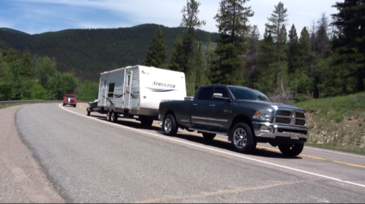

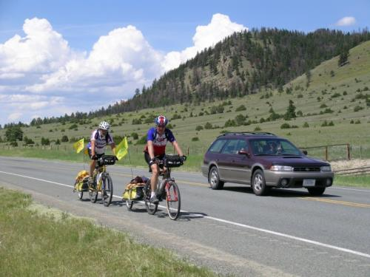
Trip Planning
Select routes using maps and technology resources.
When and how should you plan alternative routes?
What are the personal and vehicle needs for an extended trip?
Calculate the cost of an extended trip before you embark.
Know how to prepare and load a vehicle for a long road trip.
Notes:
Select routes for local trips and extended trips using local and state maps.
Planning alternate routes is important during times of highway construction and in winter months when roads might be closed. Possible landslides, floods, avalanches, road and bridge construction could be factors.
Identify different technology resources that can help the trip planning process.
How do you determine what the trip will cost? What costs are involved?

Slide 26

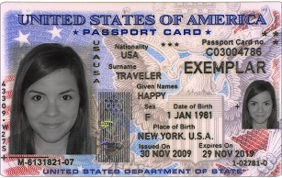
Plan an Extended Trip
Notes:
Consider driving laws in other states and countries – a Passport or a U.S. Passport Card is required to travel to Canada or Mexico.
Predict personal and vehicle needs for an extended trip.
Calculate the cost of an extended trip.
Describe how to prepare and load a vehicle for an extended trip.

Slide 27



Conserve Resources
Things you can do:
Drive less – walk , bike, and--if you have one--ride a horse.
Reduce, reuse and recycle more.
Check your tires.
Use less hot water.
Avoid products with a lot of
packaging.
Adjust your thermostats.
Plant a tree.
Turn off electronic devices.
Encourage your friends to make small changes that add up to big differences.
Consider the personal and global benefits of conserving energy, reducing pollution, and recycling.
Notes:
Reduce the number of miles you drive by walking, biking, carpooling and taking mass transit wherever possible.
You can improve your gas mileage about 15% by driving at 55 mph rather than 65 mph.
Check your tires weekly to make sure they’re properly inflated. Proper tire inflation can improve gas mileage by more than 3%.
Your car burns more gas and emits more pollution when the engine is operating under high load. Avoid carrying unneeded items in the trunk.
Park in the shade - Air conditioners increase load on the engine and can increase emissions.
If you're in bumper-to-bumper traffic or in line at a check-out window, improve your fuel economy by slipping the car into neutral instead of constantly riding the brake.
Emission test the vehicle.
http://www.fueleconomy.gov/

Slide 28
Montana Driver Education and Training
Standards and Benchmarks
1. Laws and Highway System
  1.1. know the laws outlined in the Montana Driver's manual;
  1.2. understand the laws outlined in the Montana Driver's Manual; and
  1.3. consistently demonstrate knowledge and understanding by responsible adherence to highway transportation system traffic laws and control devices.
2. Responsibility
  2.1. recognize the importance of making safe and responsible decisions for owning and operating a motor vehicle;
  2.2 demonstrate the ability to make appropriate decisions while operating a motor vehicle;
  2.3. consistently display respect for other users of the highway transportation system; and
  2.4. develop positive habits and attitudes for responsible driving.
3. Visual Skills
  3.1. know proper visual skills for operating a motor vehicle;
  3.2. communicate and explain proper visual skills for operating a motor vehicle;
  3.3. demonstrate the use of proper visual skills for operating a motor vehicle; and
  3.4. develop habits and attitudes with regard to proper visual skills.
4. Vehicle Control
  4.1. demonstrate smooth, safe and efficient operation of a motor vehicle; and
  4.2. develop positive habits and attitudes relative to safe, efficient and smooth vehicle operation.
5. Communication
  5.1. consistently communicate driving intentions (i.e., use of lights, vehicle position, and personal signals);
  5.2. adjust driver behavior based on observation of the highway transportation system and other roadway users;
  5.3. adjust communication (i.e., use of lights, vehicle position, and personal signals) based on observation of the highway transportation system and other users; and
  5.4. develop positive habits and attitudes for effective communication.
6. Risk Management
  6.1. understand driver risk-management principles;
  6.2. demonstrate driver risk-management strategies; and
  6.3. develop positive habits and attitudes for effective driver risk-management.
7. Lifelong Learning
  7.1. identify and use a range of learning strategies required to acquire or retain knowledge, positive driving habits, and driving skills for lifelong learning;
  7.2. establish learning goals that are based on an understanding of one’s own current and future learning needs; and
  7.3. demonstrate knowledge and ability to make informed decisions required for positive driving habits, effective performance, and adaptation to change.
8. Driving Experience
  8.1. acquire at least the minimum number of BTW hours over at least the minimum number of days, as required by law, with a Montana-approved driver education teacher; and
  8.2. acquire additional behind-the-wheel driving experience with a parent or guardian’s assistance in a variety of driving situations (i.e., night, adverse weather, gravel road, etc.).
Notes:
Standards and Benchmarks: This is for your reference and not to be read to the class verbatim. Please review prior to the lesson so you are aware of what the student will be required to know at the end of the module.

