Slide 1
Module 3.4
Bicycle Awareness
Montana Driver Education and Training

Slide 2
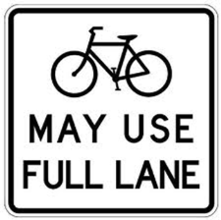
Share the road. Drive with courtesy

Slide 3
Montana law requires motorists to operate their vehicles in a
careful and prudent manner
without endangering the
life, limb, property or other rights of people entitled to use the highways. MCA 61-8-302

Slide 4
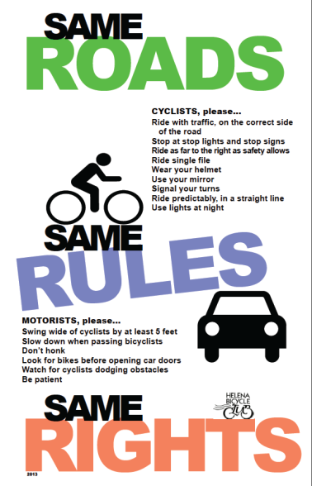

Slide 5
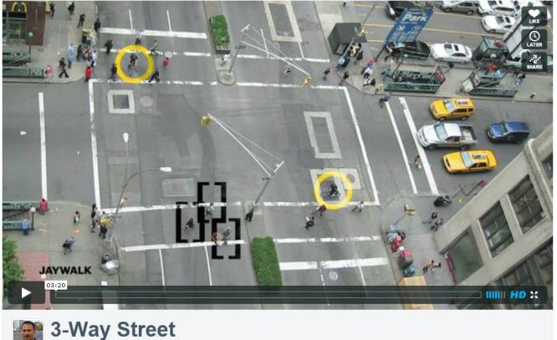
Three Way Street video
https://vimeo.com/24572222
Notes:
3-Way Street by Ron Gabriel
Music: Peter Gunn Theme by Art of Noise featuring Duane Eddy
http://www.youtube.com/watch?v=RjrEQaG5jPM - India Traffic Chaos

Slide 6
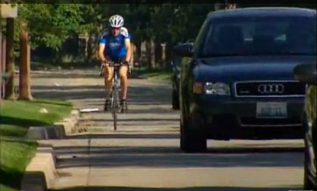
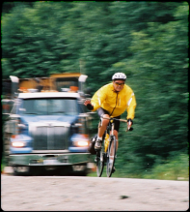
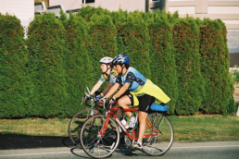
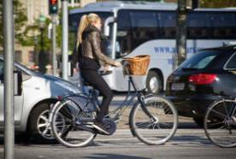
Driver-Bicyclist Safety Quiz

Slide 7
1. In what direction should a bicyclist ride?
Ride against the traffic.
Ride with the traffic.
Depends on whether it’s a one-way or two-way street.
It doesn’t matter which direction a bicyclist rides.

Slide 8
B. Ride with the traffic.
The bicyclist will:
  be more visible
  be more predictable
  sometimes move at similar speed as vehicles.
And it’s the law.

Slide 9
2. What is a safe distance for drivers to pass a bicyclist going in the same direction?
One or two feet.
More than five feet.
At least 10 feet.
15 feet or more.

Slide 10
B. More than five feet.
The bicyclist needs space for possible road obstructions.
Children may be unpredictable and need even more than five feet.

Slide 11
3. When a driver approaches a bicyclist from the rear, what should he do?
Blast the horn.
Race the engine.
Shout at the bicyclist.
None of the above.

Slide 12
D. None of the above.
Any of these can distract a cyclist and may cause a crash.
These options are neither courteous or considerate.

Slide 13
4. Where should bicyclists always ride?
On a sidewalk.
Hugging the side of the road no matter what.
As close to the side of the road as practical.
In the same lane as traffic.

Slide 14
C. Ride as close to the side of the road as practical.
However, there may be good reasons for a bike to “take the lane”: making a left turn, dodging road debris, or needing extra space.
Be prepared to share the entire road with bicyclists, if needed.

Slide 15
5. True or False:
Bicyclists have the legal right to ride on the road.
6. True or False:
Bicyclists should use only designated bike lanes and bike paths.

Slide 16
5. True
State law permits bicyclists to ride on roads and streets as long as they follow all the rules.
6. False
Because of limited designated bike paths, bicyclists must ride alongside vehicles on roads and streets.

Slide 17
7. At a stop sign or traffic light before proceeding, a driver should:
Look for cars approaching from the left, right and straight ahead.
Look for pedestrians on sidewalks and about to cross the street.
Look for bicyclists approaching on the road and the sidewalk.
All of the above.

Slide 18
D. All of the above.
Bicyclists, pedestrians and other road users are often not seen by drivers, so extra caution must be given.
Be aware of the unique position and behavior of bicyclists to minimize the risk of a car-bike crash.

Slide 19
8. A driver should always be alert to the possibility of a bicyclist:
Riding into the street from a driveway or side street.
Riding alongside parked cars.
Riding against the traffic flow.
All of the above.

Slide 20
D. All of the above.
Bicyclists can be unpredictable.
They may swerve to avoid a hazard you cannot see.
Be aware and alert in all situations.

Slide 21
9. True or False:
Drivers and bicyclists follow different traffic rules.
10. True or False:
Drivers always have the right of way when bicyclists are on the road.

Slide 22
9. False
Sharing the road means sharing all the rules.
10. False
See above. Standard right-of-way rules apply.

Slide 23
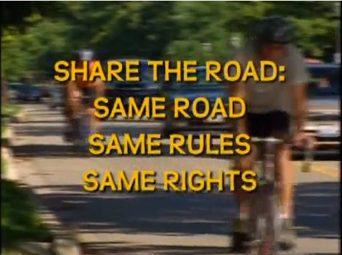
Bicycle Safety Video
Drivers’ Perspective
http://www.youtube.com/watch?feature=player_detailpage&v=S1PXvxh_6MI (Length: 6:51)
Notes:
Refer to the Teacher’s Video Guide in the Lesson Plans folder to get the most out of this video in the classroom.

Slide 24
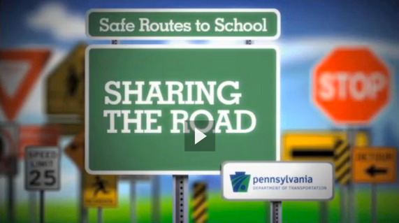
Sharing the Road Video
Bicyclists’ Perspective
To play this 6:21 minute video, access video in file or play from PennDot website.

Slide 25
Montana Driver Education and Training
Standards and Benchmarks
1. Laws and Highway System
  1.1. know the laws outlined in the Montana Driver's manual;
  1.2. understand the laws outlined in the Montana Driver's Manual; and
  1.3. consistently demonstrate knowledge and understanding by responsible adherence to highway transportation system traffic laws and control devices.
2. Responsibility
  2.1. recognize the importance of making safe and responsible decisions for owning and operating a motor vehicle;
  2.2 demonstrate the ability to make appropriate decisions while operating a motor vehicle;
  2.3. consistently display respect for other users of the highway transportation system; and
  2.4. develop positive habits and attitudes for responsible driving.
3. Visual Skills
  3.1. know proper visual skills for operating a motor vehicle;
  3.2. communicate and explain proper visual skills for operating a motor vehicle;
  3.3. demonstrate the use of proper visual skills for operating a motor vehicle; and
  3.4. develop habits and attitudes with regard to proper visual skills.
4. Vehicle Control
  4.1. demonstrate smooth, safe and efficient operation of a motor vehicle; and
  4.2. develop positive habits and attitudes relative to safe, efficient and smooth vehicle operation.
  (continued on next slide)
Notes:
Standards and Benchmarks 1-4: This is for your reference and not to be read to the class verbatim. Please review prior to the lesson so you are aware of what the student will be required to know at the end of the module.

Slide 26
Montana Driver Education and Training
Standards and Benchmarks
5. Communication
  5.1. consistently communicate driving intentions (i.e., use of lights, vehicle position, and personal signals);
  5.2. adjust driver behavior based on observation of the highway transportation system and other roadway users;
  5.3. adjust communication (i.e., use of lights, vehicle position, and personal signals) based on observation of the highway transportation system and other users; and
  5.4. develop positive habits and attitudes for effective communication.
6. Risk Management
  6.1. understand driver risk-management principles;
  6.2. demonstrate driver risk-management strategies; and
  6.3. develop positive habits and attitudes for effective driver risk-management.
7. Lifelong Learning
  7.1. identify and use a range of learning strategies required to acquire or retain knowledge, positive driving habits, and driving skills for lifelong learning;
  7.2. establish learning goals that are based on an understanding of one’s own current and future learning needs; and
  7.3. demonstrate knowledge and ability to make informed decisions required for positive driving habits, effective performance, and adaptation to change.
8. Driving Experience
  8.1. acquire at least the minimum number of BTW hours over at least the minimum number of days, as required by law, with a Montana-approved driver education teacher; and
  8.2. acquire additional behind-the-wheel driving experience with a parent or guardian’s assistance in a variety of driving situations (i.e., night, adverse weather, gravel road, etc.).
Notes:
Standards and Benchmarks 5-8: This is for your reference and not to be read to the class verbatim. Please review prior to the lesson so you are aware of what the student will be required to know at the end of the module.

